Slide 1
Russia
Germany
Germany had the largest number of soldiers and great wealth and so was likely to be a strong opponent in a war.
Click the mouse button or press the Space Bar to display the answers.

Slide 2
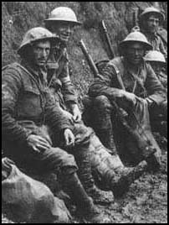
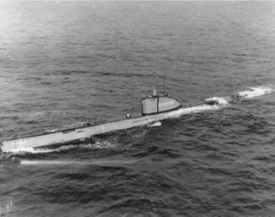
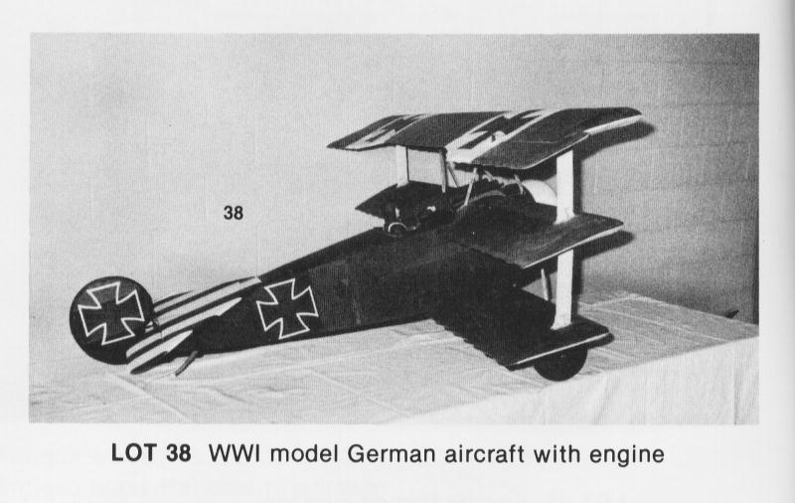
World War I
The Beginning

Slide 3
Big Ideas
What are the main causes of WWI?
What was the immediate cause of WWI?
What new technologies were introduced in WWI?
Which countries fought for the Allies/Central powers?

Slide 4
The Road to War
The four MAIN causes of WWI are Militarism, Alliances, Imperialism, and Nationalism
Militarism- Glorification of the military (everyone wanted the biggest and strongest)
Alliances- Triple Entente (Great Britain, France, Russia) and Triple Alliance (Germany, Austria-Hungary, Italy)
Imperialism- Strong nation taking over weak nations.
Nationalism- Extreme pride in one’s country
The immediate cause of the war was the assassination of Archduke Franz Ferdinand and his wife, Sophia, in Sarajevo, Serbia.
Serbia wanted independence from the Austro-Hungarian rule
1st attempt w/ a car bomb failed (got the car behind them)
Gavrilo Princip shot him later in the day.

Slide 5
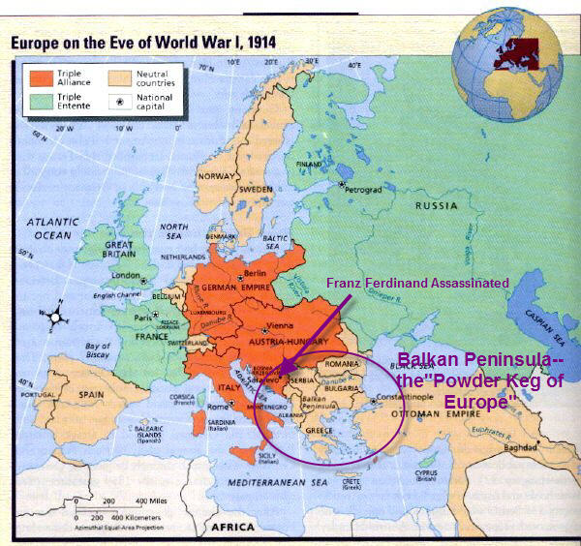

Slide 6
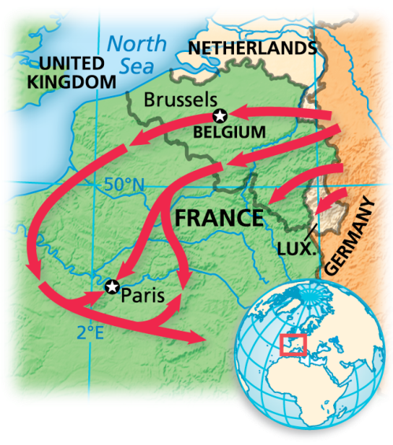
The Road to War (ctd.)
Austria wanted to attack Serbia right away, but feared Russia
Got German support
Declared war on Serbia on July 28, 1914
Russia mobilized their army (against Austria-Hungary only)
Germany and Austria declared war on Russia in response
Then, Russia declared war on Germany and Austria.
Germany’s plan was to invade France, while holding Russia (Schlieffen Plan)
Once they entered Belgium (neutral),
Great Britain declared war on Germany

Slide 7
Who’s in so far?
Allies (Triple Entente) | Central Powers (Triple Alliance)
Serbia | Austria-Hungary
Russia | Germany
France | Italy
Great Britain
Belgium

Slide 8
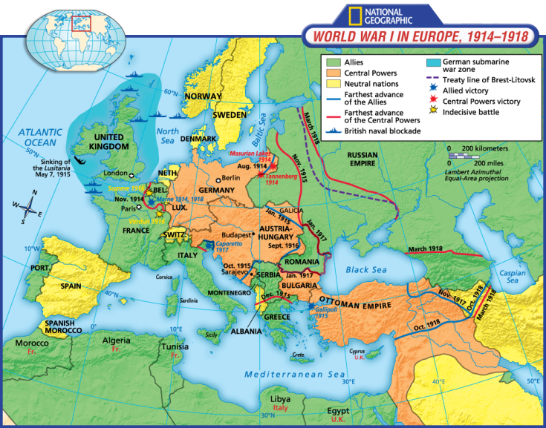
The War
The Western Front
The German plan was to encircle Paris and the French army, making it a quick victory
They were halted at the 1st Battle of the Marne
French military leaders loaded troops
in 2,000 taxicabs and got them
to the front lines to stop the
Germans
The war became a stalemate,
when neither could dislodge
their enemies from the trenches
Trenches were necessary to protect from machine guns (new technology)

Slide 9
The War (ctd.)
The Eastern Front
Russia tried to move into Germany, but was stopped at Tannenberg and Masurian Lakes (eastern Germany)
No longer a threat to German territory
Austria had been defeated by the Russians and thrown out of Serbia
In addition, the Italians betrayed them by attacking them in May 1915, joining the Allies.
The Germans had come to their aid and pushed Russia back, killing 2.5 m Russians.
Germany, Austria-Hungary, and Bulgaria (just joined the fun) attacked and eliminated Serbia from the war.
Germany was able to concentrate on the Western Front

Slide 10
The War (ctd.)
By the end of 1915, airplanes were being used
Originally for espionage
Began to attack ground targets
Pilots fought each other with pistols, at first
Later mounted machine guns on planes
Germans also used zeppelins (blimps) to bomb London and E. England
Often caught on fire if they were hit
Due to the stalemate on the Western Front, each side wanted more allies to help
Ottoman Empire joined in for the Central Powers
The Allies tried to open up the Balkans, but the Bulgarians entered the war, so they were forced to withdraw

Slide 11
The War (ctd.)
By 1917, the war had become a world war
A British officer, Lawrence of Arabia, urged Arab princes to revolt against the Ottomans
For the Mid East campaign, Britain mobilized forces from India, Australia, and New Zealand
The Allies, also, took control some German colonies in the rest of the world.
Japan seized some Pacific Islands
Australia seized German New Guinea

Slide 12
The War (ctd.)
The US joins in
At first, the US wanted to stay neutral, but was sending supplies to the British
Britain and Germany had blockaded each other (Germany with u-boats)
May 7, 1915- Germany sunk the Lusitania (128 Americans on board)
Germans suspended unrestricted
submarine warfare to keep the US
out
Germans believed that if they used
unrestricted sub warfare, they could
starve Britain into surrendering.
The British were not forced to surrender and the US joined the war.

Slide 13
Who do we have now?
Allies (Triple Entente) | Central Powers (Triple Alliance)
Serbia | Austria-Hungary
Russia | Germany
France | Italy
Great Britain | Ottoman Empire
Belgium | Bulgaria
Italy
Australia
Japan
United States

