Slide 1
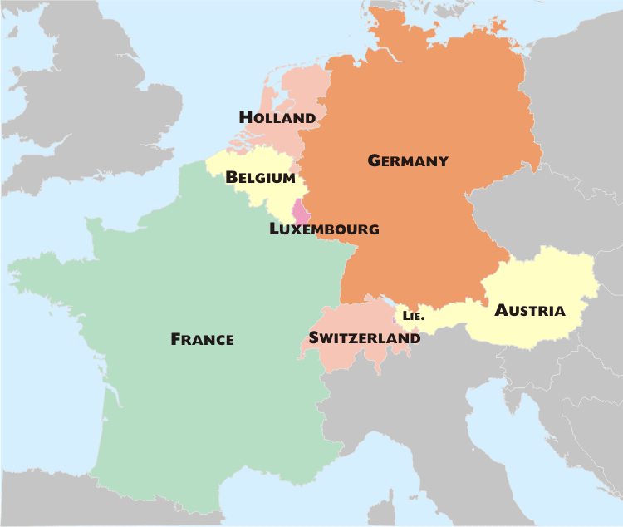
Western European Culture

Slide 2
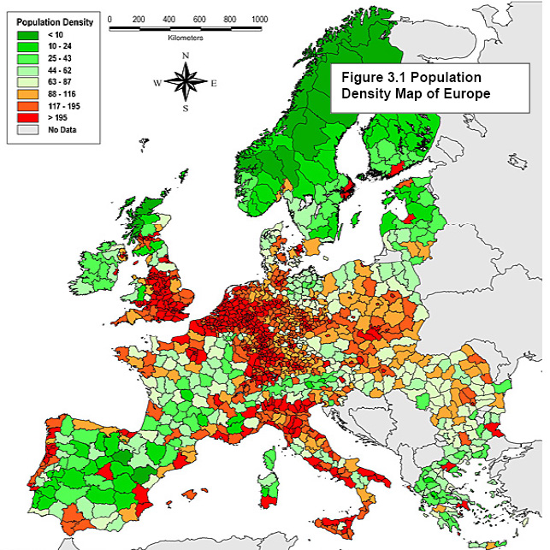
Population Patterns
The People
The people of France, Netherlands, Belgium, and Switzerland are made up of two or more ethnicities that have blended together
Germany and Austria are nearly ethnically homogenous
Density and Distribution
W. Europe is densely populated
Most live in urban areas
Paris, Brussels, Frankfurt, Berlin and Hamburg most populated
Immigration has led to increasing urban growth since WWII

Slide 3
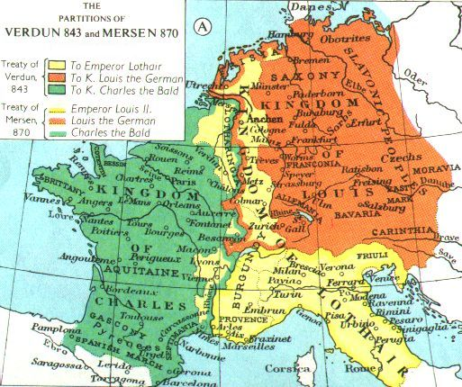
History and Government
Rise of Western Europe
W. Europe began to change after the fall of the Roman Empire
Franks (Germanic tribe) established an empire that spread across the region
Accepted Roman Catholicism
Charlemagne expanded his kingdom and Christianity
His kingdom broke apart after his death
Holy Roman Empire (Germany) lasted until 1806
Crusades- Holy wars w/Muslims over Holy Land
Failed to win permanent control
Did extend trade routes to eastern Mediterranean
Renaissance ideas spread to W. Europe by merchants going to Italy
Protestant Reformation began in Germany
By 1500s, Protestant churches were dominant in many parts of W. Europe.

Slide 4
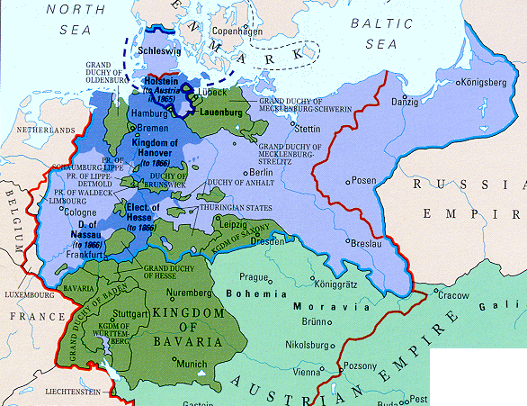
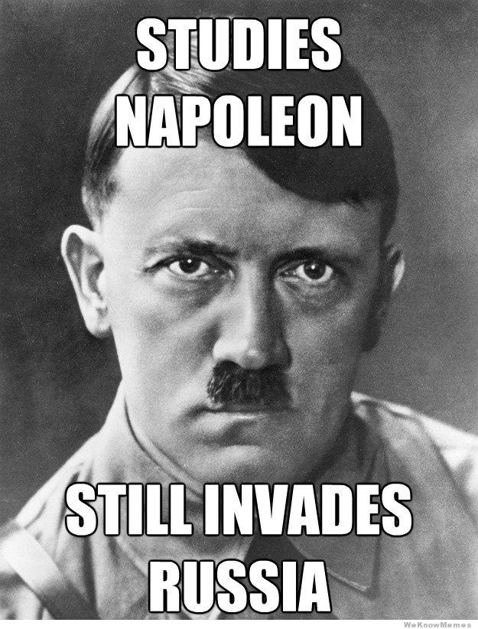
History and Government
Winds of Change
French Rev. overthrew the monarchy
Encouraged by Enlightenment ideas
Caused these ideas to spread to other nations
weakened monarchies across Europe
Prussia rose to power and unified Germany
Upset the balance of power in Europe
Germany’s industries and military strength increased
This led to WWI- Germany lost
Forced to pay reparations (payment for damages)
This led to the Depression, then WWII
Adolf Hitler wanted to create a great empire (Third Reich)
Holocaust- mass killing of more than 6 million European Jews

Slide 5
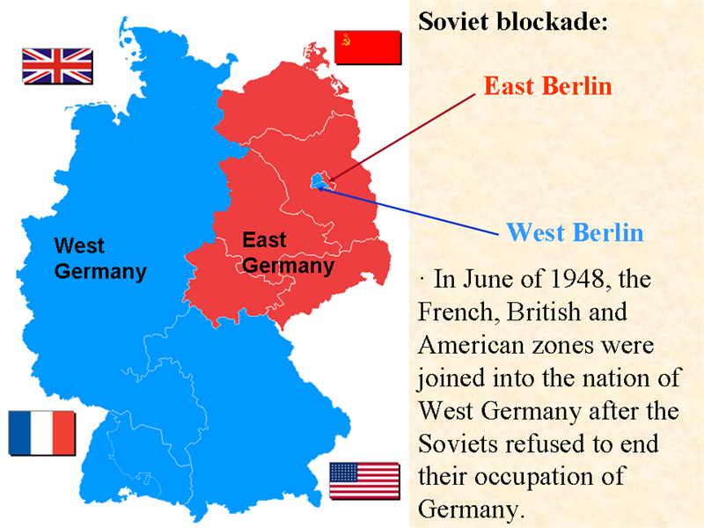
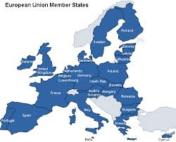
History and Government
The Cold War
Germany was divided into Communist East Germany and democratic West Germany
Remained this way until 1991 (USSR fell)
During this time, W. Europe grew closer economically
Except E. Germany (of course)
This led to the formation of the European Union
EU today→

Slide 6
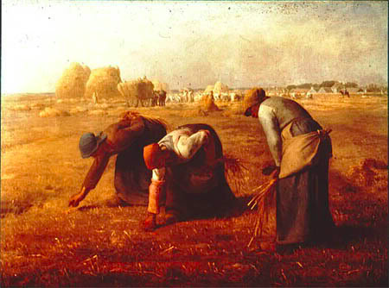
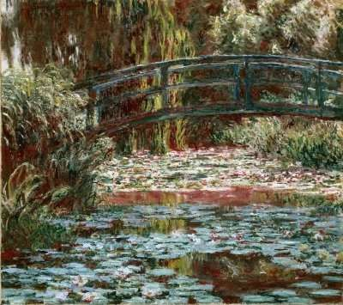
Culture
The Arts
W. Europe has long been the leaders in literature, architecture, music, and visual arts
Two influential movements:
Realism-focused on accurately depicting the details of everyday life
Impressionism-capture immediate experiences or “impressions” of the natural world

Slide 7
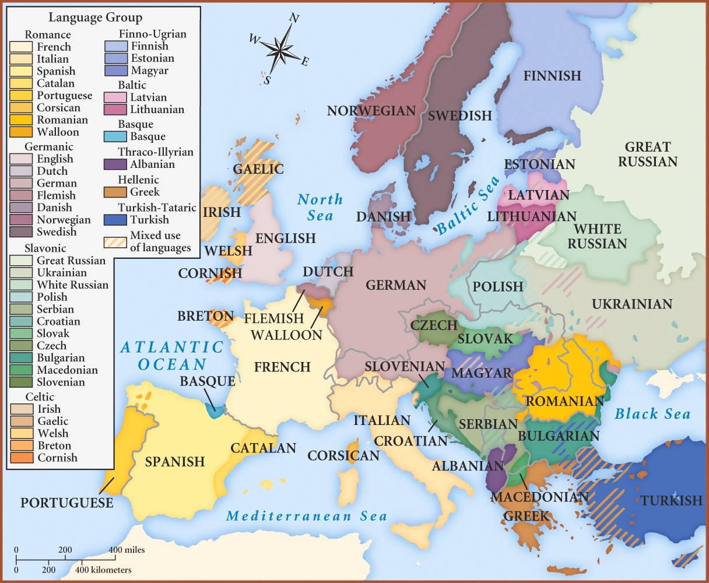
Culture
Language and Religion
Most people speak Indo-European languages
French or German
Primarily Christian, majority is Catholic
Many, especially in France and Belgium, are nominal members
Maintain a connection to their faith through traditions, like religious holidays

Slide 8
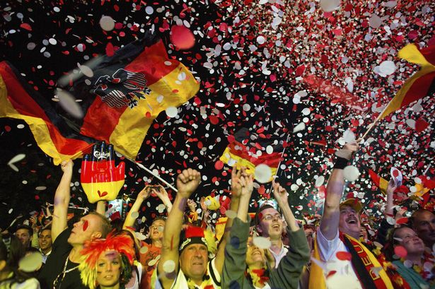
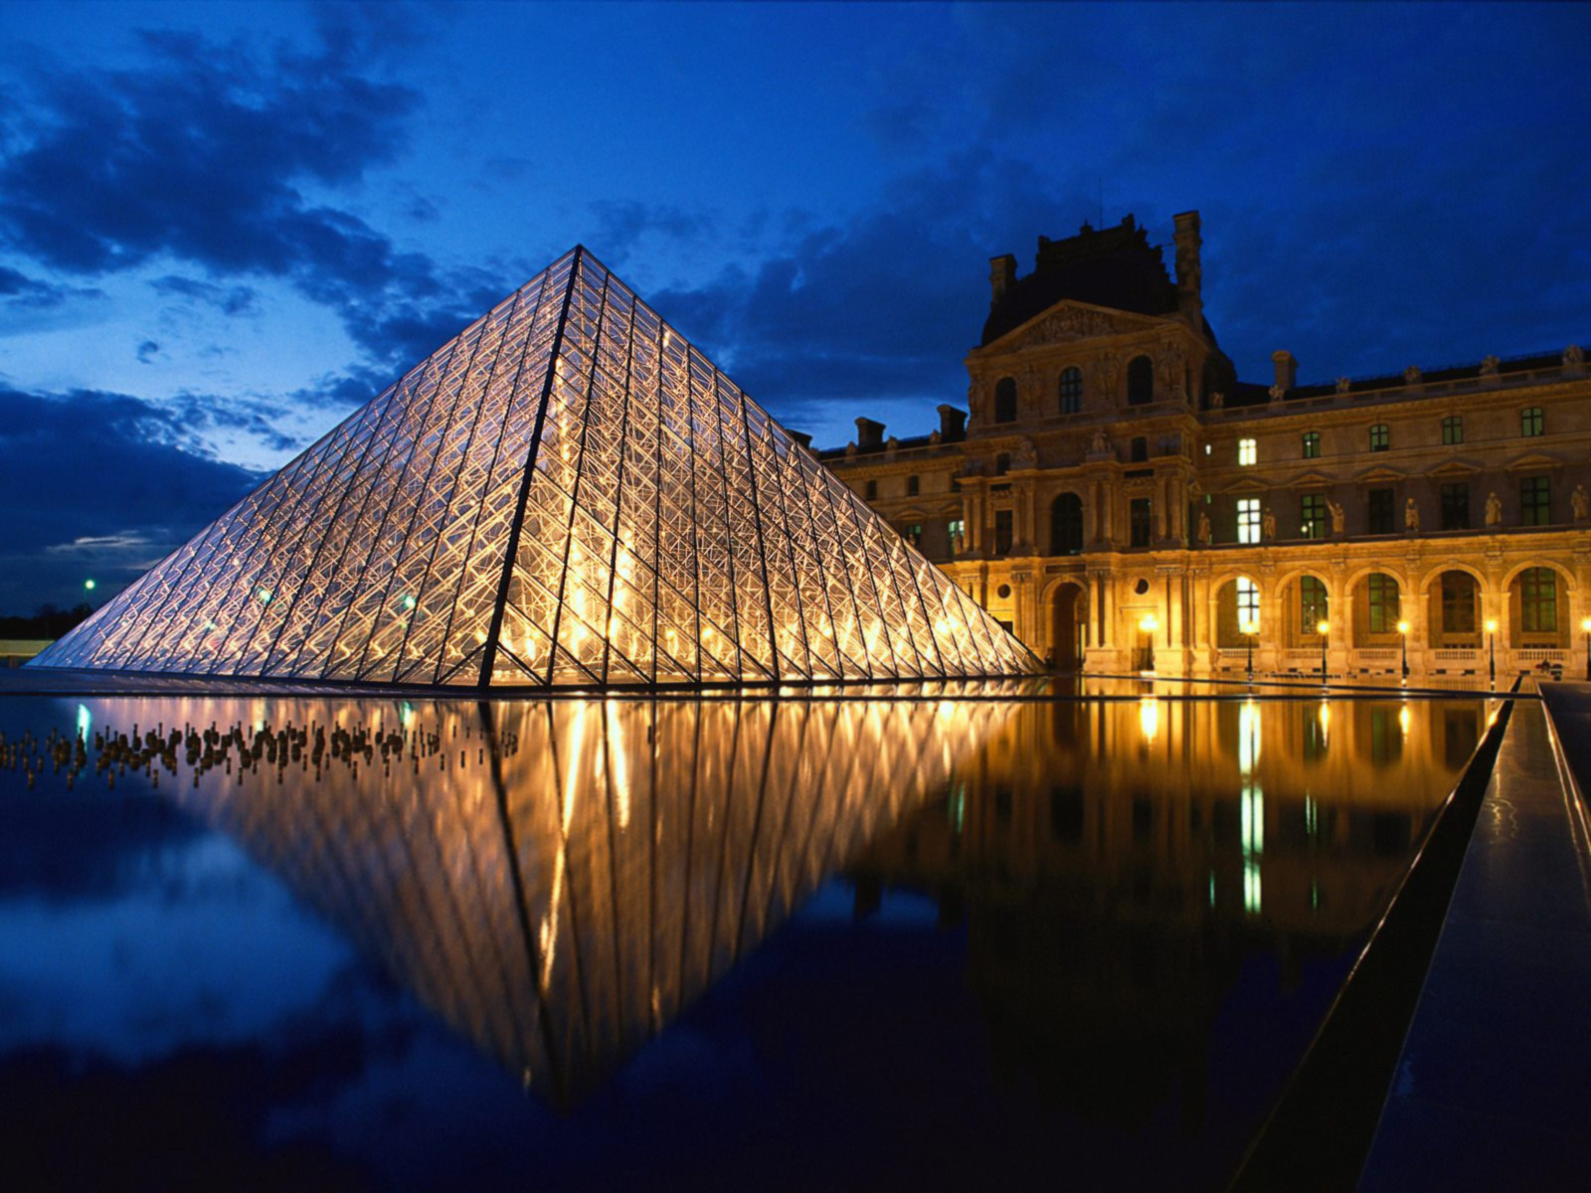
Culture
Education
Compulsory for children (98-100% literacy rate)
Healthcare
Gov’t provides comprehensive health care and social services
Provides unemployment and many other services
Family Life and Leisure
High standard of living
Gov’t provides retirement benefits
They have an aging population, with low birth and death rates
Soccer most popular sport in W. Europe
Also love to visit museums, travel, walk, or hike

