Slide 1
Daily Focus Skills Transparency 1
Pepin the Short
Charles Martel
Many rulers had the same name, so an adjective such as “bald,” or “short” could help people identify them; sometimes numbers were used.
Click the mouse button or press the Space Bar to display the answers.

Slide 2
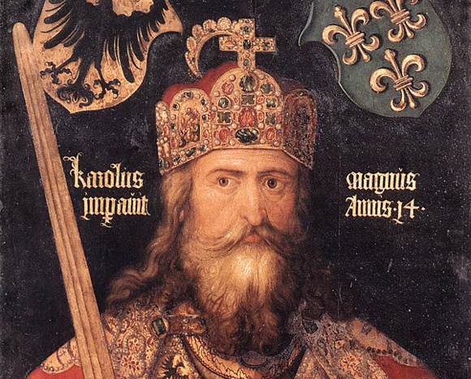
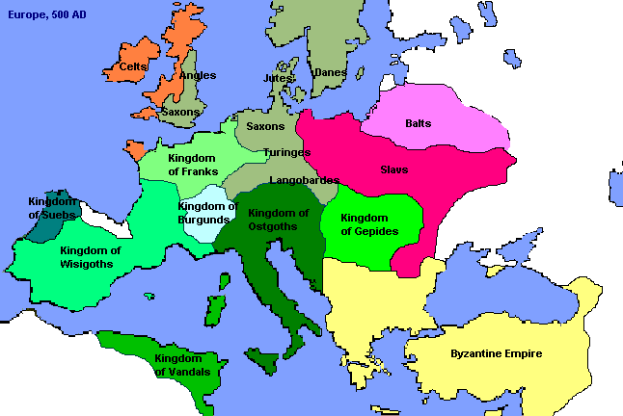
Transforming the Roman World
Charlemagne
Germanic Kingdoms
500 AD

Slide 3
New Germanic Kingdoms
Germanic peoples began moving into the lands of the Roman Empire around the 3rd Century
Visigoths occupied Spain and Italy(Ostrogoths later took control)
Angles and Saxons- Britain
Saxons- Northern Germany
Franks- France
Longest lasting was the K. of the Franks
Clovis established it around 500
Strong military leader
First Germanic ruler to convert to Christianity- won support of Roman Catholic Church

Slide 4
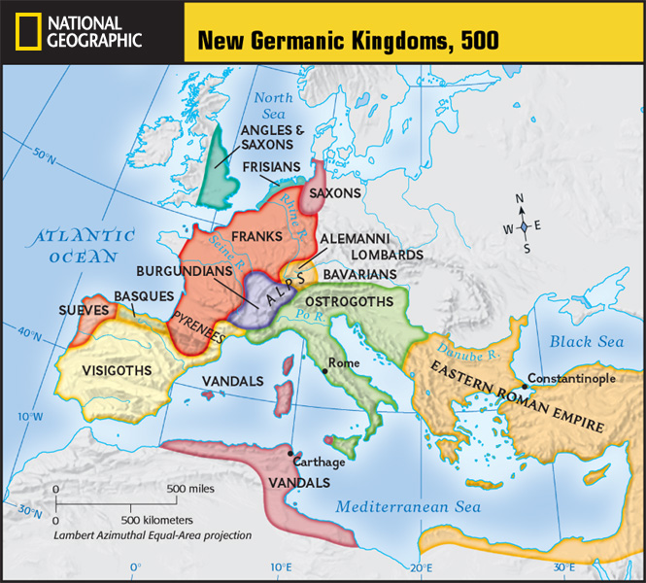
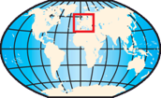

Slide 5
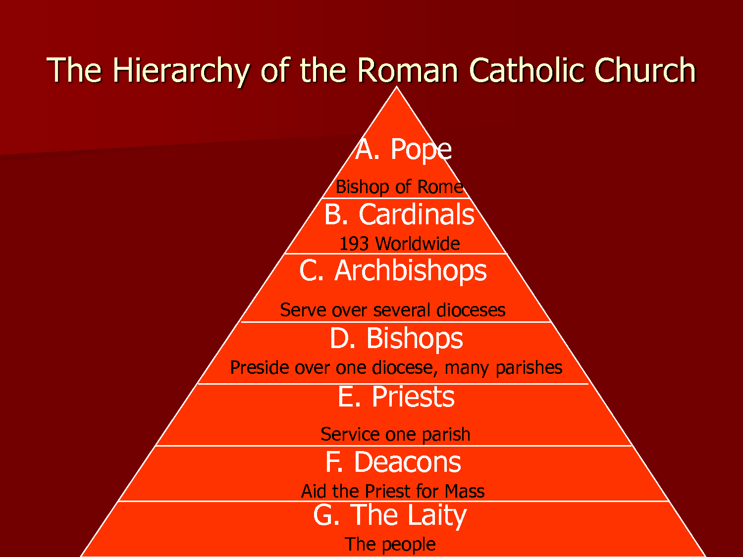
The Role of the Church
By the 4th C, Christianity had become the supreme religion of the Roman Empire
Developed a system of organization
Priests head local parishes
A group of parishes=bishopric
Headed by a bishop
A group of bishoprics=archbishopric
Headed by an archbishop
The Bishop of Rome came to claim he was the leader of the Roman Catholic Church (the Pope)
Based on the belief that Jesus gave Peter the keys to Heaven
Peter=1st Bishop of Rome (1st Pope)

Slide 6
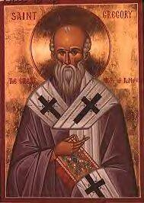
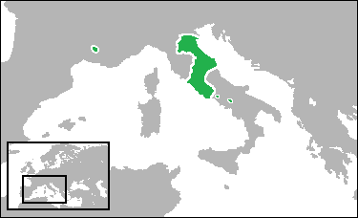
The Role of the Church
Most Western Europeans accepted the pope as leader, but his role was undecided
Pope Gregory I (590-604) extended the power of the papacy
Took political control over Rome and surrounding areas (Papal States)
Used Church revenues to raise armies
Fought off the Byzantines and the Lombards
Extended his power within the Church
Converted non-Christians through the monastic movement

Slide 7
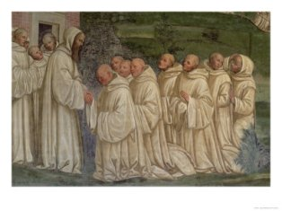
The Role of the Church
Monks separate themselves from worldly, everyday life to dedicate themselves to God
Monasticism=living the life of a monk
6th C- St. Benedict founded an order
Divided the day into activities
Emphasize prayer and physical labor
All aspects of Benedictine life were communal
An abbot (“father”) ruled each Benedictine monastery
Took a vow of poverty
Became the heroes of Christian civilization due to their commitment
Became the social workers of society
Monasteries became important centers of learning
Monks would spread Christianity
Missionaries= people sent out to carry a religious message

Slide 8
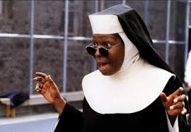
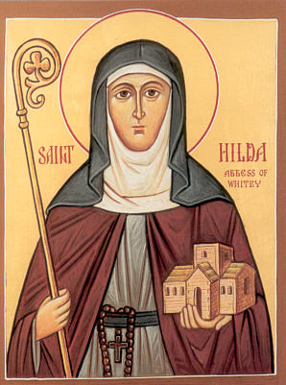
The Role of the Church
Women
Could become nuns- dedicate their lives to God
Lived in convents, headed by abbesses
Many belonged to royal houses
Only way for women to receive an education
The abbess Hilda founded a monastery in Whitby in 657
Gave learning an important role
Educated 5 future bishops

Slide 9
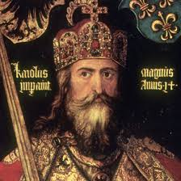
Charlemagne and the Carolingians
7th century- Frankish kings lost their power
Chief officers of the king took control
Pepin assumed the throne
Pepin’s son was Charles the Great (Charlemagne)
He was a strong warrior and statesman, and a devout Christian
He expanded the Frankish Kingdom into the Carolingian Empire (Western and Central Europe)
800- he was crowned Roman Emperor
Testifies to the enduring nature of the Roman Empire
Symbolized the coming together of the Christian and Germanic elements of society
The Pope crowned him Emperor

Slide 10
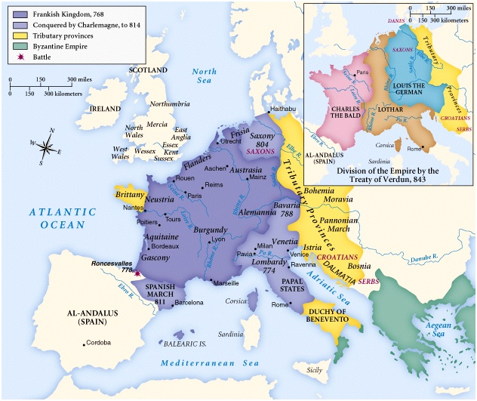

Slide 11
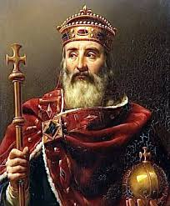
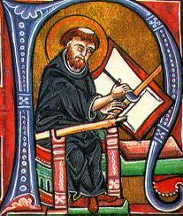
Charlemagne and the Carolingians
Charlemagne strongly supported learning
Led to the Carolingian Renaissance (rebirth)
Renewed interest in Latin culture and classical works (Greeks and Romans)
Monasteries played an important role
Benedictine monks copied Christian and Latin manuscripts in writing rooms, called scriptoria
Most of the Roman works we have today exist because of these Carolingian monks

