Slide 1
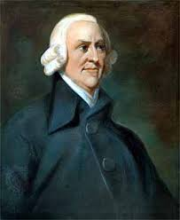
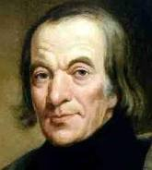
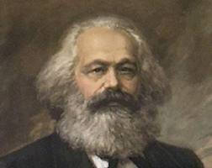
Three Economic Systems

Slide 2
Capitalism
Capitalism- began during the Commercial Revolution of the 16th Century
Definition: Wealth or capital is privately owned and invested in business to create more wealth for that investor.
Key Words:
Entrepreneur- a person who risks his or her wealth for a commercial undertaking
Laissez-faire- government keeping hands off business (Industrialization and capitalism were built on this at the expense of the people)
Key Person:
Adam Smith
Believed in free market economy
Wrote The Wealth of Nations

Slide 3
Socialism
Socialism- began as a reaction to the Industrial Revolution
Definition: an alternative to the laissez-faire style of government that developed during the Industrial period. (Endorsement of public ownership, rather than private ownership of factories, property, and the means of production).
Key Person:
Robert Owen
Utopian socialist
Bought land and built factories and homes
Paid workers better, better living and working conditions
Provided education for kids

Slide 4
Communism
Communism- began as a reaction to the Industrial Revolution
Definition: a form of socialism that sees class struggle between employers and employees as inevitable
Key Words:
Proletariat- middle class, working people
Bourgeoisie- upper class business owners
Key People:
Karl Marx
Father of Communism and wrote The Communist Manifesto
German philosopher
Believed all of history was based on economics
Believed there would be a worldwide revolt in violent revolution resulting in a classless society where government would no longer be needed
Working class must overthrow business owners
Friedrich Engels
Socialist supporter

