Slide 1
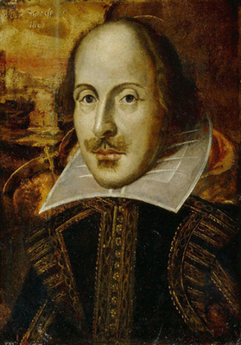
William Shakespeare was a famous playwright and actor.
Shakespeare has been viewed as a universal genius.
The era was named for Queen Elizabeth because great works of drama and literature and a “cultural flowering” occurred during her reign.
Click the mouse button or press the Space Bar to display the answers.

Slide 2
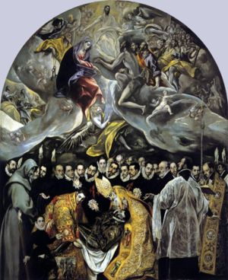
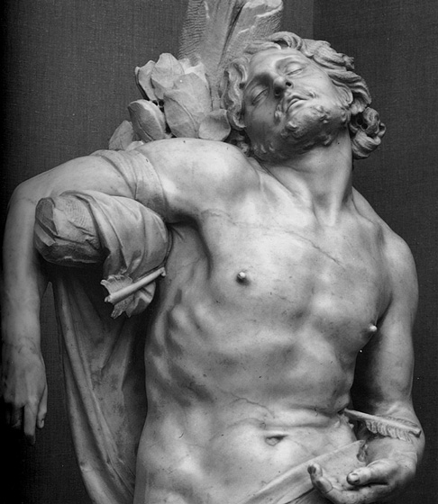
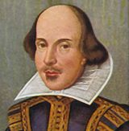
The World of European Culture

Slide 3
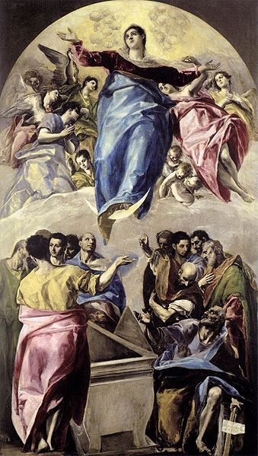
Mannerism
Mannerism emerged in Italy in the 1520 and 30’s
It broke down the values of balance, harmony, moderation, and proportion
Elongated figures showed suffering, heightened emotions, and religious ecstasy
El Greco- portrayed elongated figures in unusual yellows and greens against a black background
The mood he depicts reflects the tensions created by the religious upheavals of the Reformation.

Slide 4
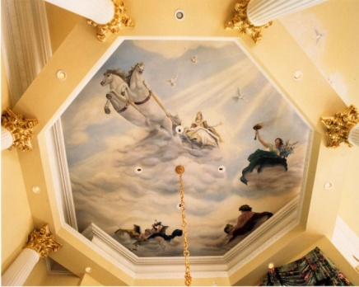
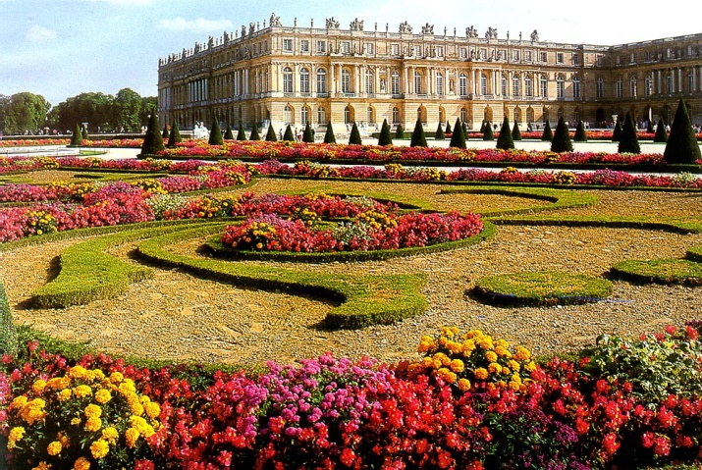
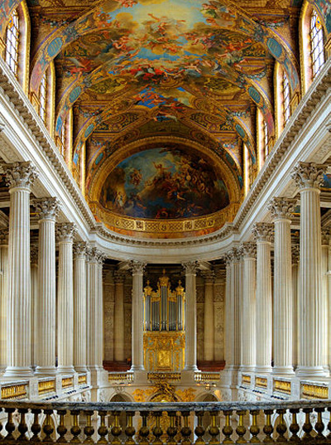
The Baroque Period
Baroque replaced Mannerism.
Began in Italy and was adopted by the Catholic reform movement.
Tried to join Renaissance ideals w/newly revived spiritual feelings
Known for its dramatic effects that arouse emotions
Baroque was used to show power, because the buildings became magnificent and rich.
Ex. Versailles

Slide 5
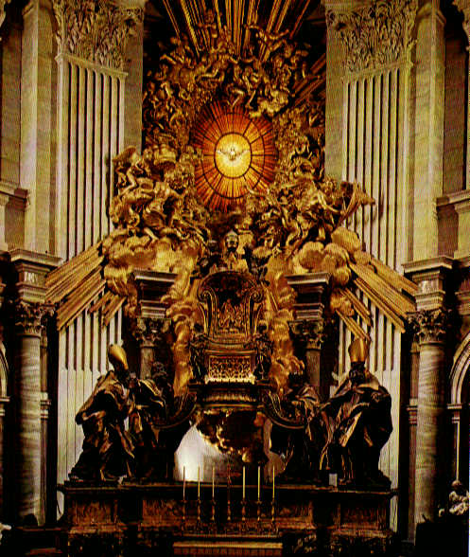
The Throne of Saint Peter
Gian Lorenzo Bernini completed St. Peter’s Basilica with a wooden “Throne of Saint Peter”
It seems to hover in midair as rays of heavenly light drive a mass of clouds toward the spectator.

Slide 6
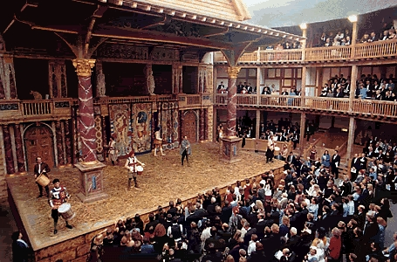
Golden Age of Literature
England had a cultural flourishing
during Elizabeth’s reign.
William Shakespeare
Works performed at the Globe Theater
Actor and shareholder in Lord Chamberlain’s Men (Acting troupe)
Low admissions allowed lower classes to attend, but his plays appealed to people in all classes.
He is viewed as a universal genius
Used masterful language and showed deep insight into human psychology.

Slide 7
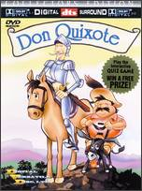
Golden Age of Literature
Spain
Lope de Vega wrote almost 1,500 plays
Witty, charming, action-packed, and realistic.
Miguel de Cervantes- Don Quixote
Don Quixote- knight w/ lofty ideals
Sancho Panza- fat, earthly realist (sidekick)
Each come to value the other’s perspective
Vision and hard work are necessary to achieve

Slide 8
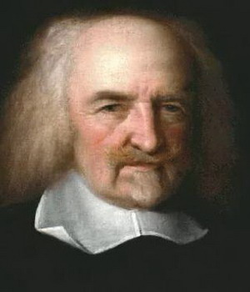
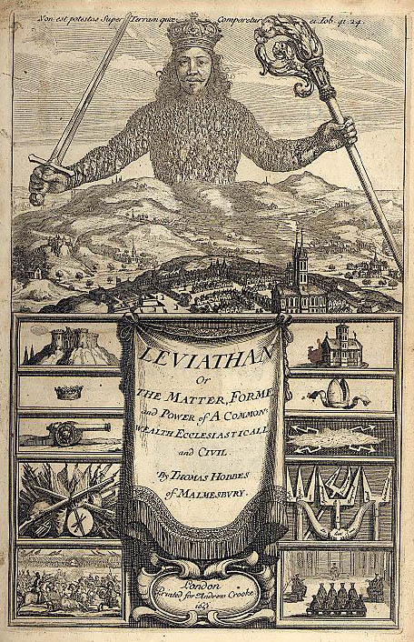
Political Thought
Thomas Hobbes- Leviathan
Before society, there was a “state of nature”
Life is brutal and violent because human nature is self-interested
To keep people from destroying each other, we need gov’t with an absolute ruler

Slide 9
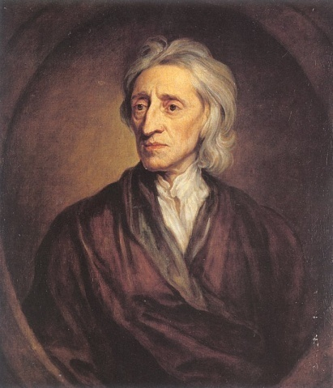
Political Thought
John Locke- Two Treatises of Government
Before society, people lived in freedom and equality, not violence and war
People had natural rights (life, liberty, and property)
They had trouble protecting those rights
Establish government to protect rights
Contract between people and gov’t establishes mutual obligations
If it’s broken, the people have the right to overthrow the gov’t
His ideas were important in the American and French Revolutions.
Used in the Dec. of Independence and US Constitution

