Slide 1
Which effects of WWI became causes of WWII?

Slide 2
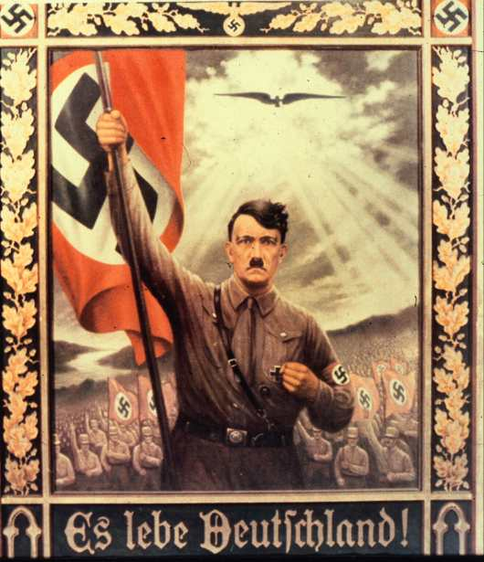
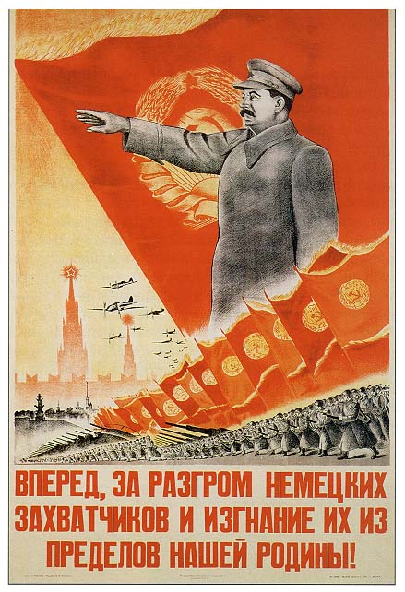
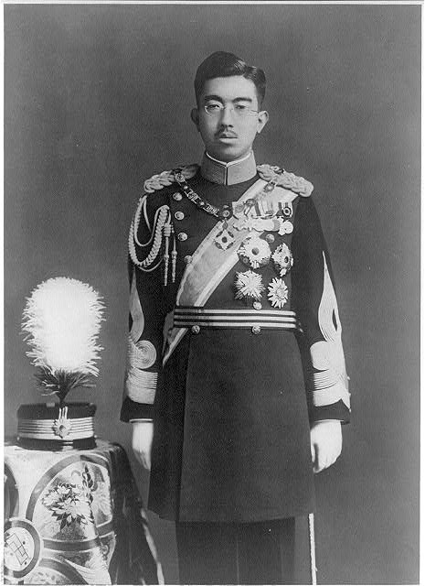
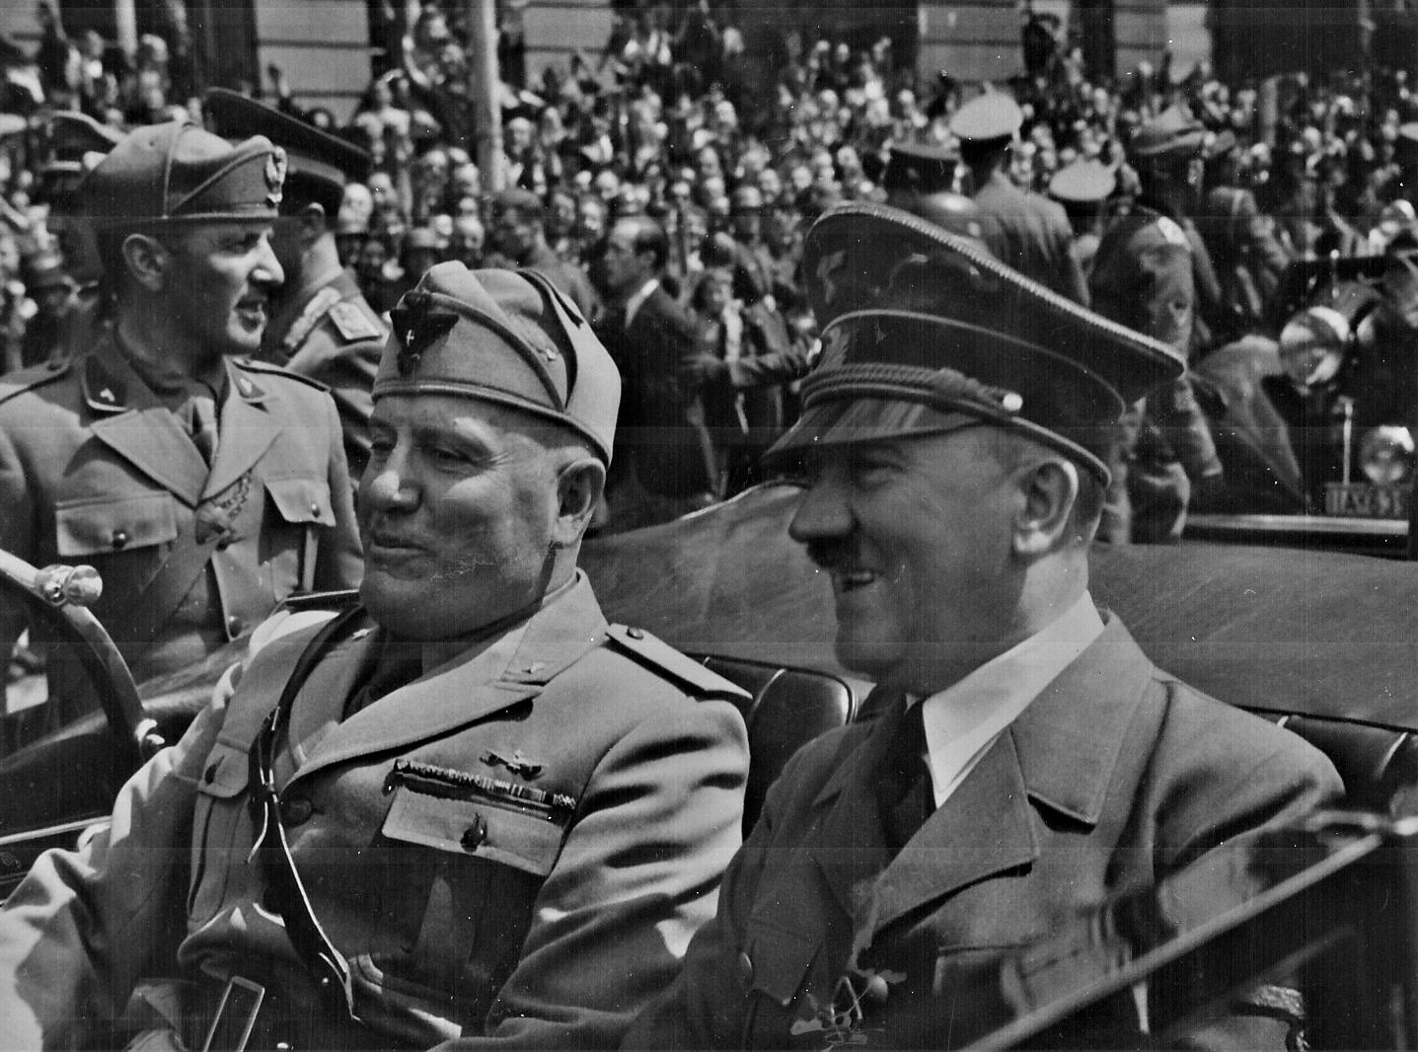
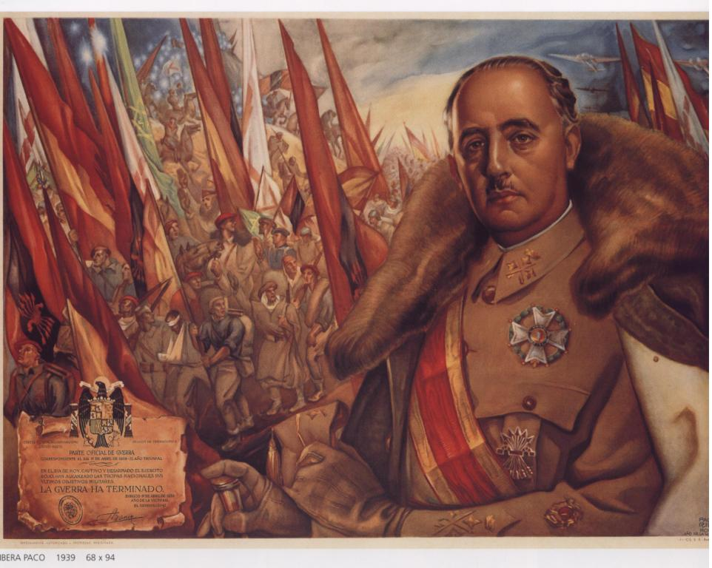
The Rise of Dictatorial Regimes

Slide 3
Big Ideas
Which leaders became dictators in Europe?
Explain how Hitler rose to power in Germany.
How did Germany and Japan begin WWII?

Slide 4
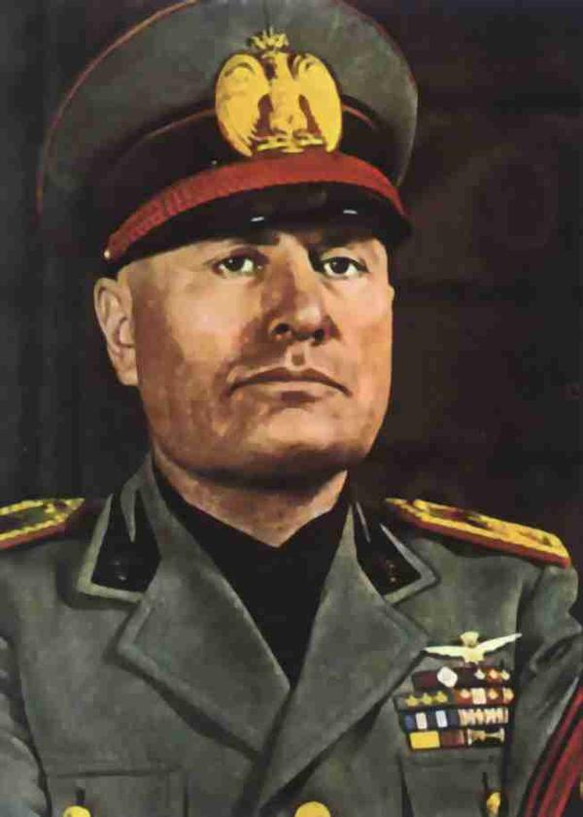
Italy
Totalitarianism= the government controls the political, economic, social, intellectual, and cultural lives of its citizens
Used propaganda to conquer the minds of their subjects and limited individual freedoms
Italy- Benito Mussolini created the first European fascist movement
Glorified the state above the individual
Focused on a strong central state led by a
dictatorial ruler
Mussolini established total control over his
people and exercised control over all media
outlets

Slide 5
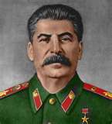
Russia
Lenin adopted a new policy called the New Economic Policy (NEP)
Peasants could sell their produce openly
Companies with less than 20 workers could be privately owned and operated
Agricultural production and the market went up
USSR created in 1922
Joseph Stalin used his position as general secretary to gain control of the Communist Party
Gave political positions in exchange for support
Implemented the collectivization of agriculture
private farms are eliminated and peasants work land owned by the government
Peasants resisted by hoarding crops and killing livestock, which led to widespread famine
Established complete control by sending his opposition to work in forced labor camps in Siberia
Bolsheviks were put on trial and condemned to death

Slide 6
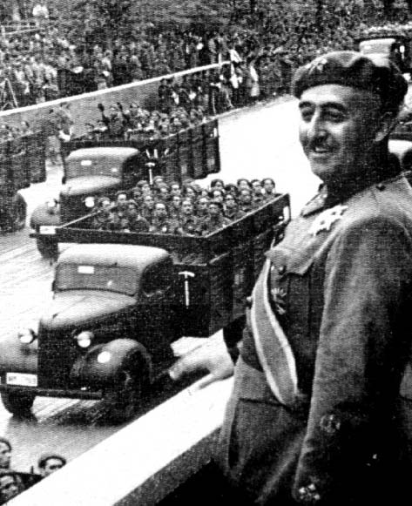
Spain
Francisco Franco led a military revolt against the democratic government
Resulted in a brutal civil war
Spanish Civil War ended when Franco’s forces captured Madrid in 1939
Franco established an authoritarian
dictatorship
favored traditional groups of large
landowners, businesspeople, and
Catholic clergy

Slide 7
Germany
Adolf Hitler entered politics by joining the German Workers’ Party in Munich
He took over the party, which was renamed the National Socialist German Workers’ Party or Nazi
After an unsuccessful revolt against the government, Hitler was imprisoned and wrote Mein Kampf
endorsed German nationalism, strong anti-Semitism, and anticommunism
Hitler won support of the right-wing elites of Germany
1933- pressured the president to allow Hitler to become chancellor and create a new government
Enabling Act was passed, allowing the government to ignore the constitution for 4years while it issued laws to deal with the country’s problems
1934- Hitler became the sole ruler of Germany (president died)

Slide 8
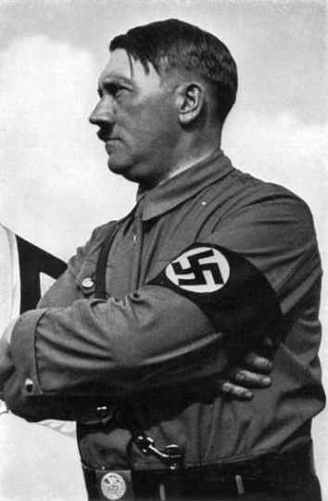
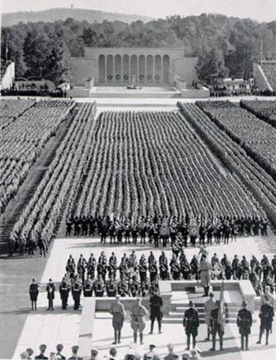
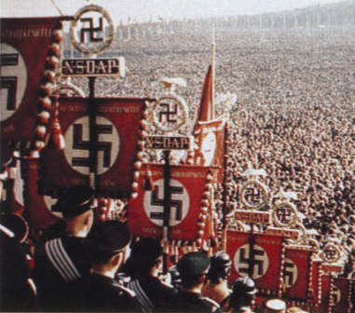
Germany
Hitler=dictator
Nazi Party quickly brought all institutions under their control,
purged the Jews from civil service jobs, and set up concentration camps
Hitler dreamed of creating a purely Aryan state that would dominate the world
To achieve his goal of a Third Reich, Hitler and the Nazis used economic policies, mass demonstrations, organizations, and terror
Schutzstaffeln (SS) was used to carry out this terror
Hitler created public works projects to help with the high unemployment rates and end the Depression
Nazis used mass demonstrations and
meetings to gain support and evoke
excitement from the German people

Slide 9
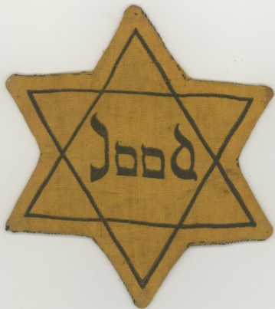
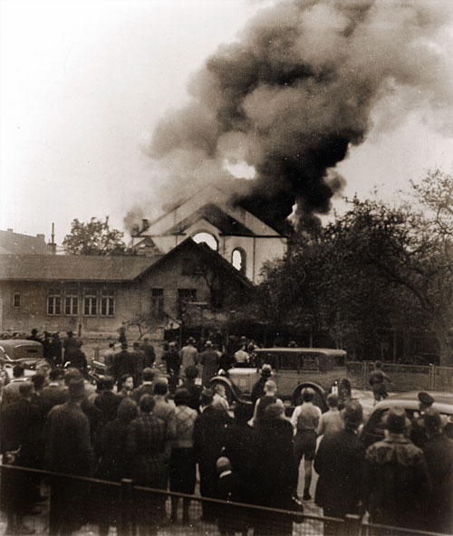
Germany
Nuremberg Laws
Defined anyone with one Jewish grandparent as a Jew
Excluded Jews from German citizenship
Stripped Jews of their civil rights
Forbade marriages between German citizens and Jews
Forbade Jews from teaching in schools and participating in the arts
Required Jews to wear yellow Stars of David and carry identification cards
Kristallnacht- Nov. 9, 1938
Nazis burned synagogues and Jewish businesses and sent
30,000 Jews to concentration camps
Jews were barred from all public transportation and
public buildings, and were prohibited from owning or
working in any retail store
SS encouraged Jews to “emigrate from Germany”

Slide 10
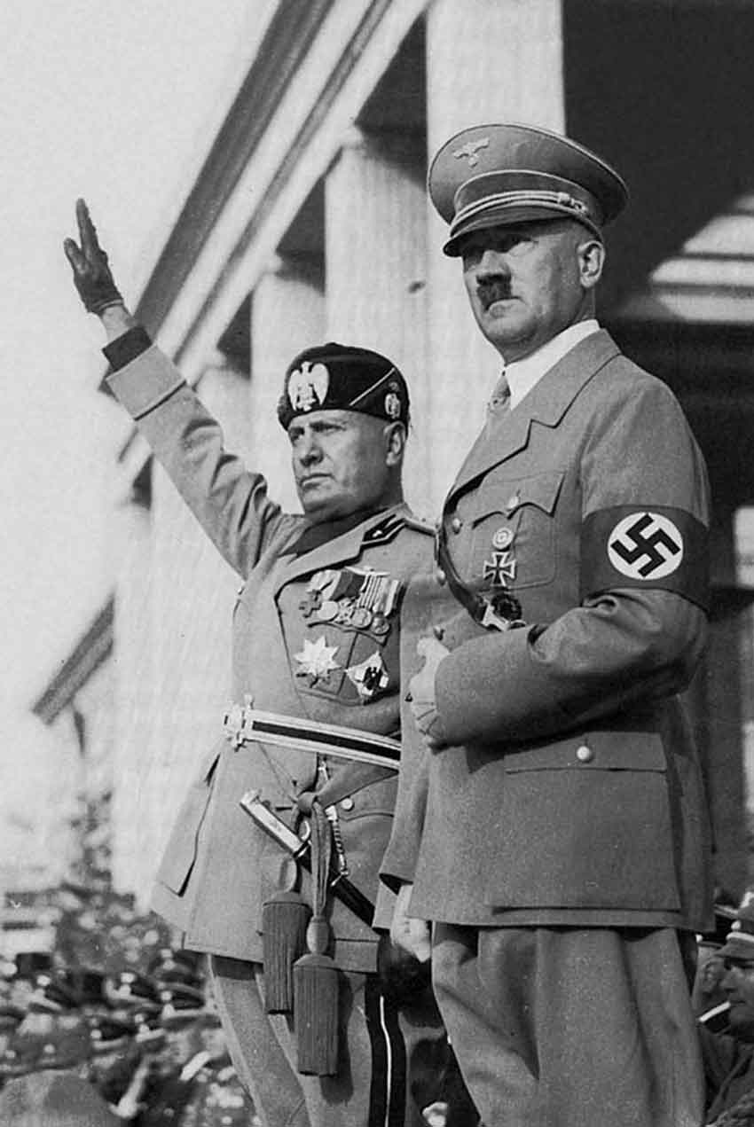
Germany- Path to War
Hitler violated the Treaty of Versailles by creating a new air force and expanding Germany’s army
France, GB, and Italy condemned this
1st aggressive move- invaded a demilitarized zone in Germany known as the Rhineland
GB adopted a policy of appeasement-did not take military action
Mussolini and Hitler created the Rome-Berlin Axis
pact recognizing their shared political and
economic goals
Nov. 1936, Hitler formed an anti-communist
alliance with Japan known as the
Anti-Comintern Pact

Slide 11
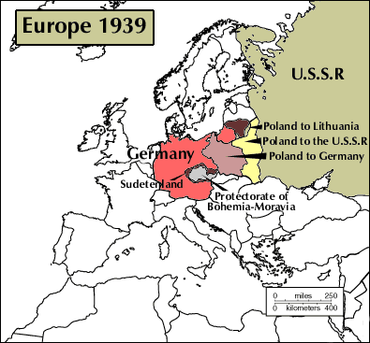
Germany- Path to War
Hitler annexed his homeland of Austria on March 13, 1938
Hitler announced, in 1938, that he would wage a world war if he was denied occupation of Sudetenland (Czech Rep.)
France, GB, Italy, and Germany gave in to his demands
Hitler continued to advance and demanded the Polish port of Danzig
France and GB needed Soviet help
But, Hitler signed a non-aggression
pact with the USSR on Aug. 23, 1939
Sept. 1, 1939- Hitler invaded Poland

Slide 12
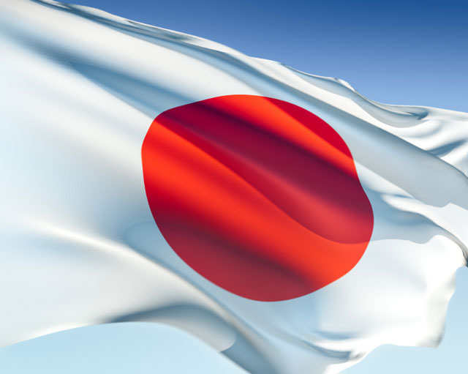
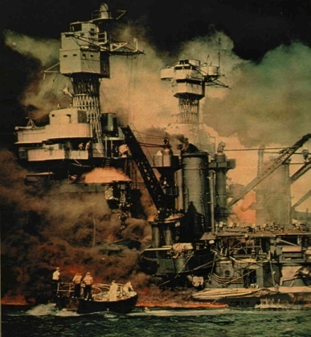
Japan- Path to War
Japan wanted to be a major imperial power
Japan wanted to control Manchuria
Sept 18, 1931- Japanese troops dressed as Chinese and blew up a portion of a Japanese-owned railway
Japan “retaliated” by seizing Manchuria
Japan did not want to fight the European colonial powers or the US, but by 1940, they began to demand rights to French Indochina
US objected and warned that it would retaliate with economic sanctions
Japanese industry depended upon importing natural
resources
The US placed an oil embargo on them
Because of these sanctions, the Japanese attacked
Pearl Harbor

