Slide 1
Niccolò Machiavelli
1513
actual or appearance of good qualities and the ability to do evil if necessary

Slide 2
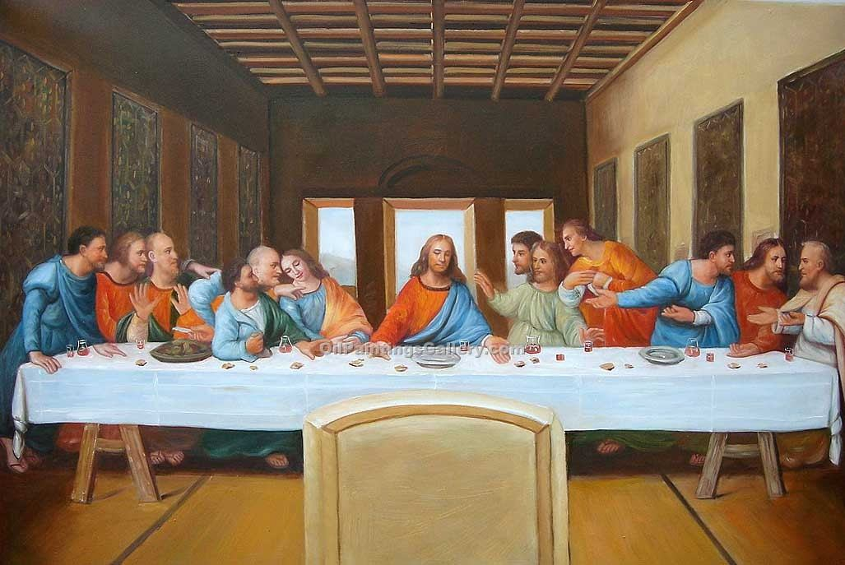
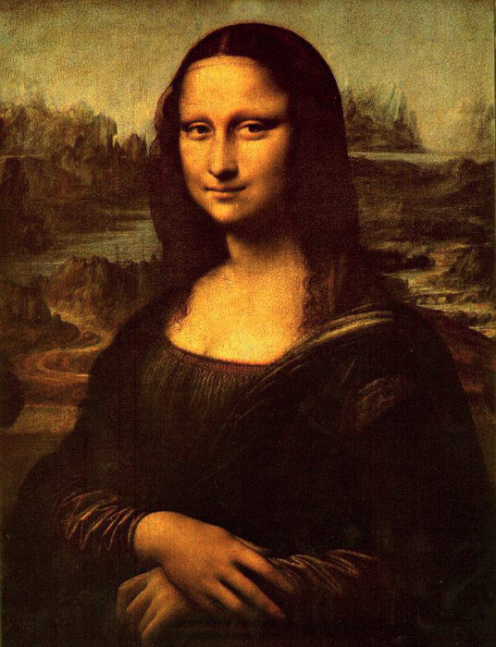
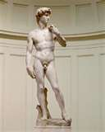
The Renaissance

Slide 3
The three-volume Gutenberg Bible was organized into two 42-line columns per page. In the later stages of production, six people worked simultaneously on composing the type. About 40 Gutenberg Bibles are still in existence, including perfect copies in the U.S. Library of Congress, the French Bibliothèque Nationale, and the British Library.

Slide 4
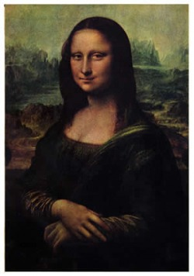
The Italian Renaissance
The word renaissance means rebirth.
Of the Ancient Greek and Roman cultures
The Italian Renaissance, which spread to the rest of Europe, occurred between 1350 and 1550.
During this time, secular, or worldly, viewpoint developed
Urban society had increasing wealth, which created new opportunities for material enjoyment.

Slide 5
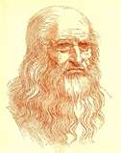
The Italian Renaissance
The Renaissance was also an age when the power of the Church declined, and society recovered from the plagues and instability of the Middle Ages.
Part of this recovery was a rebirth of interest in the ancient Greek and Roman cultures.
A new view of human beings that emphasized individual ability and worth emerged in the Renaissance.
The well-rounded, universal person was capable of achievements in many areas of life.
For example, Leonardo da Vinci was a painter, sculptor, architect, inventor, and mathematician.

Slide 6
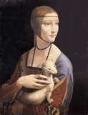
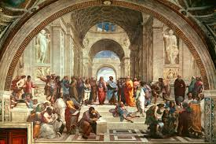
The Italian Renaissance
The upper classes were more affected by the Italian Renaissance than the lower classes
Churches, wealthy homes, and public buildings displayed art that celebrated the human body, classical antiquity, and religious and secular themes.

Slide 7
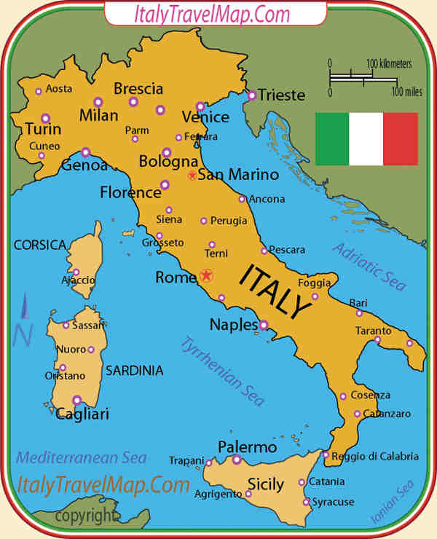
The Italian States
The northern and central Italian city-states of Milan, Venice, and Florence played crucial roles in the Italian politics of the time.
They prospered from trade with the Byzantine, Islamic, and Mediterranean civilizations.
They set up trading centers in the east during the Crusades, and they exchanged goods with merchants in England and the Netherlands.

Slide 8
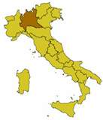
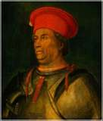
The Italian States
The wealthy city of Milan was located in the north at the crossroads of the main trade routes from Italian coastal cities to the Alpine passes.
After the last Visconti family ruler died in 1447, Francesco Sforza conquered the city with a band of mercenaries–soldiers for hire.
He made himself duke and had absolute power

Slide 9
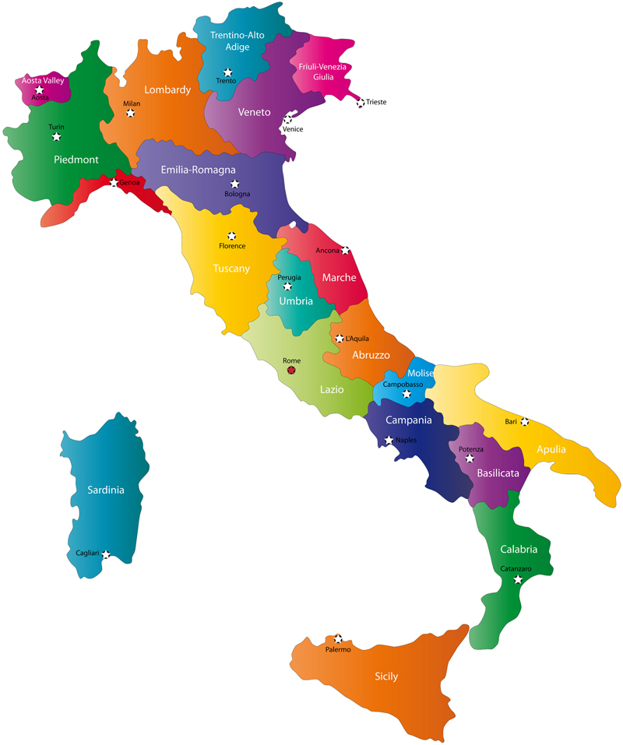
The Italian States
Venice was a link between Asia and western Europe.
Traders from all over the world came there.
A small group of wealthy merchants ran the city to serve their interests.
Due to its trade empire, Venice was an international power.
The republic of Florence dominated the Tuscany region.
In 1434, Cosimo de’ Medici took control of Florence.
He, and later his grandson Lorenzo de’ Medici, dominated Florence when it was the cultural center of Italy.

Slide 10
The Italian States
Attracted by Italy’s riches, Charles VIII of France led an army of thirty thousand men into Italy in 1494.
He occupied Naples in the south.
Northern Italian states asked Spain to help.
For the next 30 years, France and Spain made Italy their battleground.
In 1527 thousands of Spanish troops along with mercenaries arrived at Rome.
They had not been paid for months and demanded money.
The leader let them sack Rome as their pay.
The soldiers went crazy in a frenzy of bloodshed and looting.
The authorities had to establish order.
This sacking of Rome ended the wars and left Spain a dominant force in Italy.

Slide 11
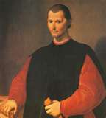
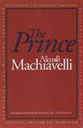
Machiavelli & the New Statecraft
The Prince by Niccolò Machiavelli is one of the most influential works on political power in the western world.
It concerns how to get and keep political power.
Previously authors had stressed that princes should be ethical and follow Christian principles.
Machiavelli argued the prince’s attitude toward power should be based on understanding that human nature is self-interested.
A prince, therefore, should not act on moral principles but on behalf of the interests of the state.
His views influenced political leaders who followed.

Slide 12
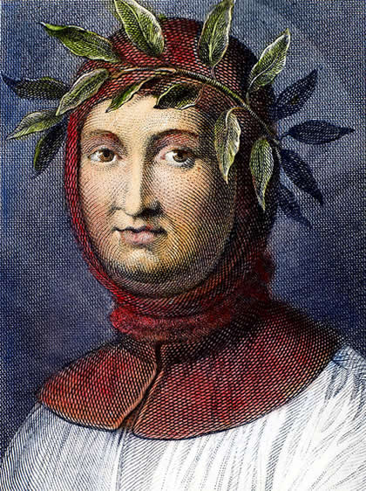
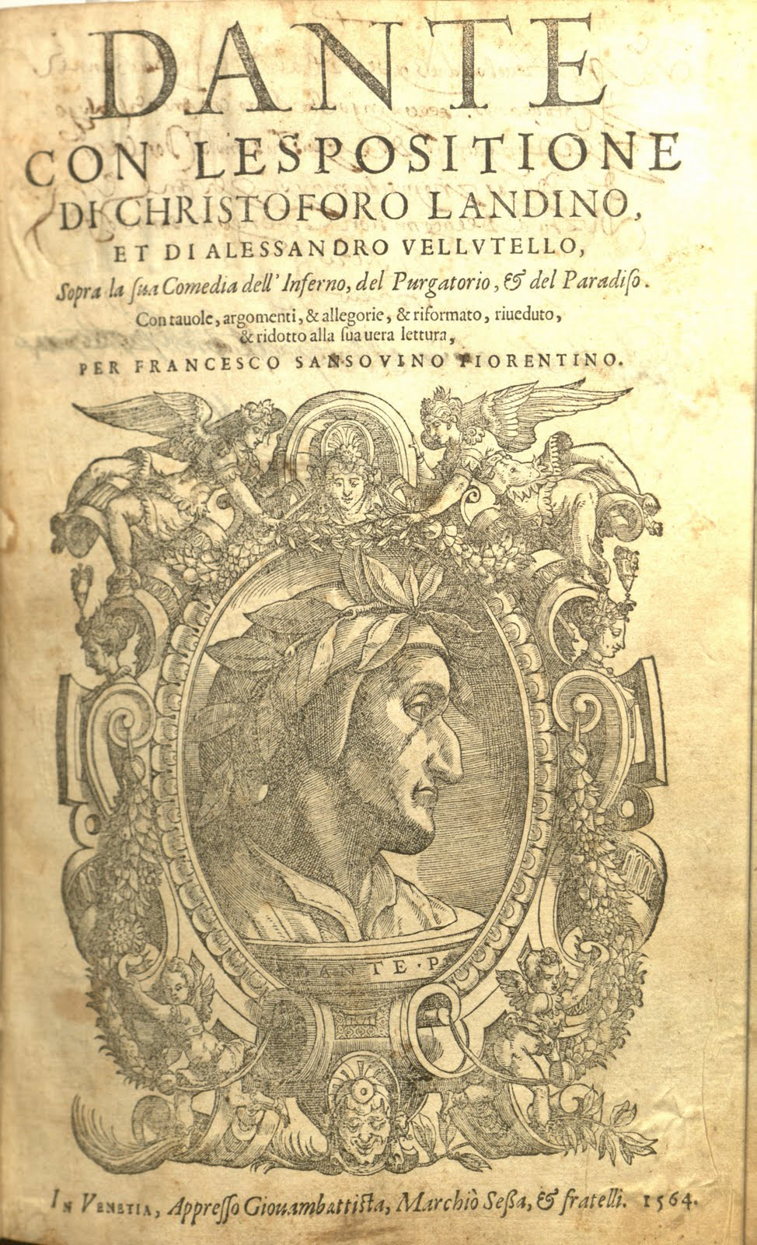
The Development of Humanism
Humanism was based on the study of the classics.
Grammar, rhetoric, poetry, moral philosophy, and history
Petrarch= father of Italian Renaissance Humanism
Looked for forgotten manuscripts
Described the intellectual life as one of solitude
Believed that intellectuals had a duty to live an active civic life and to put their study of the humanities to the state’s service
Humanists mostly used Latin
Other writers wrote in their vernacular (language spoken in their region)
Ex. Dante (Italian) wrote the Divine Comedy
Ex. Chaucer (English) wrote The Canterbury Tales

Slide 13
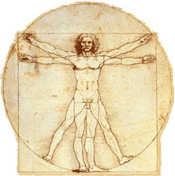
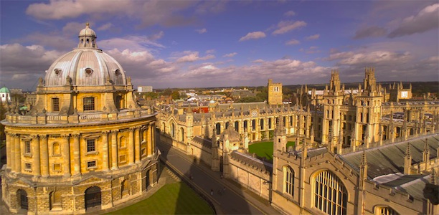
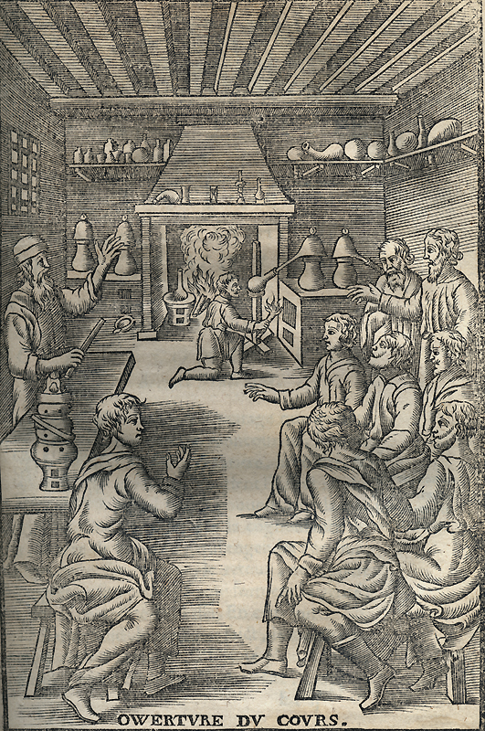
The Development of Humanism
The Humanist movement had a profound effect on education
Education became more secular
Humanists opened their own schools
Believed the liberal studies could help humans to reach their full potential.
History, philosophy, rhetoric, grammar, poetry, mathematics, astronomy, and music
Also emphasized physical education
Very few females were educated
Those who did learned the classics and some history
No mathematics or rhetoric
Supposed to learn about religion, so they can be “good Christian ladies”

