Slide 1
The spinning jenny met the need for more thread.
The flying shuttle and the water-powered loom both caused the need for more thread.
Production increased.
Click the mouse button or press the Space Bar to display the answers.

Slide 2
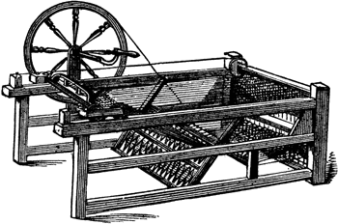
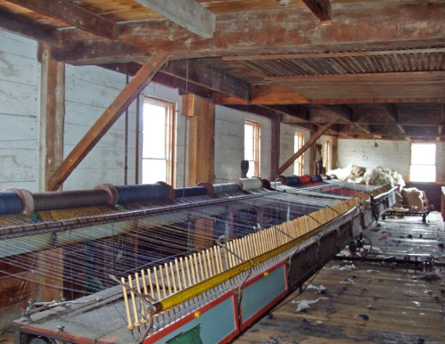
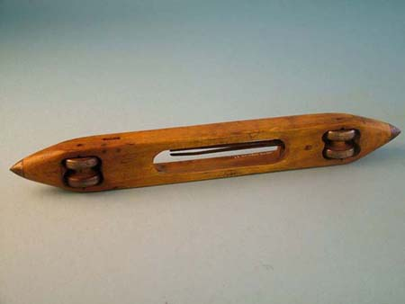
The Industrial Revolution
Spinning Jenny
Water-powered loom
Flying Shuttle

Slide 3
Big Ideas
Why did the Industrial Revolution begin in Britain?
What new inventions led to increased industrialization?
What are the positive and negative effects of the Industrial Revolution?

Slide 4
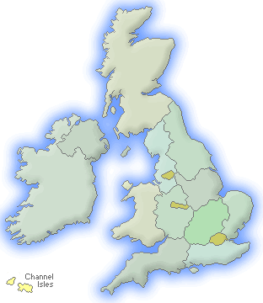
Great Britain
The Industrial Revolution began in Great Britain
5 reasons
Improved farming methods
Because of more food, population grew
Britain had a supply of money to invest in new machinery
Plentiful natural resources
Supply of markets to sell their goods

Slide 5
Great Britain
Cotton Industry
18th Century- Britain surged ahead in production of cotton goods
Before- Cottage Industry- goods made in the home
New inventions-
Flying shuttle, spinning jenny, and water-powered loom
These made the process more efficient
More efficient to bring workers to the machines in factories
James Watt improved the steam engine
Powered by coal
Mills no longer had to be by water
By 1840, cotton cloth was Britain’s most important export
Sold all over the world

Slide 6
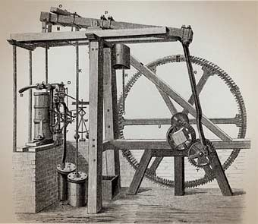
Great Britain
Coal & Iron Industry
Because the steam engine now ran on coal, the coal industry expanded
It, also, transformed the iron industry
Henry Cort invented a process, puddling, that allowed better quality of iron
Quadrupled production
1740- They produced 17,000 tons of iron
By 1852, they produced 3 m tons of iron
annually

Slide 7
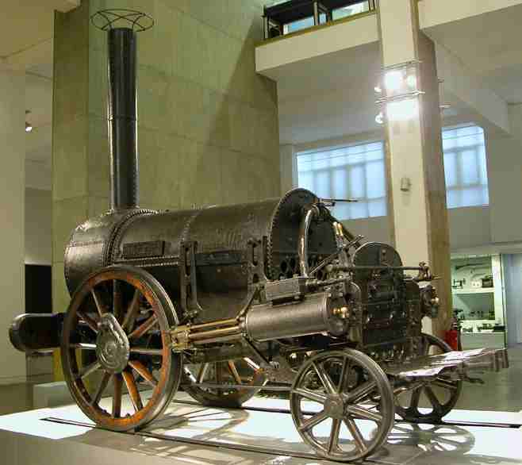
Great Britain
Railroads
Railroads were crucial to the Industrial Rev.
Efficient way to move goods
The Rocket was used on the first public railway line, which opened in 1830
Went from Manchester to Liverpool
Pulled a 40 ton train at 16 mph
By 1850, trains were going 50 mph
GB had more than 6,000 miles of track
Advantages
Provided new jobs
Goods became less expensive
More sales= more demand
Led to more factories and machines
More jobs
This cycle was the basic feature of the Industrial Revolution

Slide 8
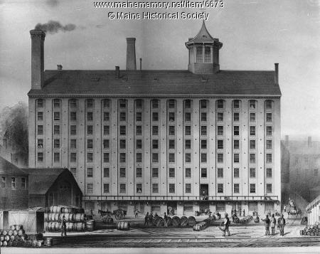
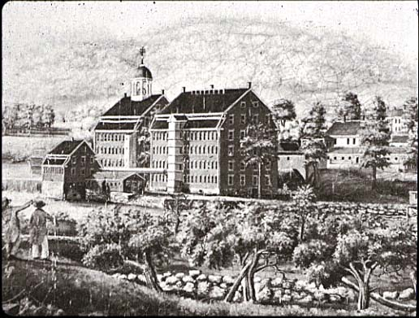
Great Britain
Factories
Factories created a new labor system
To keep machines going constantly, workers had to work in shifts
Workers trained to work the same hours everyday and do repetitive work
One early industrialist said his goal was “to make the men into machines that cannot err.”

Slide 9
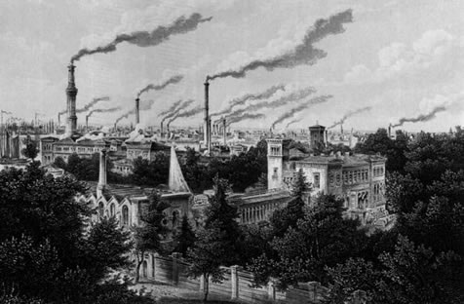
Spread of Industrialization
Europe
The Industrial Revolution spread to other parts of the world at different speeds.
Belgium, France, and Germany were the first to industrialize
Their governments built infrastructure such as canals and railroads
North America
It hit the US too
In 1800, 6 out of 7 American workers
were farmers
By 1860- 1 out of 2
Population went from 5 m to 30 m
Large cities developed

Slide 10
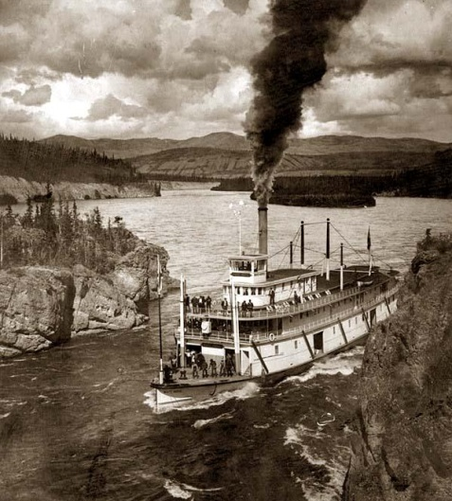
Spread of Industrialization
Transportation in the US- miles of railroads and canals were built
Robert Fulton- built the first paddle-wheel steamboat, the Clermont, in 1807
1860, thousands of these boats were on rivers, lakes, and even the ocean.
Railroad was the most important form of transportation
Went from 100 miles of track in 1830 to 30,000
miles in 1860
It turned the US into a massive market for goods
Labor came from the farm population
Many were women and girls (primarily textile
factories)
Sometimes entire families would work in the same factory

Slide 11
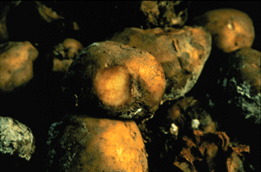
Social Impact in Europe
Population and Urban Growth
During the Rev. cities grew and two new social classes were created: industrial middle class and industrial working class
Pop. in Europe increased (1750- 140 m, 1850- 266 m)
Decline in death rates
Increased food supply
Exception- Irish potato famine- 1840’s
Cities were home to many industries
People moved in from the country to find work, taking the new railroads.
Many lived in miserable conditions
prompted urban social reformers to call for cleaning up the cities

Slide 12
Social Impact in Europe
Industrial Middle Class
The Ind Rev replaced the commercial capitalism of the Middle Ages with industrial capitalism–an economic system based on industrial production
This produced the industrial middle class
people who built the factories, bought the machines, and figured out where the markets were
characteristics were initiative, vision, ambition, and money making
Industrial Working Class
workers faced horrible working conditions with hours ranging from 12 to 16 hours a day, 6 days a week
No job security, no min. wage, hot temps
In Britain, women and children made up 2/3 of the cotton industry’s workforce.
Factory Act of 1833 set 9 as the min age to work
Children from ages 9 to 13 could work only 9 hours a day
Those between ages 13 and 18 could work only 12 hours

Slide 13
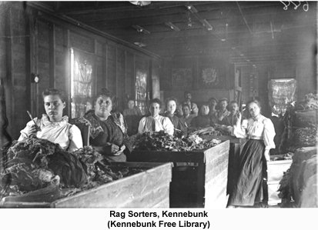
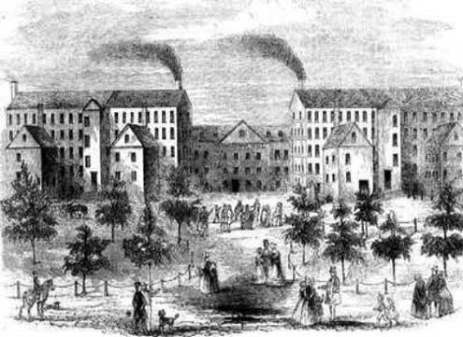
Social Impact in Europe
Women
Worked more in textile factories
Unskilled and paid ½ of what men made
Excessive working hours for women were outlawed in 1844
New roles
Married men were now expected to support the family,
Married women were to take care of the home and perform low-paying jobs in the home, like taking in laundry, to help the family survive

Slide 14
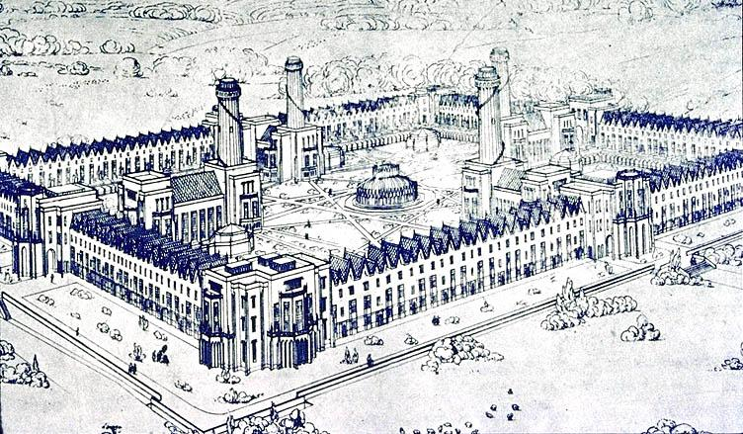
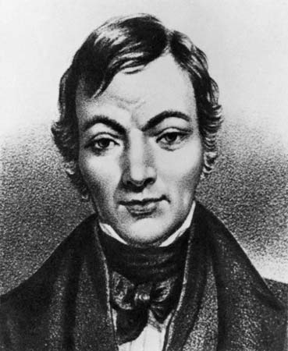
Social Impact in Europe
Early Socialism
Pitiful conditions led to a movement called Socialism
Society, usually government, owns and controls some means of production–such as factories and utilities
Early socialism -believed in the equality of all people and wanted to replace competition with cooperation
Later socialists said this wasn’t practical
Called them utopian socialists

