Slide 1
people standing in a bread line
They are out of work and have no money to buy food.
free food
Click the mouse button or press the Space Bar to display the answers.

Slide 2
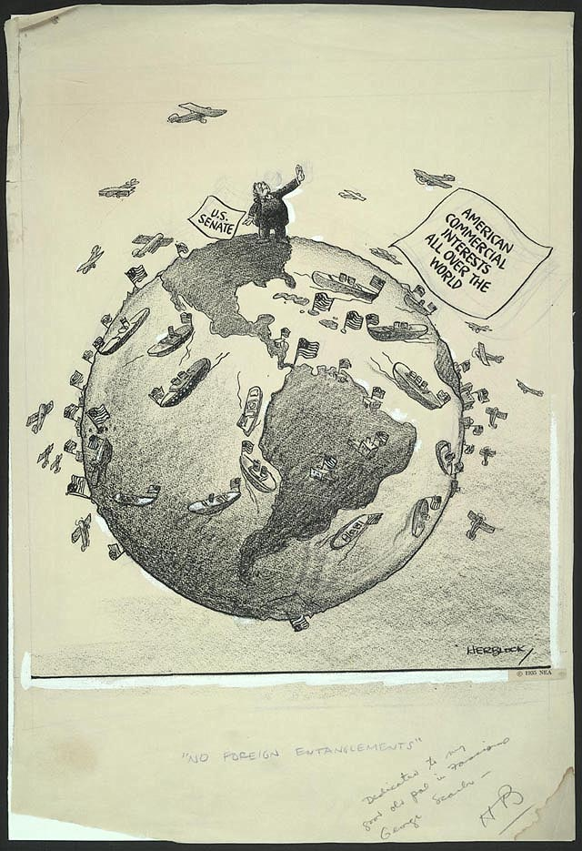
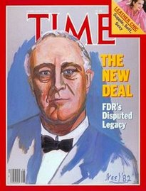
The Great Depression

Slide 3
Big Ideas
What problems existed due to an uneasy peace after WWI?
How did the Depression affect various countries around the world?

Slide 4
Uneasy Peace
The Treaty of Versailles created repeated border disputes among nations and Germans were determined to change it.
League of Nations did not solve the new conflicts
US didn’t join
League members couldn’t agree to use force
French wanted it strictly enforced
Germans couldn’t pay back reparations, so the French occupied the Ruhr Valley, an industrial and mining center
They planned to take reparations from German industry

Slide 5
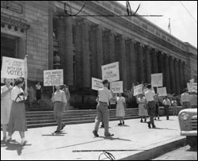
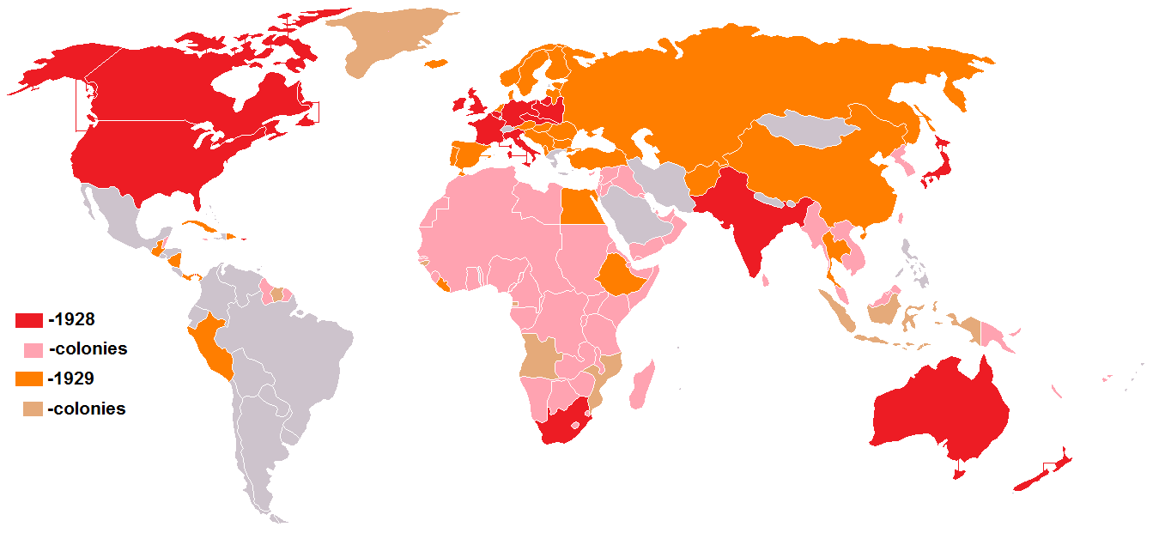
Uneasy Peace
German workers went on strike
Gov’t printed more money to pay workers
Made the German mark useless because of inflation
The Dawes Plan: reduce reparation payments to what they could afford.
$200 million went to Germany- led to heavy American investment
French and Germans became more cooperative
Treaty of Locarno- Germany’s western borders wouldn’t be threatened
1926- Germany joined the L of N
1928- 63 nations signed the
Kellogg-Briand Pact
Pledged to renounce war
No one reduced their military

Slide 6
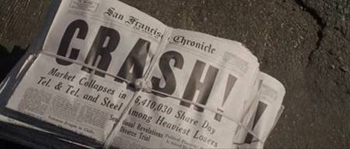
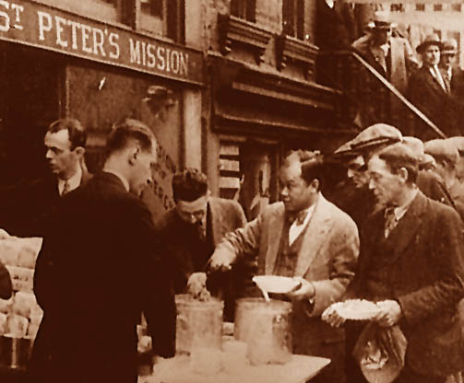
Great Depression
Depression- very low economic activity and high unemployment
2 main causes
1. Downturn in economies of nations during the 2nd half of the 1920’s
2. Collapse of US stock market in 1929
Germany had been borrowing $ since 1924, but American investors pulled $ out of Germany
This weakened banks around Europe

Slide 7
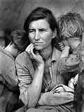
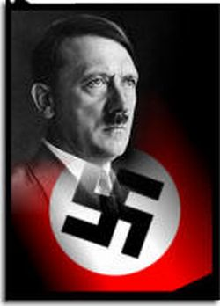
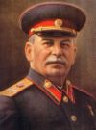
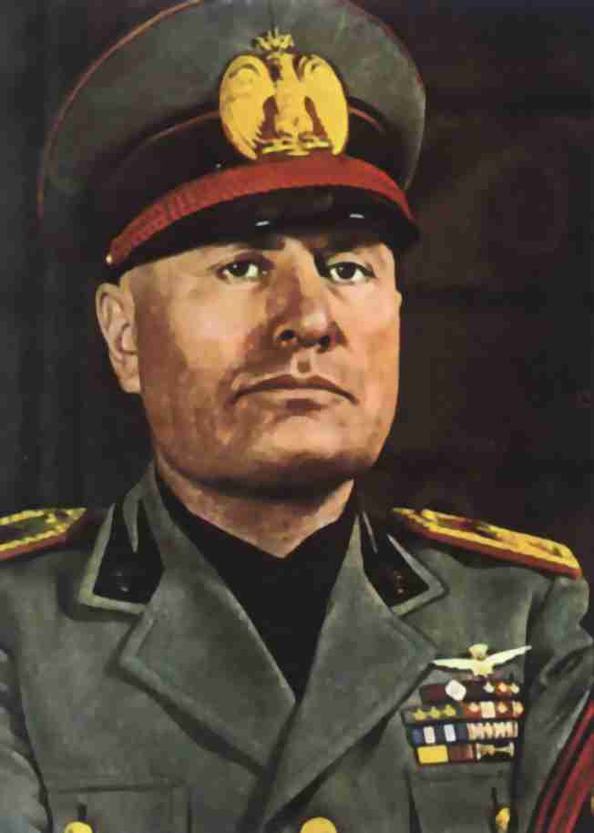
Great Depression
As trade and production slowed, people lost jobs
Gov’ts didn’t know how to deal with the problems
Tried to lower wages and raise tariffs
Made things worse
Many people looked to leaders who proposed simple solutions in return for complete power
Challenged democratic nations

Slide 8
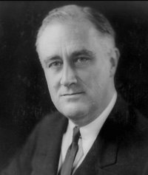
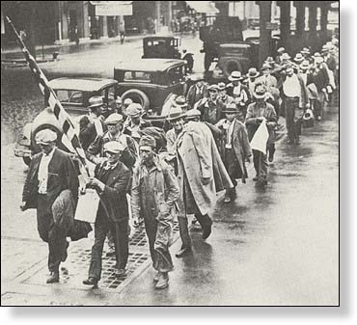
Great Depression
John Maynard Keynes said that unemployment came from decline in demand, not overproduction
Gov’t should finance projects to put people to work
Many in his gov’t ignored him.
The US was terribly affected too.
12 million unemployed
Franklin Delano Roosevelt instituted the New Deal
The gov’t created jobs by funding public works projects
Social Security Act- created a system of old-age pensions and unemployment insurance
It was not until WWII that American workers regained full employment

