Slide 1
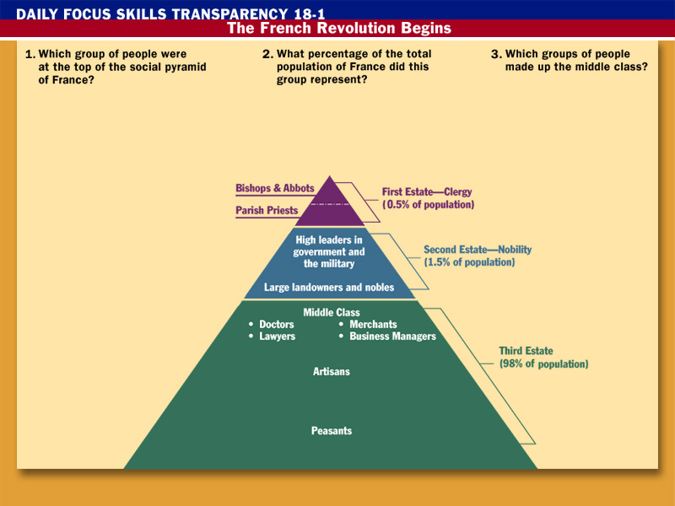
Doctors, lawyers, merchants, and business managers made up the middle class.
Clergy: bishops, abbots, and parish priests are at the top of the social pyramid.
The clergy represented .5% of the total population.
Click the mouse button or press the Space Bar to display the answers.

Slide 2
The French Revolution
The Beginning Stages

Slide 3
Big ideas:
Describe the 4 main causes of the French Revolution.
Describe the different governments that were created during the French Revolution.

Slide 4
Background to the Revolution
Estates General:
Divided into 3 estates
1st Estate= clergy (.5%)
2nd Estate= nobles (1.5%)
3rd Estate= commoners (98%)
Each estate gets one vote in the Estates General
1 & 2 vote together, making 3 powerless
King had absolute power in gov’t
Nobles and bourgeoisie (middle class) wanted power
Use Enlightenment principles to gain power

Slide 5
Background to the Revolution
There are 4 causes of the revolution
Near collapse of the gov’t finances
Wars: 7 Years War, American Revolution
Royal luxuries (Queen especially known for spending $)
King wanted to raise taxes to fix this, but the country was going into an economic depression
Economic depression
Serfdom had been abolished, but people still paid feudal dues (relics of feudalism)
Living conditions were terrible
Inequality in the gov’t
Only the Third Estate pays taxes
98% is the minority in the Estates General
New ideas of the Enlightenment
People should be free to elect gov’t officials.

Slide 6
Estates General-> National Assembly
King Louis XVI needed to call the Estates General to meet to fix money troubles
3rd Estate wanted to vote with each member getting a vote
They had many more members than the other two
King used the traditional method of voting (1 per estate)
So, the 3rd Estate broke away from the gov’t
They became the National Assembly and went to draft a constitution
They were locked out of their meeting place, so they went to a tennis court to draft it
There, they promised to meet until it was drafted (Tennis Court Oath)

Slide 7
Estates General-> National Assembly
The king’s forces were going to attack the National Assembly, but many commoners stepped in
They stormed the Bastille
Royal armory and prison in Paris
The king’s authority collapsed
The Great Fear
Many people felt threatened by the revolution
They were scared it would hurt them or their livelihoods
They were also scared that foreign monarchs would send troops to support the king
They didn’t want this to happen in their countries.
Militias were formed to protect themselves

Slide 8
Destruction of the Old Regime
Declaration of the Rights of Man and the Citizen
The National Assembly proclaimed freedom and equal rights for all men, access to public office based on talent, an end to exemptions from taxation.
All citizens have the right to participate in gov’t
Freedom of speech and press
Women would get these rights, but not be allowed to participate in gov’t (including voting)
Women in the US got the right to vote in _______

Slide 9
Destruction of the Old Regime
Louis XVI wanted to stay in Versailles
Thousands of Parisian women marched there armed with pitchforks, swords, muskets, etc.
They met with him and told them about their plight
They captured him and his family and marched them to Paris
Louis brought flour as a goodwill gesture
The royal family was virtually held prisoner in Paris
The Church was reformed too
Lands were seized
Bishops and priests were to be elected by the people and paid by the state
Many Catholics became enemies of the revolution

Slide 10
Destruction of the Old Regime
Constitution of 1791
Limited monarchy w/ Legislative Assembly (made laws)
Only men over 25 who paid enough taxes could vote
Only rich guys got in
Many people opposed the new order
Catholics, nobles, the poor, royalists
The king tried to flee, but was returned to Paris
Other monarchs (Austria and Prussia)
The Legislative Assembly met for the 1st time in 1791
Declared war on Austria, but lost

Slide 11
Destruction of the Old Regime
Because of these factors, political demonstrations broke out
Paris Commune organized a mob attack on the king and L.A.
Captured the king and demanded an end to the monarchy.
Power went to the Paris Commune
Made up of working people and the poor (sans-culottes= without fancy clothes)
The revolution was about to enter a more radical phase

