Slide 1
on November 11, at 5 A.M., Paris time in Paris
at 11:00 A.M. Paris time
They rejoiced.
Click the mouse button or press the Space Bar to display the answers.

Slide 2
The End of WWI

Slide 3
Big Ideas
How did Germany lose the war?
What were the major provisions of the Treaty of Versailles?
What happened in the Middle East?

Slide 4
The Last Year of the War
During 1917, the Allies had been defeated on the Western Front and Russia had withdrawn from the war (Russian Revolution)
The Germans decided to launch a large offensive
Got within 50 miles of Paris
Stopped at the 2nd Battle of the Marne
By 1918, it was clear that the Germans were going to lose.
Americans had joined and Allies continued to advance
Allies wouldn’t negotiate with Emperor William II
Angry Germans revolted and set up their own councils
William II fled the country

Slide 5
The Last Year of the War
The German Socialist Democratic Party declared Germany would become a democratic republic
On Nov. 11, 1918, Germany signed an armistice, ending the war.
In Dec. 1918- radicals set up the German Communist Party and tried to take over the gov’t
They were defeated
Many Germans feared communism
The Austro-Hungarian Empire disintegrated into the independent nations of Austria, Hungary, Czechoslovakia, and Yugoslavia.
National rivalries will weaken E. Europe for many years to come

Slide 6
Peace Settlements
Jan. 1919- reps met in Paris to make final settlement of the war
Woodrow Wilson outlined his “Fourteen Points”
Intended to provide lasting peace
Included in this: open treaty negotiations, reducing military strength
League of Nations- peacekeeping org.
The conf. was met with many difficulties
Secret treaties outlined territory that would be given to certain nations
GB and France wanted Germany to pay for the war (reparations)
They also wanted Germany stripped of all weapons

Slide 7
Peace Settlements
The Big Three (US, GB, and France) compromised
US got the L of N (but would never join)
US had to agree to territorial settlements that went against self-determination
French gave up the Rhineland (buffer between them and Germany)
Accepted a defensive alliance with GB and US instead

Slide 8
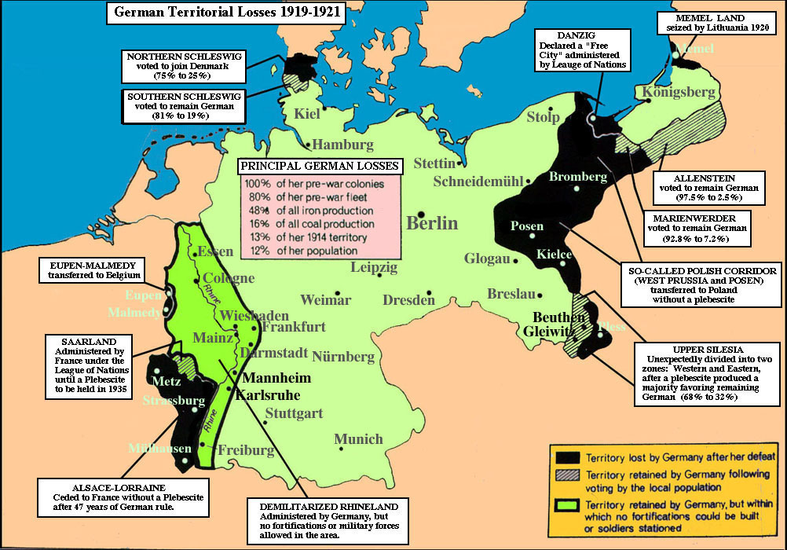
Peace Settlements
The Treaty of Versailles was actually 5 separate treaties with the defeated nations: Germany, Austria, Hungary, Bulgaria, and Turkey
Germans declared guilty for the war and forced them to pay reparations
Forced to reduce military force
Gave back Alsace and Lorraine to France
Sections of E. Germany became a Polish state
German land on both sides of the Rhine was a demilitarized zone

Slide 9
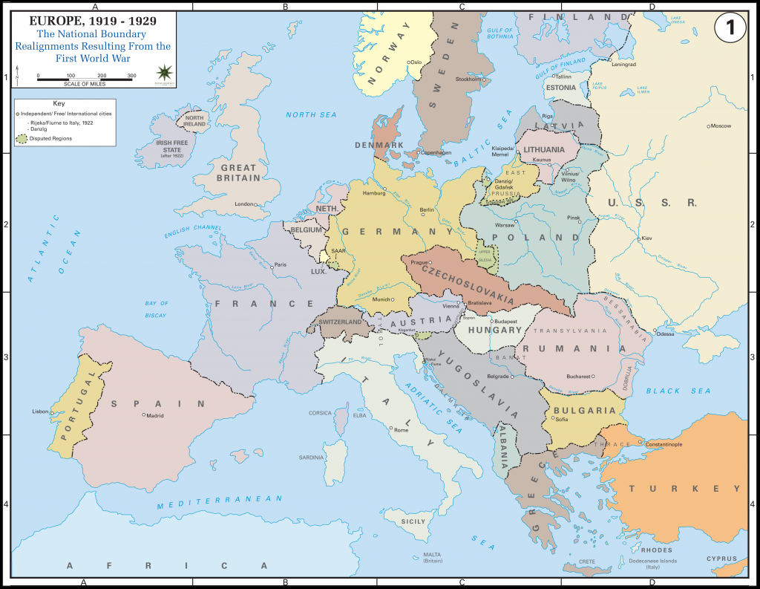
Peace Settlements
E. Europe was greatly changed
Russians and Germans lost land
Austro-Hungarian Empire was gone
New nation-states: Finland, Latvia, Estonia, Lithuania, Poland, Czechoslovakia, Austria, and Hungary
Romania got land from Russia, Hungary, and Bulgaria
Yugoslavia was formed (included Serbs, Croats, and Slovenes)

Slide 10
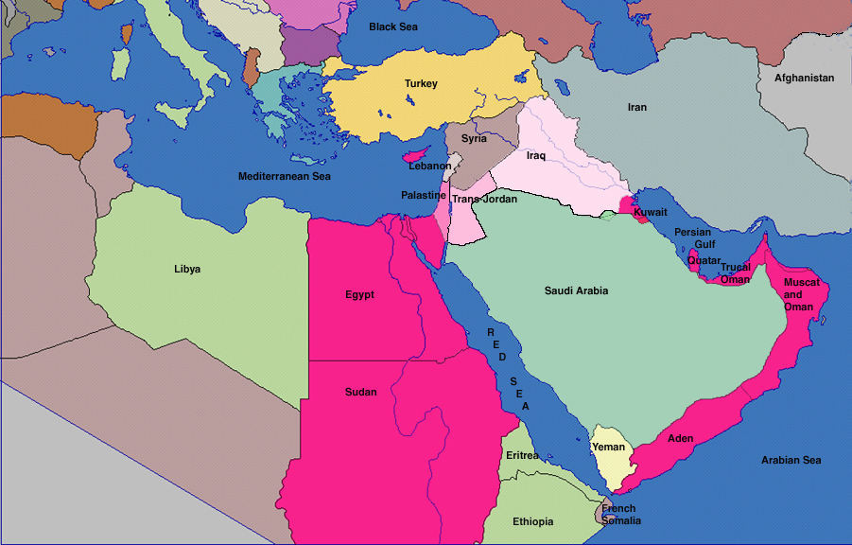
Peace Settlements
Broke up the Ottoman Empire:
France and GB took control over Lebanon, Syria, Iraq, and Palestine
These were called mandates- a country controlled another as a mandate on behalf of the L of N, but didn’t own the territory

