Slide 1
52°30’ S latitude
Atlantic and Pacific
Cape Pilar, south
Click the mouse button or press the Space Bar to display the answers.

Slide 2
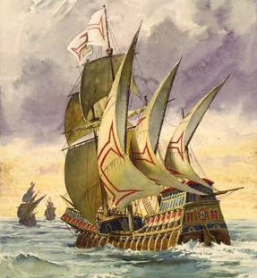
Exploration
The Portuguese and Spanish Phase

Slide 3
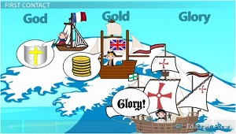
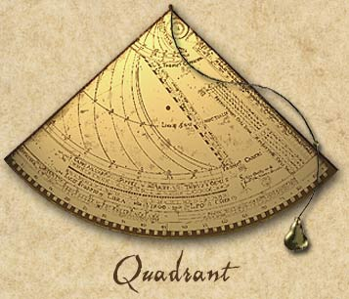
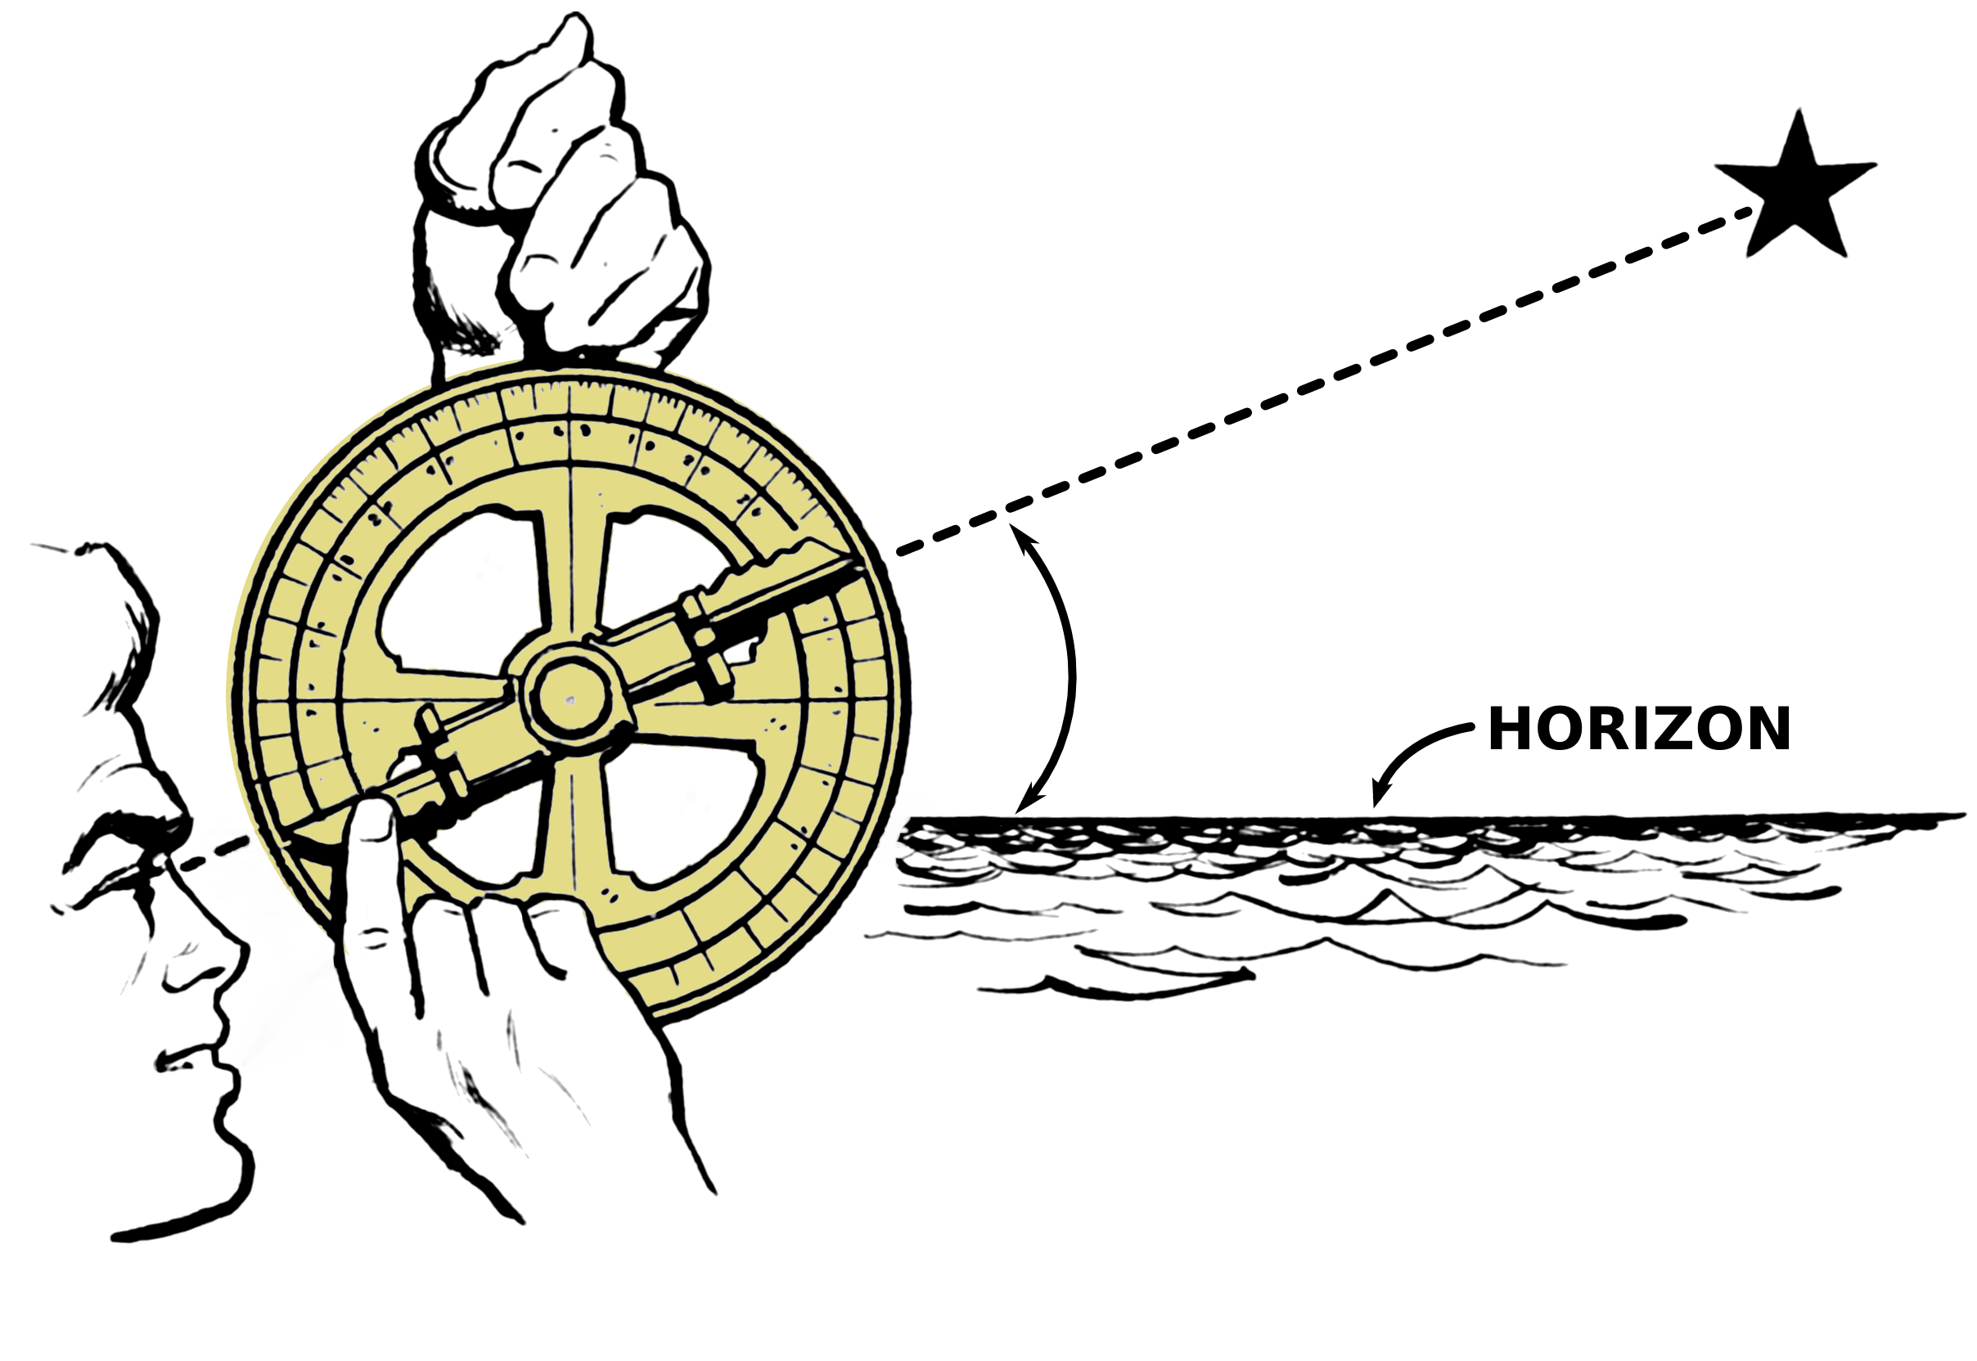
Motives
God, Glory, and Gold:
God= Religious motives (spread Christianity)
Glory= Political motives (more power and land)
Adventure and myth- Fountain of Youth
Gold= Economic Motives (make money)
Technology made exploration possible
Ships are faster and more maneuverable
Magnetic compass- find directions
Astrolabe- used to observe position of stars
Quadrant- measure altitude of heavenly bodies
Maps- map-making improved

Slide 4
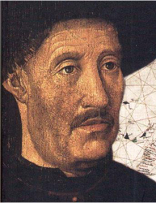
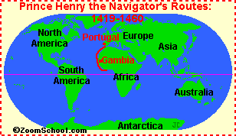
Portuguese Exploration
Prince Henry the Navigator
Hoped to discover Prester John’s Christian empire by sailing around Africa (conducted research along the way)
Early Explorations & Discoveries
As they moved down the coast of Africa, they brought back gold and slaves
Bartholomew Diaz- rounded Cape of Good Hope
Opened the way for water voyages to Asia
Vasco Da Gama- 1st European to reach India
Trading posts quickly established in India
1st trip, Da Gama made 60x his initial investment
Discovery of Brazil-1500
Pedro Alvarez Cabral discovered it when his ship to India veered off course

Slide 5
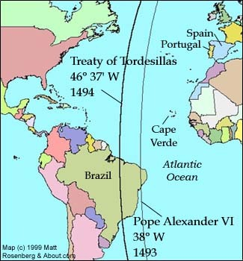
Spanish Exploration
Christopher Columbus-1492
Wanted to prove that it was 3,000 miles to Japan (going west)
Queen Isabella of Spain sponsored him
Mid-October 1492- he landed on Hispaniola
Made 3 more voyages and found all of the islands of the Caribbean
Treaty of Tordesillas
1493- To avoid fighting, the pope divided the “discoveries” between Spain and Portugal
1494- Moved the line west (gave Portugal claim to Brazil)

Slide 6
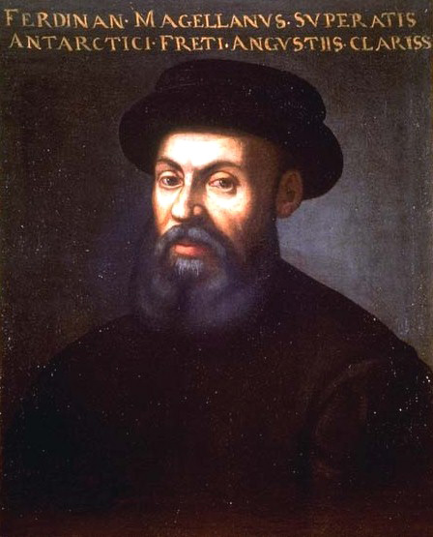
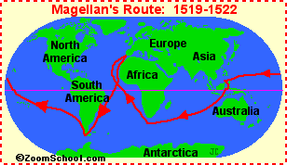
Spanish Exploration
Magellan
1st to circumnavigate (travel around) the globe
Left Seville, Spain in Sept. 1519
Reach Straits of Magellan (Southern tip of S. America) that October
He and 40 crew members died in Philippines- March 1520
Rest of crew went to Spice Islands
Limped into Seville in 1522
Demonstrated that the voyage was possible
1 single cargo of spices paid all the expenses of the entire 2½ year voyage

Slide 7
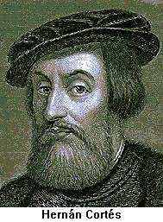
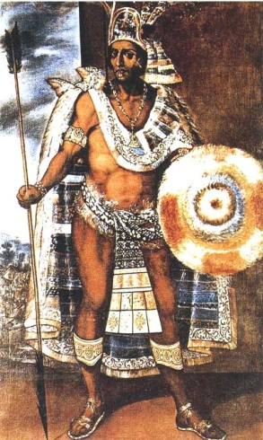
The “New World”
Conquistadors
Most advanced & complex civilizations in Central & South America=Aztecs & Mayas (Mexico) and the Incas (Peru)
Conquistadors = adventurers & soldiers of fortune on a quest for wealth conquered these civilizations
Hernan Cortéz = 1519: led 600 men, 17 horses, a cannon, & some muskets
Eventually took the city with 800 more Spaniards & 25,000 native allies; Aztecs surrendered in 1521
Francisco Pizarro & the Conquest of the Incas
Invaded Peru with only 180 men, 27 horses, & 2 cannons
Incas had 50,000 overconfident troops who thought the “white men’s” weapons were harmless
Incan ruler Atahualpá captured, then executed; many natives slaughtered
Empire fell apart without Atahualpá

Slide 8
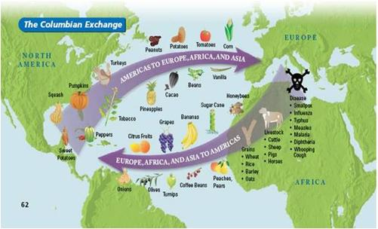
Impact of Colonization
Spain’s American Empire
mercantilism = idea that colonies existed for the benefit of the mother country
Colonies provided raw materials, food, gold, & silver; transported only on Spanish ships
Spain sold finished (manufactured) goods back to the natives

Slide 9
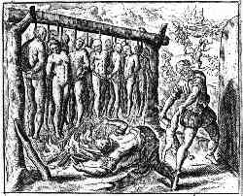
Impact of Colonization
Social & Economic Impact of Colonization
Changes in society:
Indians placed under new forms of government
Required to speak a new language
Converted (usually by coercion) to a new religion
Culture practically destroyed
Exploited & brutalized by a new labor system
South American slaughter:
Death of millions of natives
Murder & carnage of conquest & subjugation
Work conditions = long hours in hot sun or below ground in dangerous mines
Disease = epidemics such as smallpox (no immunity to European diseases)

Slide 10
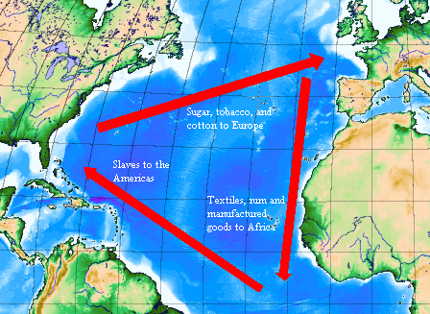
Impact of Colonization
African slavery:
16th century = Africans captured & shipped to replace native populations who were dying off in mines & on plantations
Economy of the empire:
Most important = gold & silver of Mexico & Bolivia
Other: sugar, tobacco, coffee, & cotton
The Pacific trade:
Centered in Manila (link between Spanish America & Orient)
Main product: silk

