Slide 1
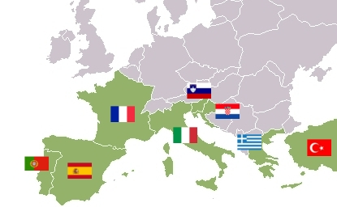
Southern Europe

Slide 2
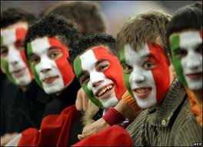
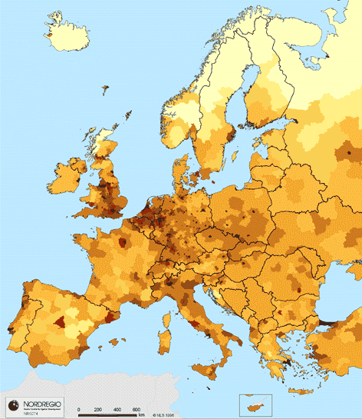
Population Patterns
The People
Italians- come from ancient Etruscans, Romans, etc.
Spanish- Iberians (prehistoric people)
Andorrans- Catalans (speak Catalan)
Greeks- Minoans and Mycenaeans
Portuguese- homogenous mix of early European groups
Density and Distribution
The most populated areas:
Rome (Vatican City), Athens, Madrid, Milan, Venice, Lisbon

Slide 3
History and Government
Early History
Two early civilizations laid the foundation of Western Europe
Greeks- peak=400-300 BC
Formed city-states- linked by language and culture
Athens introduced idea of democracy
Romans-peak= 27 BC-AD 180
Christianity became the official religion of the Romans shortly before its fall in the 400s
The eastern half of the empire survived and became the Byzantine Empire
Capital= Constantinople
Germanic groups that overthrew Rome established separate kingdoms
Kept Roman Catholicism
Italy remained fragmented for hundreds of years
711- Muslim group (Moors) settled in Spain

Slide 4
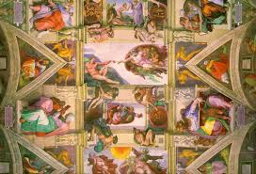
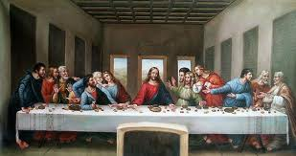
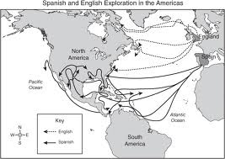
History and Government
The Renaissance was Europe’s period of artistic and intellectual achievement
Began in Italy in the 1300s
Wealth and stability of Italian states gave some the freedom to study and pursue new ways of thinking
These ideas and art would spread across the continent
1400s- Europeans began to explore throughout the world
1500s- Spain and Portugal became wealthy from their colonies in the New World

Slide 5
History and Government
Winds of Change
1800s and 1900s brought dramatic changes
Increased nationalism, independence movements, civil wars, dictatorships, and world wars marked this period
Spain and Portugal lost much of their territory overseas
Greece won independence from Turkey
Italy became united in the 1870s
World Wars
Much of the fighting of the world wars took place in Southern Europe
Spain remained neutral (civil war in the 1930s)
Allied with Western Democracies
Greece was ruled by a military dictatorship from 1967-1974
Today Southern Europe has democratically elected gov’ts
Members of the EU

Slide 6
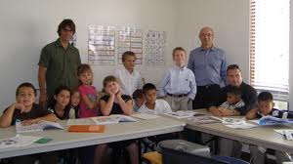
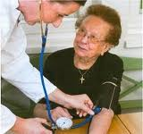
Culture
Education and Health Care
Literacy rates are above 95%
Strong gov’t support of education
Compulsory for all children
University education is more common
Health care varies from country to country
Spain has more doctors per person than many other countries
Greece, however, has been less successful
Gov’ts fund all health-care programs and provide other social services

Slide 7
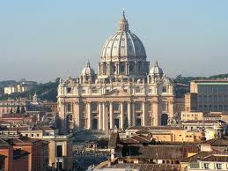
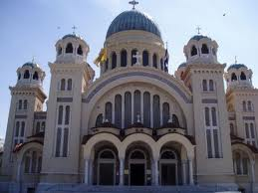
Culture
Language and Religion
Romance languages dominate the region
Derived from Latin
Italian, Spanish, Portuguese
Majority of the population in Italy, Spain, and Portugal are Catholic
In Greece, they belong to the Greek Orthodox Church
Italy and Spain have a growing Muslim population

Slide 8
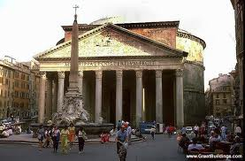
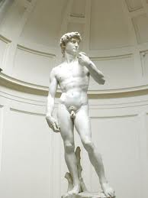
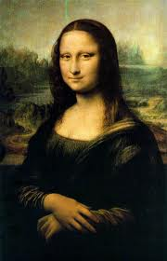
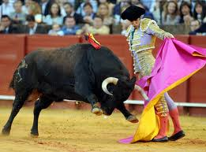
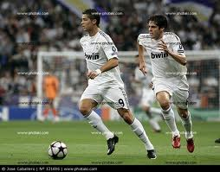
Culture
Arts and Leisure
Ancient Greeks and Romans developed basic architectural elements
Columns, arches, and domes
Most of the greatest works of art come from Southern Europe
Leonardo Da Vinci and Michelangelo come from Italy
Soccer is the most popular sport in Southern Europe
Bullfighting is an important tradition in Spain and Portugal

