Slide 1
Southern Africa

Slide 2
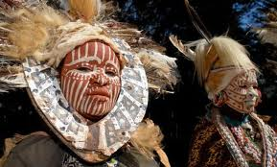
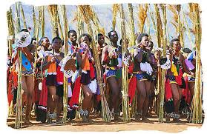
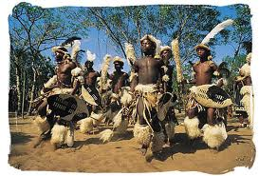
Population Patterns
The People
As with most of Africa, country borders separate politically, not ethnically
Some ethnic groups span political boundaries
Bantu ethnic group exist throughout most is S Africa
Swazi people migrated to what is now Swaziland
Have to contend with the Zulu population
Maintained strong political and cultural presence in south Africa
San people of Namibia are the best-known hunter-gatherers in the world
Bantu
Swazi
Zulu

Slide 3
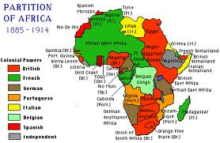
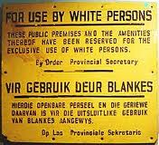
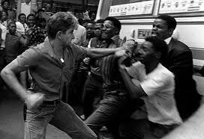
Population Patterns
Since colonial rule, tensions in southern Africa between white and black people have dominated certain countries
South Africa- law separated the population into white, black, mixed, and Asian
Black = majority
Whites (Afrikaners)- enacted strict codes that separated blacks and denied them voting rights

Slide 4
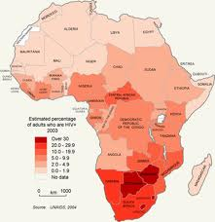
Population Patterns
Despite population explosions in parts of Africa, one factor may begin to limit it.
AIDS has spread rapidly throughout southern Africa
About 70% of the population living with AIDS/HIV live in this region
Disease expected to significantly reduce the population within the next 10 years
About 10.7 million children have lost at least one parent to AIDS

Slide 5
History and Government
European Colonization
People in Madagascar were trading with outsiders as early as 600 AD
Arabs and Europeans settled in the region for economic reasons
Some set up trading posts, while others colonized
Portuguese controlled Angola throughout the 1500s (strong slave trade)
Sent workers and slaves to Americas and other Portuguese colonies
In Mozambique, Portuguese built railroads to transport labor for mining and plantation work
Indigenous population did not benefit and were usually exploited
This led to conflict and movements for independence

Slide 6
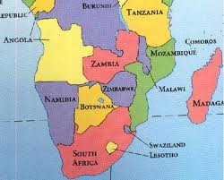
History and Government
Challenges after Independence
Most colonies experienced difficult transitions to independence
Angola got it quickly, though, with a coup de tat
Overthrew the Portuguese in 1975
Botswana got it quickly, too, and has been stable and economically successful
Zambia had vast resources, but few trained people were available to run the gov’t
Economy depends on foreign oversight
Civil wars in neighboring countries forced refugees into Zambia

Slide 7
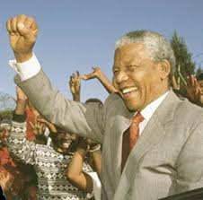
History and Government
South Africa became independent in the early 1900s
White minority population ran the gov’t
Imposed Apartheid- separation of the races
Non-whites were denied political rights and equality with whites in education, jobs, and housing
Internal unrest and international pressures forced them to end apartheid in the early 1990s
Nelson Mandela (most popular anti-apartheid leader)was freed after 27 years in prison.
1994- South Africa held its first election based on universal suffrage
Nelson Mandela became their first black president
Within a short time, they became committed to democracy
Many blacks live in poverty
Because of legacy of apartheid

Slide 8
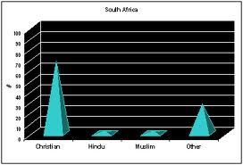
Culture
Language
Some languages are non-African
English, French, and Afrikaans were introduced by Europeans
Afrikaans- derived from language of early Dutch traders
Contains words taken from English, French, German, and African language
Religion
Christianity is most common
Traditional religions are also practiced
Education
Higher education has expanded in southern Africa
Mozambique- new schools and teaching training to match pace of pop. increases
Rural areas have lower literacy rates

Slide 9
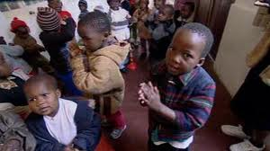
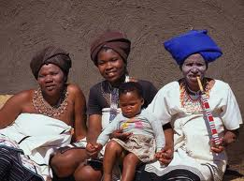
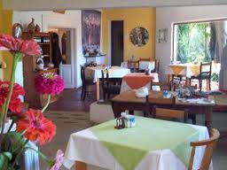
Culture
AIDS
Reached epidemic proportions
A child born in Zimbabwe is more likely to die from AIDS than anything else
Drug treatments cost too much there’s a lack of knowledge about how it’s spread
Causes the disease to spread faster
Leisure time
Rural areas- people spend their leisure time playing games and spending time with family
They embrace local culture, including music and dancing
Urban areas- enjoy a variety of culture
Western music and movies
Often wear western-style clothing, use cell phones, and watch TV

