Slide 1
Southeast Asia

Slide 2
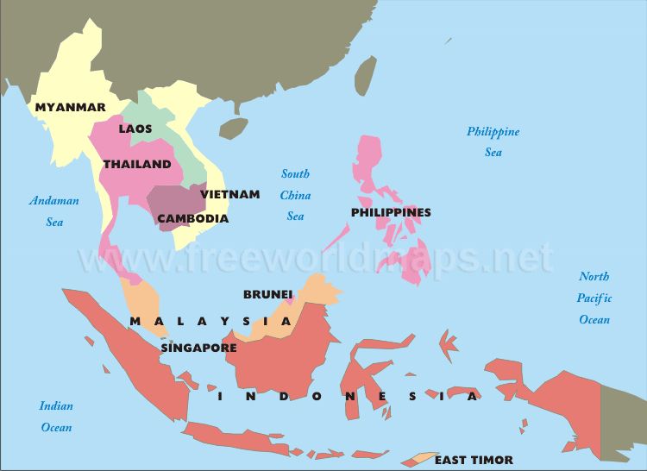
Southeast Asia
Mainland=Cambodia, Vietnam, Thailand, Myanmar, and Laos
Islands=Malaysia, Indonesia, Brunei, Singapore, and Philippines

Slide 3
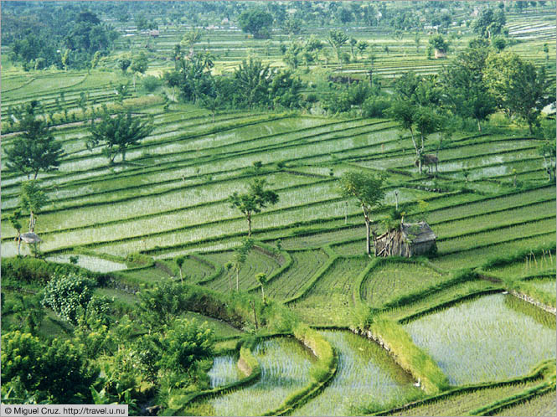
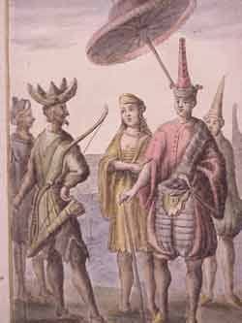
History and Government- Mainland
Early Civilizations
Early peoples were highly skilled farmers
Rice=most important crop
Skilled in metal works
Bronze was first cast in Thailand around 3000 BC
They worshiped ancestors, animals, and natural spirits
Kingdoms and Empires
Many civilizations developed on seaports
Became mariners (sailors)
Gained wealth through trade

Slide 4
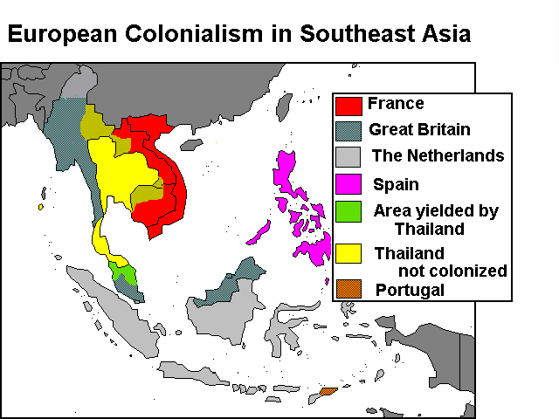
History and Government- Mainland
Western Colonization
By 1500’s, Europeans had arrived
Set up spheres of influence
Later gained SE Asia lands as colonies
Siam=only country to remain free
Freedom
After WWII, fought for independence
By 1965, all had gained it
Some still suffered instability
Myanmar’s military overthrew its gov’t in the 80’s
Instituted martial law- control and policing by military rules

Slide 5
History and Government- Mainland
Vietnam War
1954- Communist forces defeated the French
Vietnam was divided between North (communist) and South (non-communist)
US supported the south (containment policy)
By 1975- 2 Million Vietnamese and tens of thousands of Americans were dead
US left and Vietnam was unified under a communist gov’t
Cambodia
1975- communist forces (Kmer Rouge) took over
Forced people out of cities and onto farms
About 1 mil died from starvation, overwork, disease, or execution

Slide 6
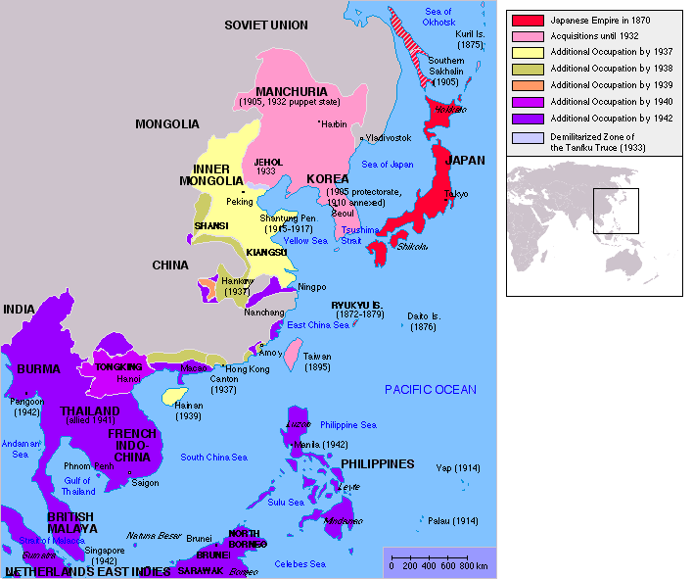
History and Government- Islands
Colonization and Freedom
Netherlands claimed most of the islands
UK controlled Brunei and Singapore
US controlled the Philippines
Brought infrastructure improvements
Replaced small farms with large commercial farms
SE Asians worked for wages
Japan occupied the islands in early 20th century
Philippines- about 1 mil died
US gave independence after WWII
After WWII – Europeans took over again
Insurrections led to independence
1998- Indonesia has moved towards a democracy
Brunei and Malaysia are constitutional monarchies

Slide 8
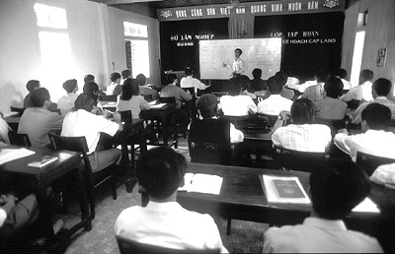
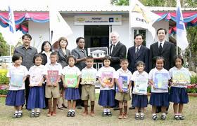
Culture
Education
Mainland- literacy is increasing
Gov’ts are working on improving education
There is a shortage of teachers and funds, however.
Islands- education and quality of life is increasing
Most children in Indonesia attend primary school
Literacy=88% (Indonesia and Malaysia)
93% in Philippines, Singapore, and Brunei

Slide 9
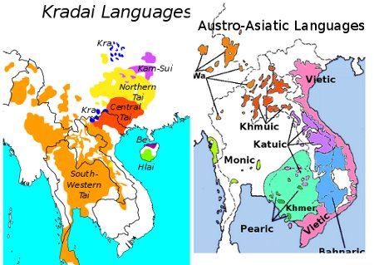
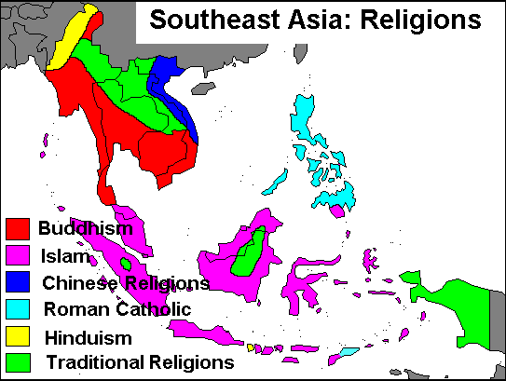
Culture
Language and Religion
Hundreds of languages and dialects
Most stem from Sino-Tibetan and Mon-Khmer
Many speak languages of their colonizers, as well
Nearly all of the major religions are practiced in SE Asia
Sometimes, they blend the religions
Islands- Islam is a major religion
Indonesia is largest Islamic country in the world
Majority of Filipinos are Catholic

Slide 10
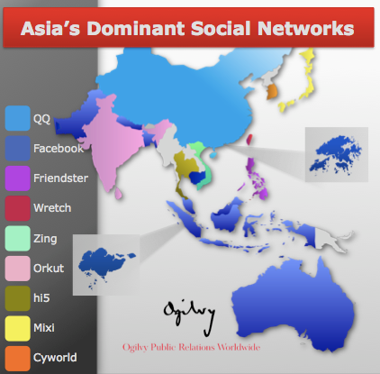
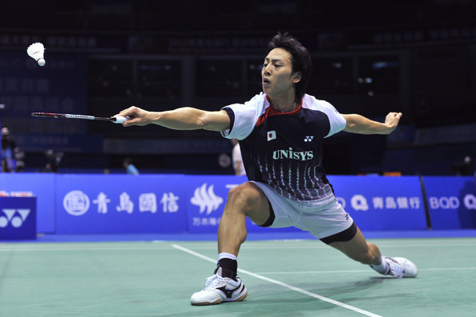
Culture
Leisure and Celebrations
Mainland- enjoy a variety of leisure activities
Cities- museums, theaters, parks, restaurants, night clubs
Rural- visiting neighbors, celebrating family occasions
Islands- very diverse
Singapore- pop culture is based on modern mass media
Most popular sport=soccer and badminton
Celebrations include religious and national holidays
Chinese New Year and Muhammad’s Birthday are observed by most on the islands

