Slide 1
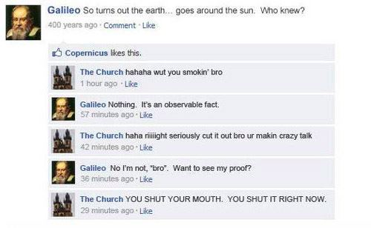
DAILY FOCUS SKILL:
Why do you think the Church wanted to keep people believing that the Earth was the center of the universe?

Slide 2
The Scientific Revolution

Slide 3
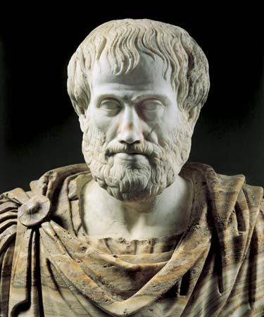
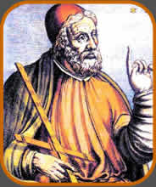
How did thinking change?
Medieval scientists did not make observations
Looked at the works of Aristotle for knowledge
Renaissance thinkers studied newly discovered works of Ptolemy, Archimedes, and Plato
Learned that some had disagreed with Aristotle
Tried to reconcile the differences

Slide 4
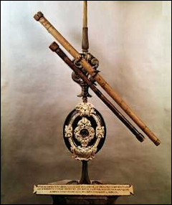
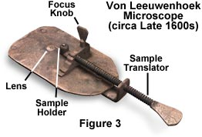
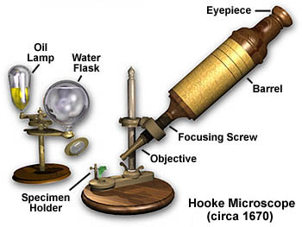
How did thinking change?
Technical problems, like determining how much a ship could carry spurred a movement towards observation and experimentation.
New instruments, like telescope and microscope, will make these experiments possible
They used mathematics to lead these experiments

Slide 5
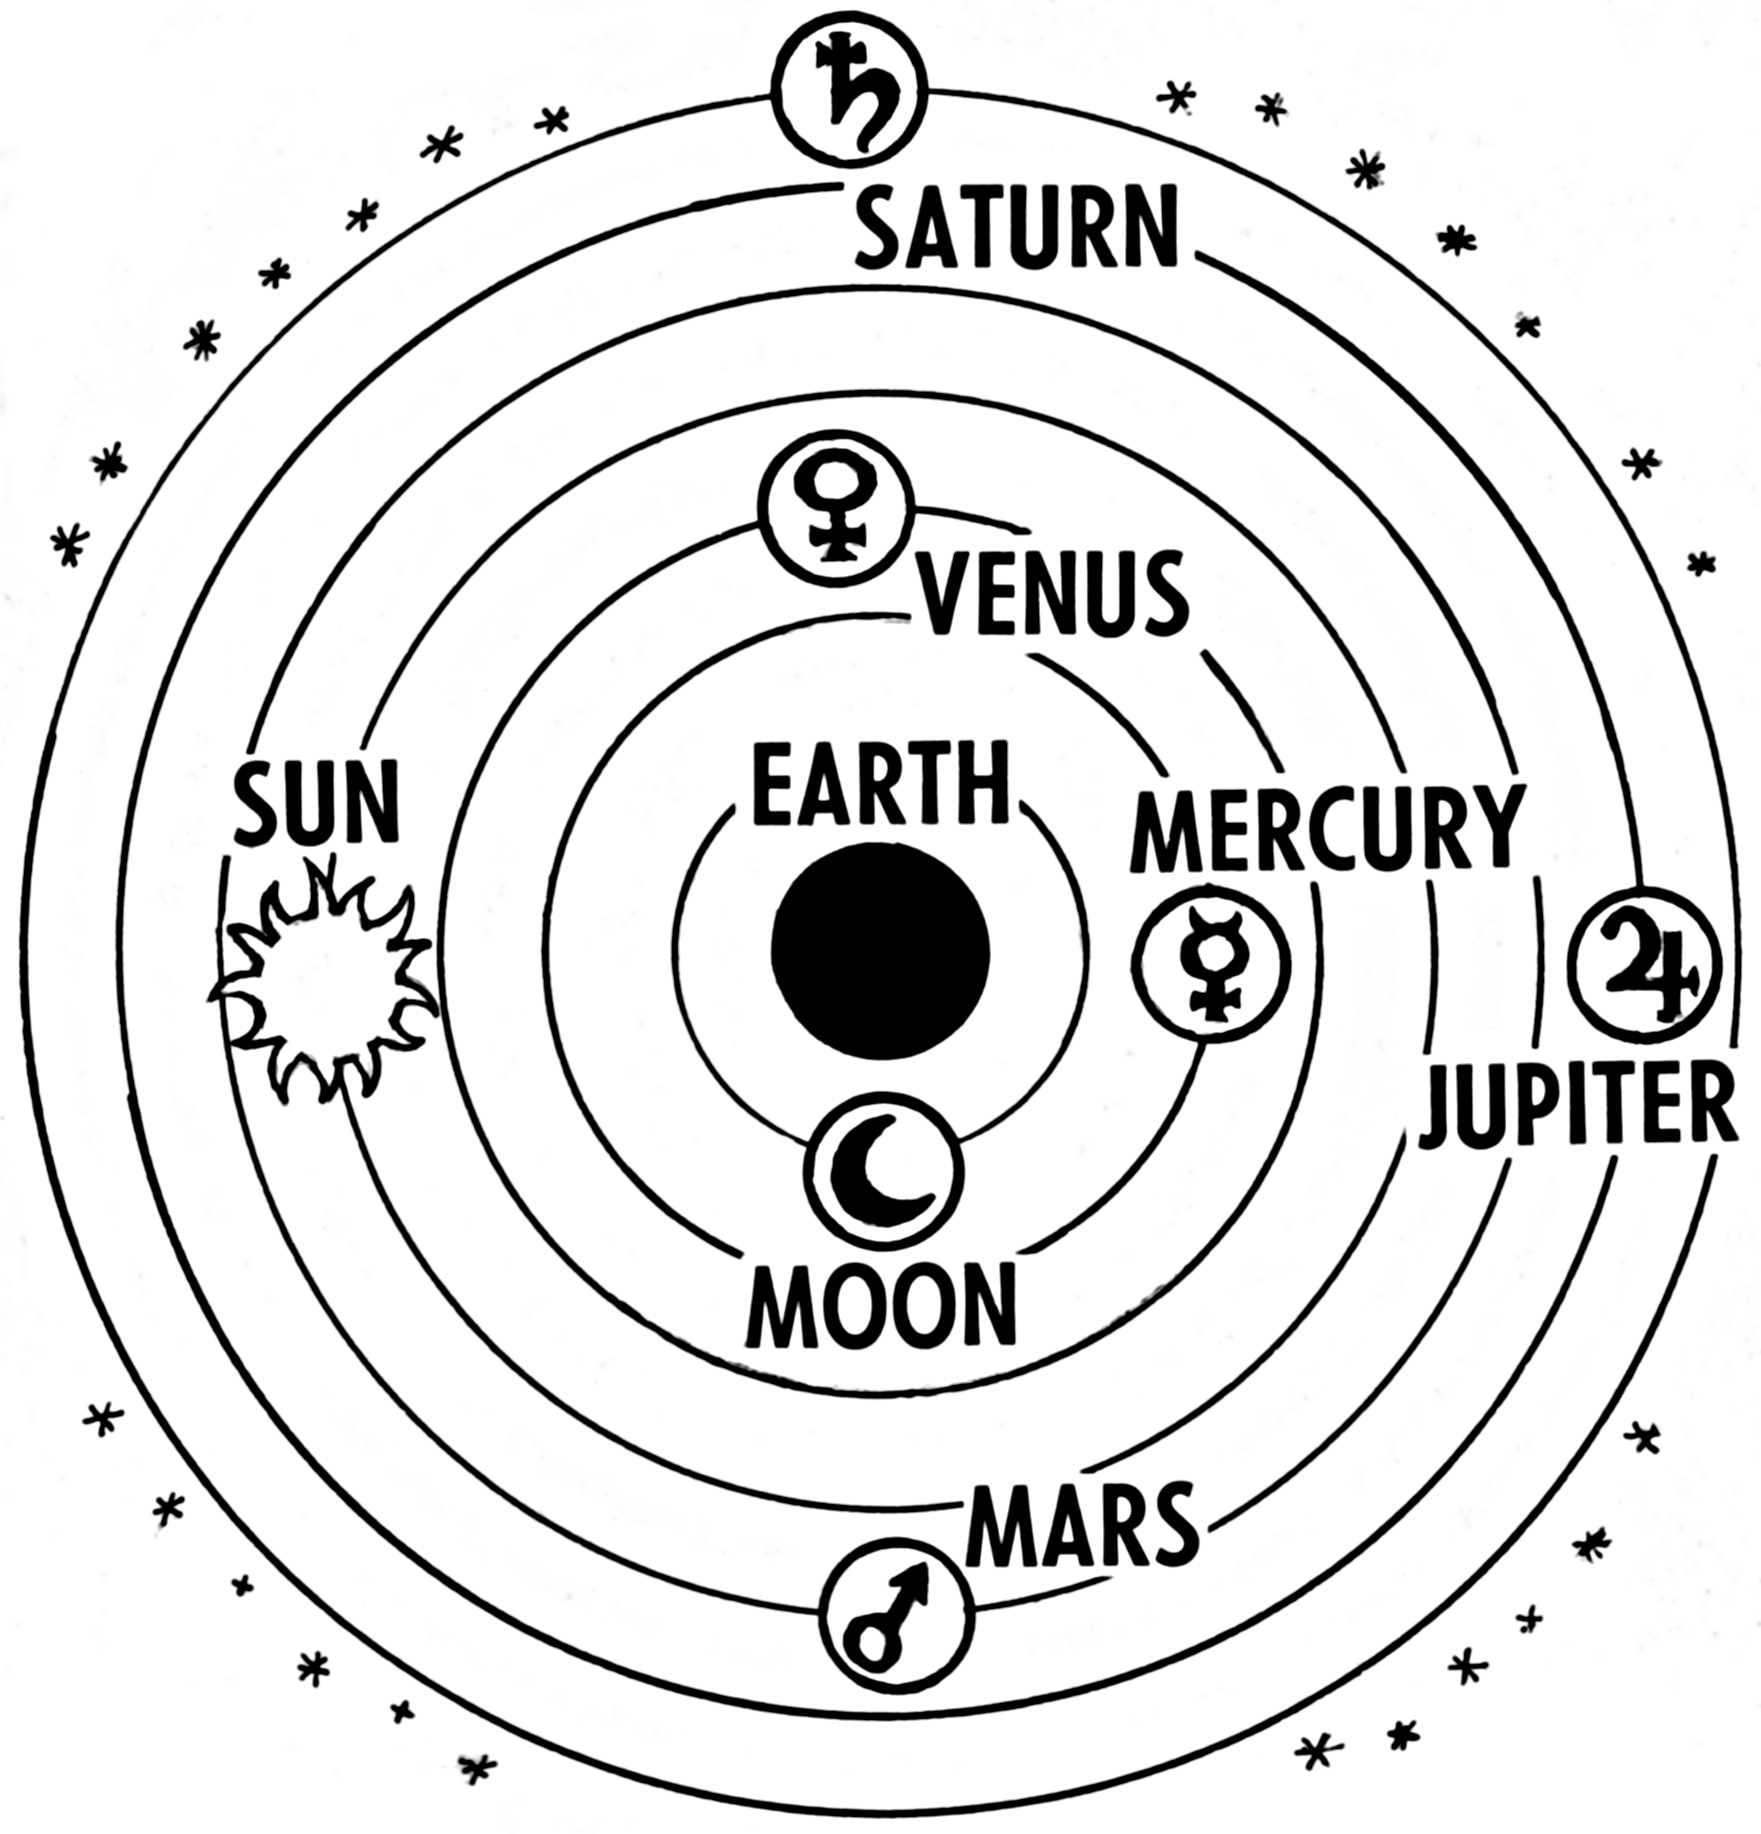
Astronomy
Born in 2nd Century AD, Ptolemy was antiquity’s greatest astronomer
Ptolemaic system= geocentric model of the universe
Earth (motionless) is in the center
Planets are different crystal-like spheres
10th sphere=prime mover
It moves, so everything inside its path moves
Beyond this, is Heaven

Slide 6
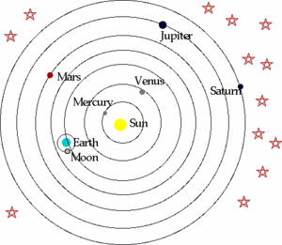
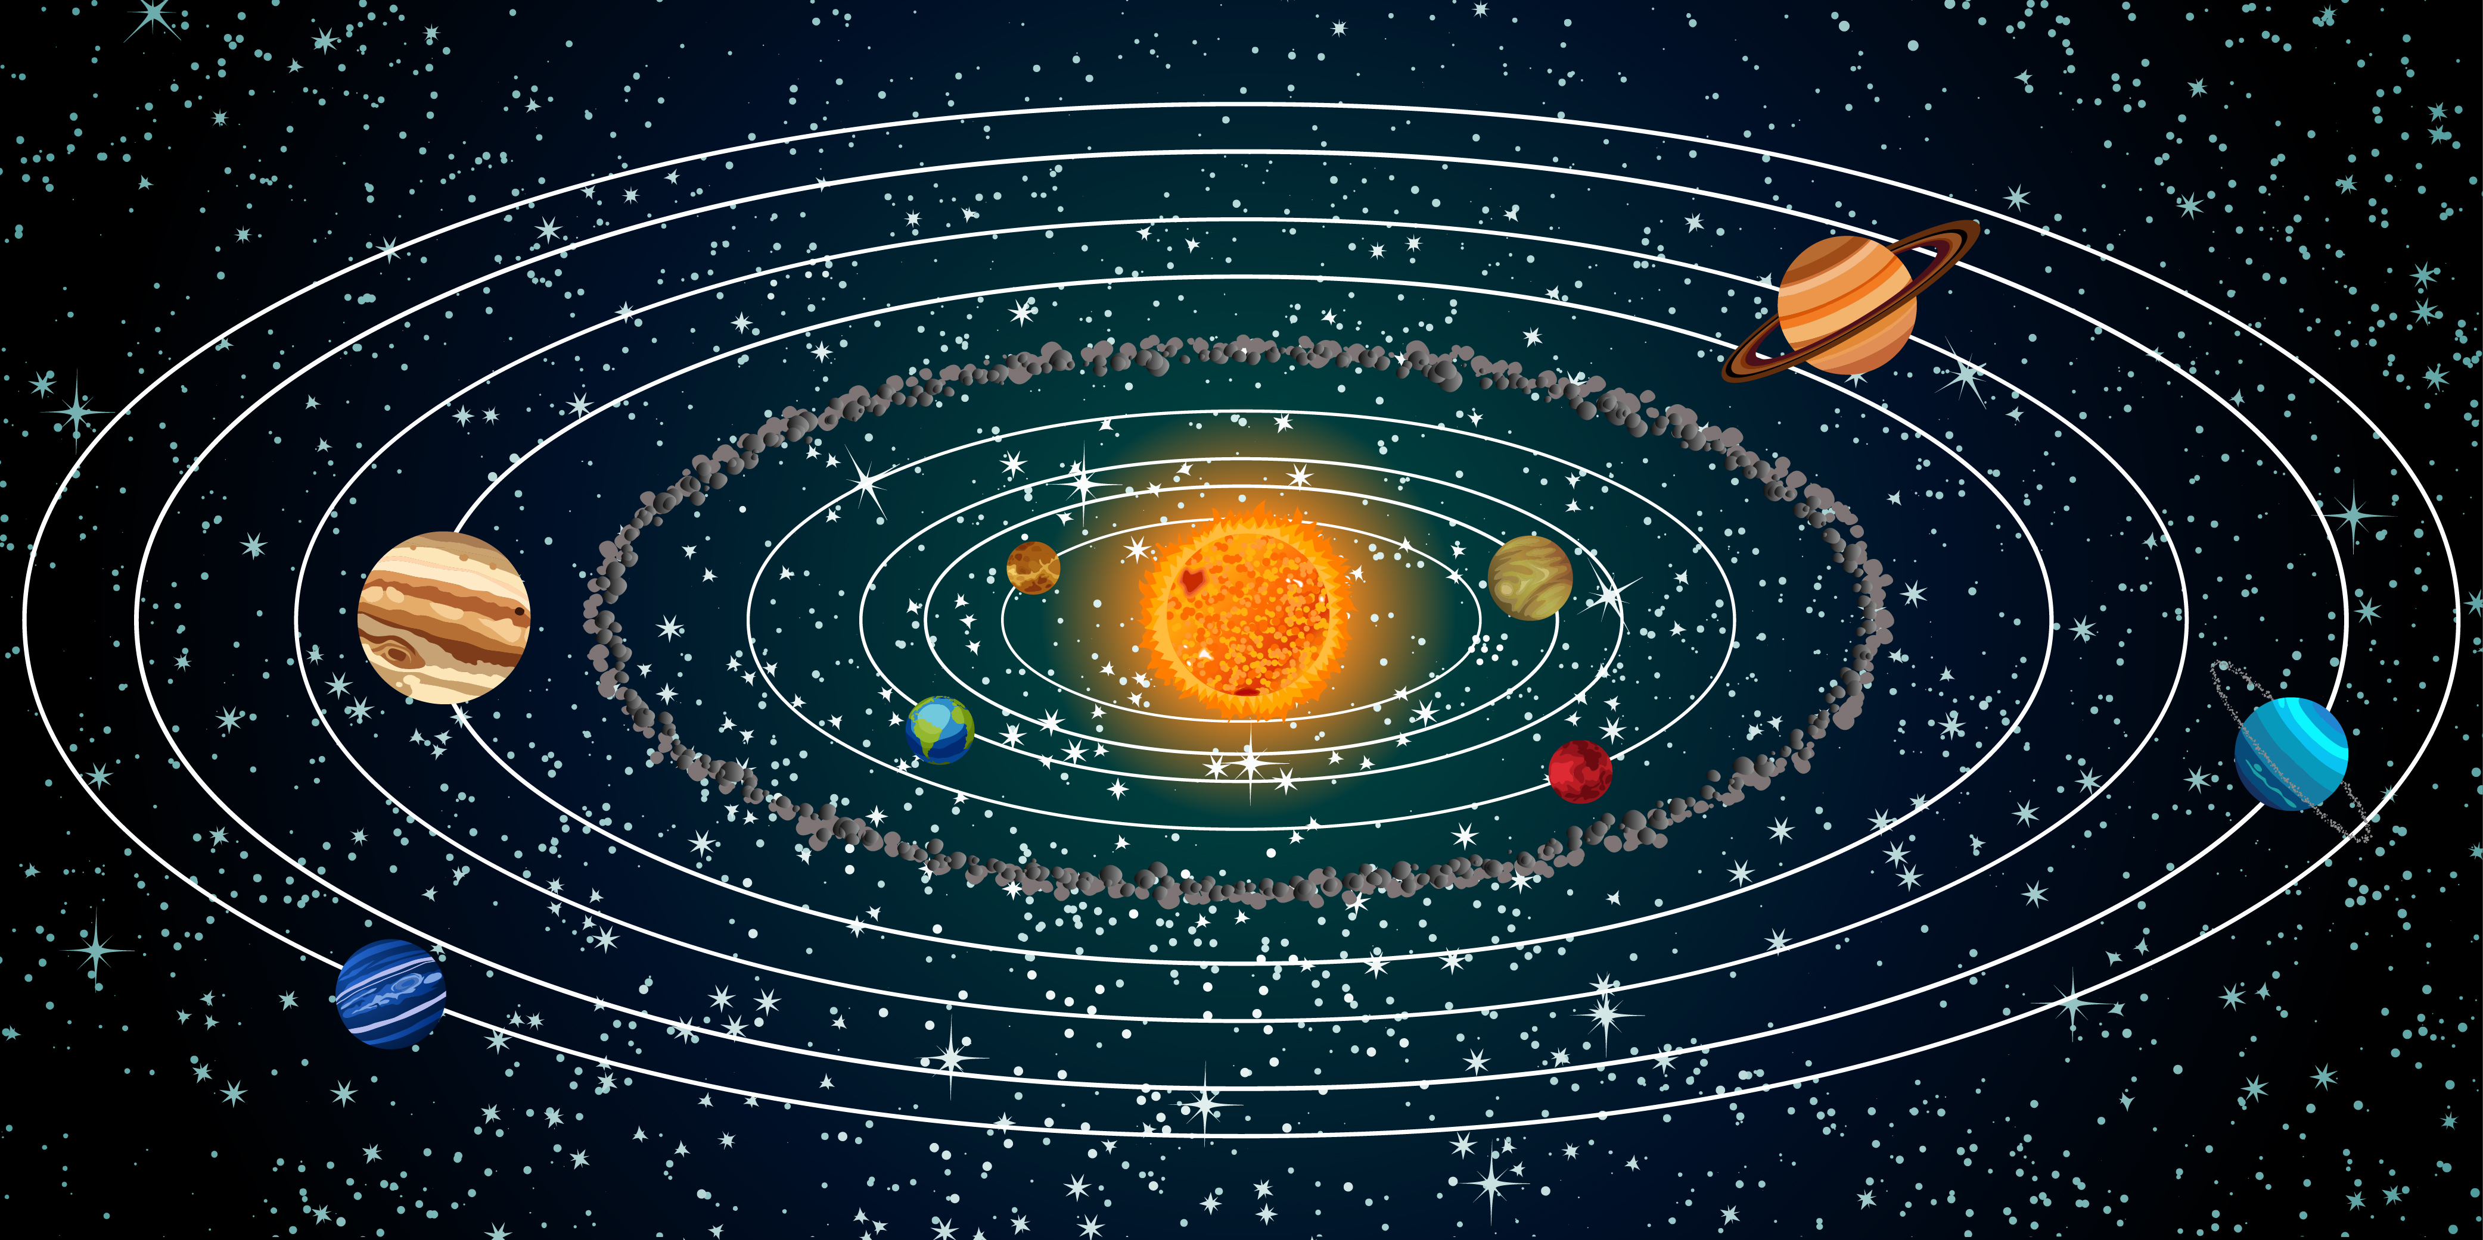
Astronomy
Nicholas Copernicus believed in his heliocentric system
Sun is in the center
Planets revolve around the sun, the moon around the Earth, and Earth rotates on an axis
Johannes Kepler helped to destroy the Ptolemaic system
Observations confirmed the sun was the center
Tracked elliptical orbits of the planets
Ptolemy said they were circles

Slide 7
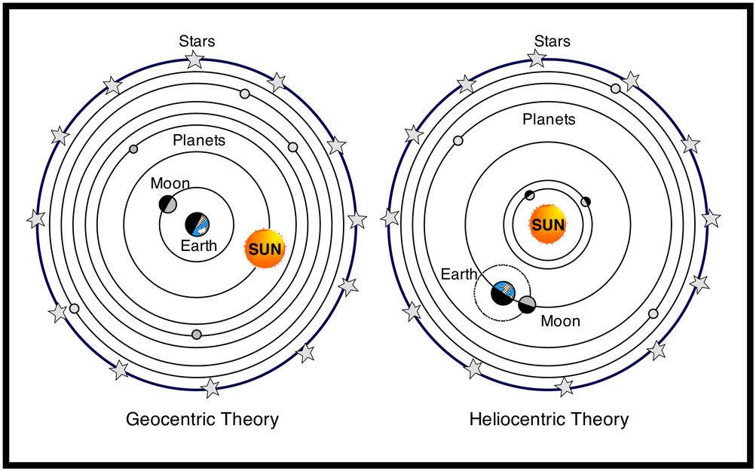

Slide 8
Astronomy
Englishman Isaac Newton responded to one of the questions for the new model of the universe: What explains motion in the universe?
He defined 3 laws of motion
Crucial to his view is the universal law of gravitation
Every object in the universe is attracted to every other object by a force called gravity
This explained why planetary bodies did not go off in a straight line, but traveled in elliptical orbits
This dominated the worldview until Einstein’s Theory of Relativity

Slide 9
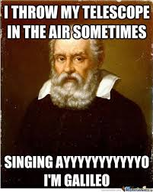
Astronomy
Galileo Galilei answered the other question for the new astronomy: What are the planets made of?
He made regular observations using a telescope
Saw mountains on the moon and moons orbiting Jupiter
Ptolemy said they were made of light, but now it seems they are made of material

Slide 10
Galileo vs. The Church
Galileo’s work began to make Europeans aware of the new view of the universe
He got into trouble with the Catholic Inquisition
The Pope ordered him to abandon the new system
Copernican model contradicted that of the Church and the Bible
The heavens were not spiritual but material, and God was no longer in a specific place
Most astronomers, however, believed the new model was correct

