Slide 1
Russian Culture

Slide 2
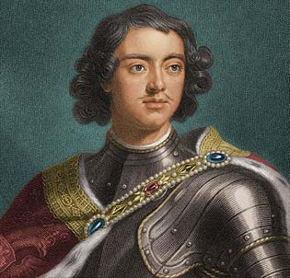
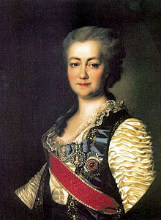
History and Government
Romanov Czars and the Empire
Russia was left behind as W. Europe thrived
Czar Peter I (the Great) worked to modernize Russia
Gained land and seaports
New capital- St. Petersburg (major port)
Catherine the Great expanded the empire
Gained ports on the Black Sea
New lands=serfdom expanded (lived in poverty)
Alexander III expanded into Siberia
1916- made Trans-Siberian Railroad (6,000 miles long)

Slide 3
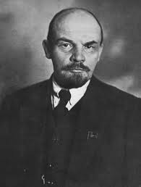
History and Government
Revolution and Change
Many former serfs moved to cities- faced poor conditions and meager wages
Russification- forced Non-Russians to speak Russian and adopt Eastern Orthodoxy
Harshly persecuted if you refused, especially the Jews
Discontent led to the rise of socialism
Calls for greater economic equality (public ownership of land and a classless society)
Bolsheviks overthrew Nicolas II in 1917
Killed him and his family
Led by Vladimir Lenin

Slide 4
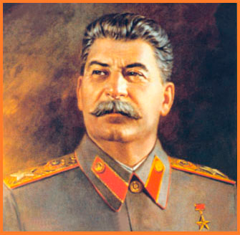
History and Government
The Soviet Era
Bolsheviks took control easily, promising the people “Peace, Land, and Bread!”
Established the Union of Soviet Socialist Republics (USSR) in 1922
Regained Ukraine, Belarus, and parts of the Caucus region and C. Asia
Lenin died in 1924, Joseph Stalin took over
Took control of farms and factories
Became an industrial giant
He eliminated anyone who disagreed with him
Killed about 20 million
Either killed or died from hunger, physical hardships or brutal conditions in labor camps

Slide 5
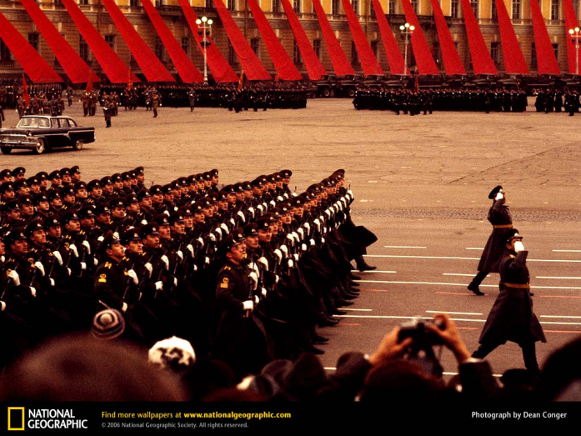
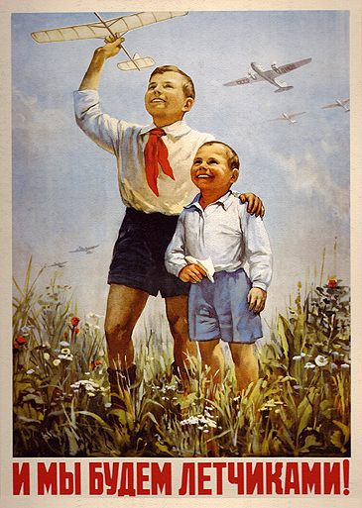
History and Government
A Superpower
After WWII, they gained superpower status (control most of E. Europe)
By 1949 most of these countries were satellites of the USSR
Soviet Union vs. United States= Cold War
Competed with each other for world influence and power
Both had nuclear weapons
Most used weapons= propaganda, threats, aid to other nations

Slide 6
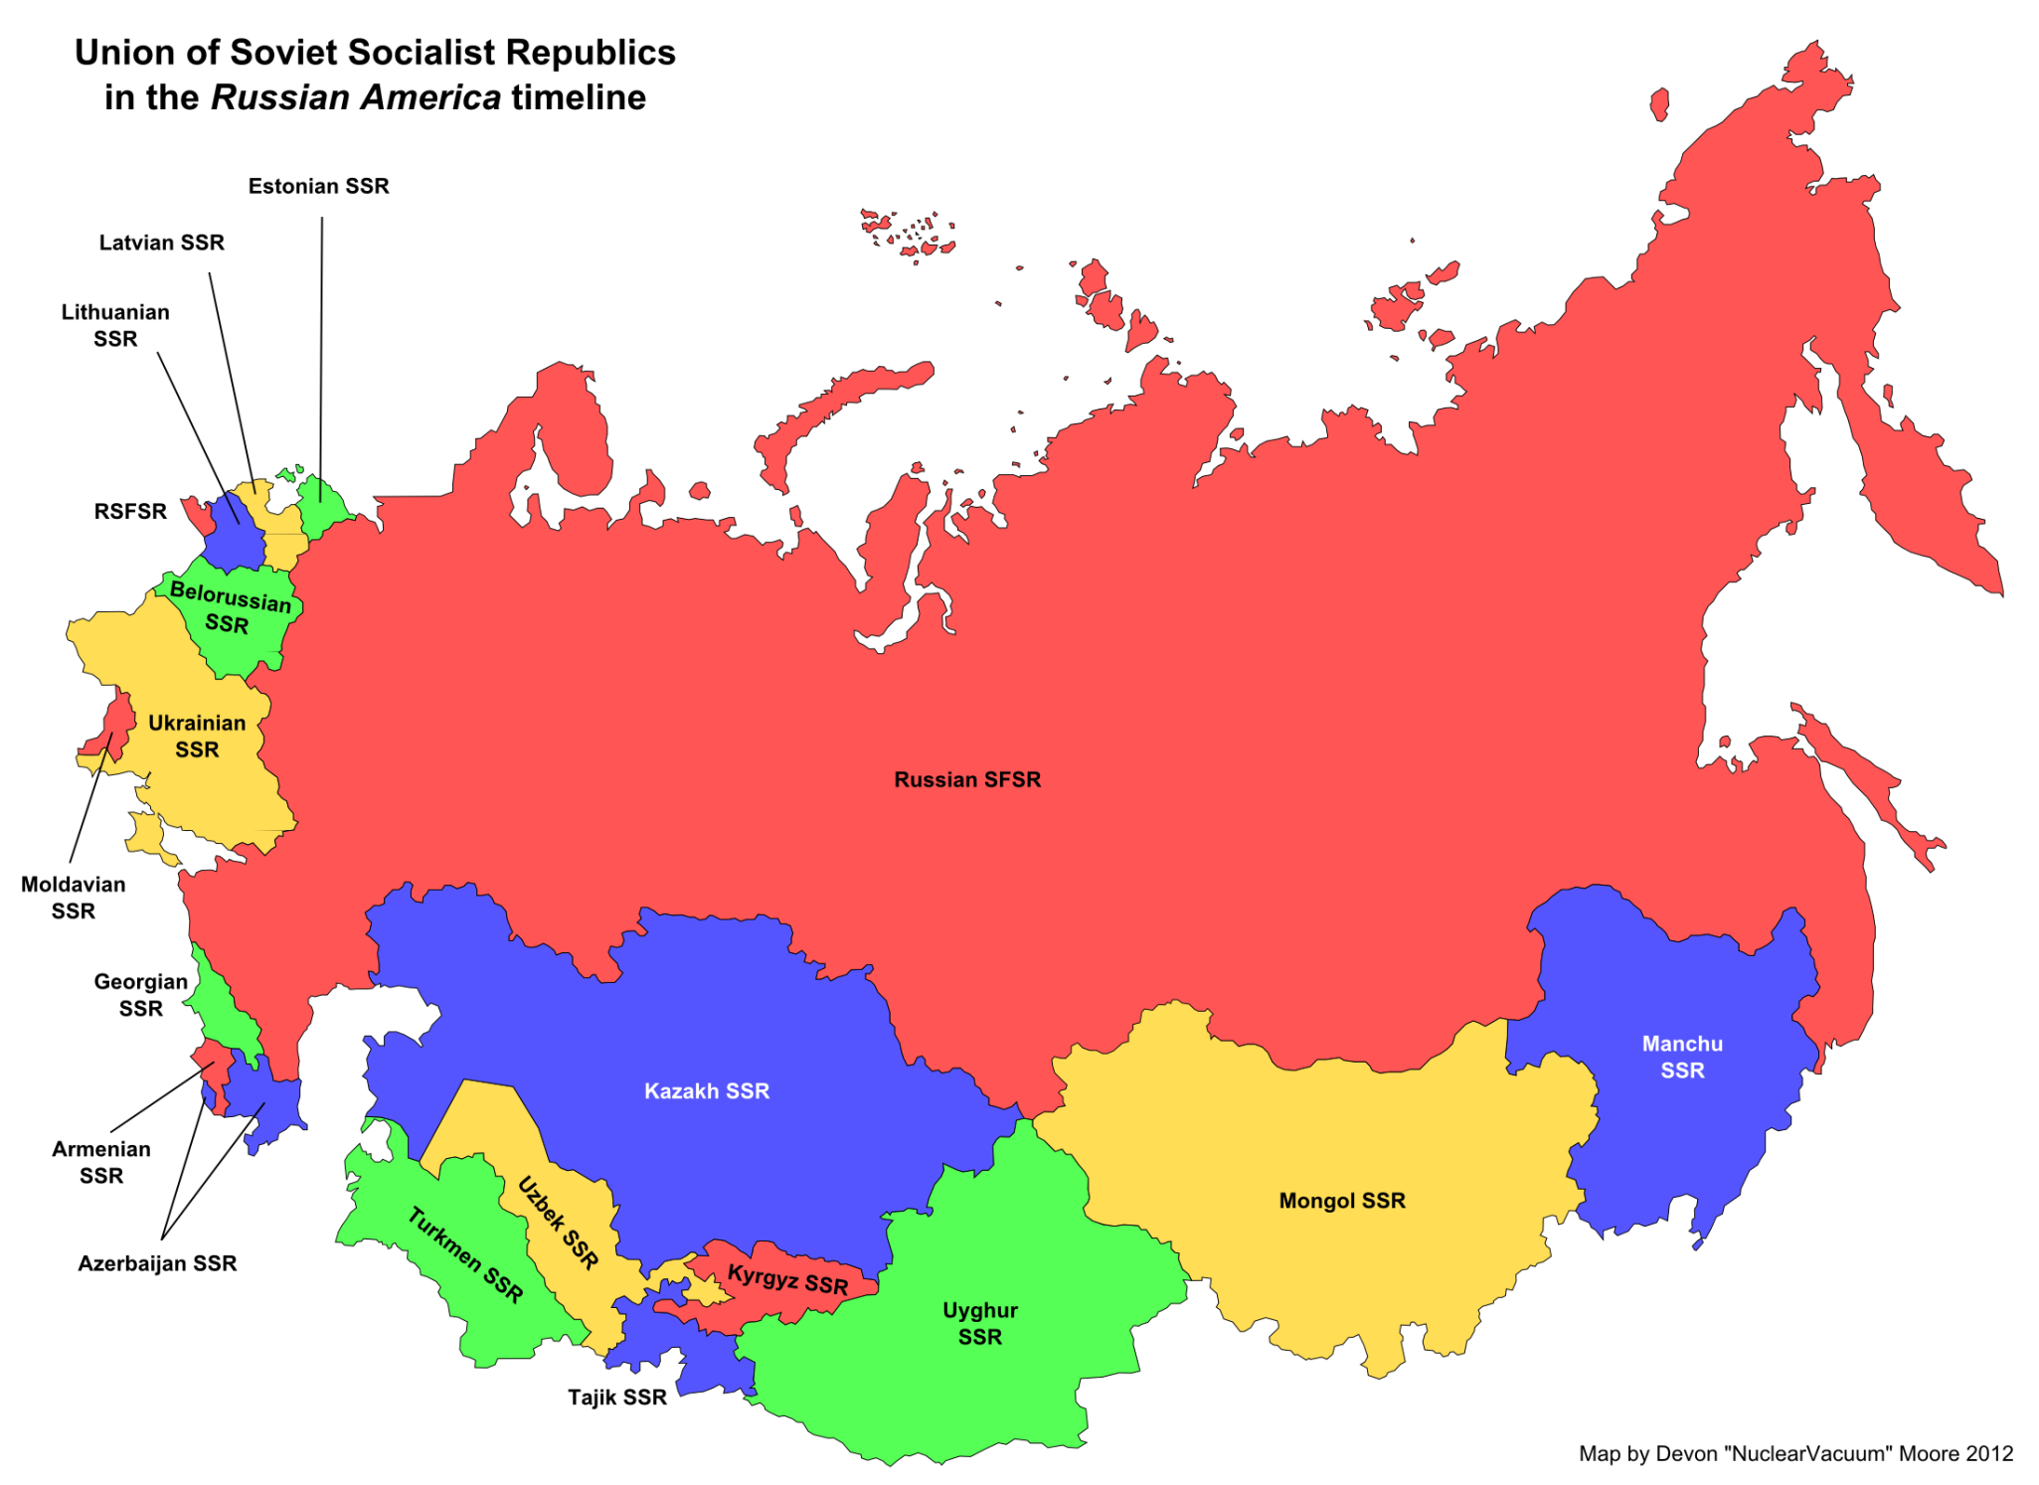

Slide 7
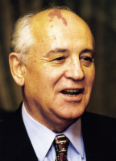
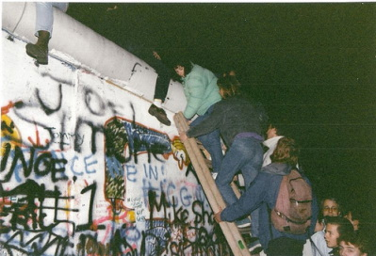
History and Government
Fall of the Soviet Union
Fell due to weakening economy and the gap between the leaders and the poor
1985- Mikhail Gorbachev gained power
Perestroika- economic restructuring
Glastnost- greater political openness
Many satellites overthrew their rulers in 1989
Berlin Wall came down Nov. 9, 1989
Boris Yeltsin was elected first president of the Russian Republic

Slide 8
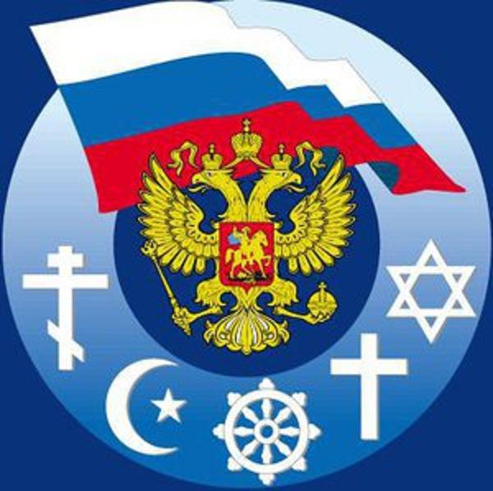
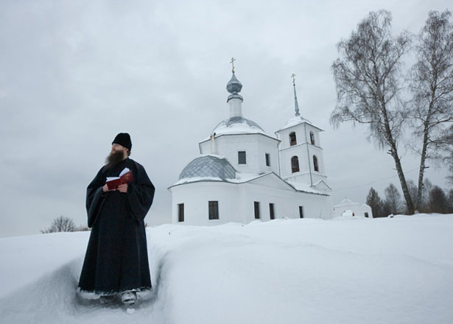
Culture
Language and Religion
Official language= Russian, but more than 100 are spoken in Russia
Many are bilingual
Soviets discouraged religion and promoted atheism
Influx of missionaries came to Russia after the fall of the USSR
Gov’t officials restricted religious groups in 1997
Only Russian Orthodoxy, Islam, Judaism, and Buddhism were allowed full liberty as traditional religions of Russia
Most Russians are Russian Orthodox

Slide 9
culture
Education
During Soviet era, education was free, but mandatory
Focused on math, science, and engineering- became technologically focused
Intelligentsia- Intellectual elite
After the Fall, curriculum has taken a more balanced approach
Teach language, history, literature, etc.
Teachers are paid very little and
often quit
Students focus on earning
money, not education

Slide 10
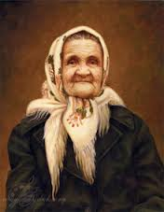
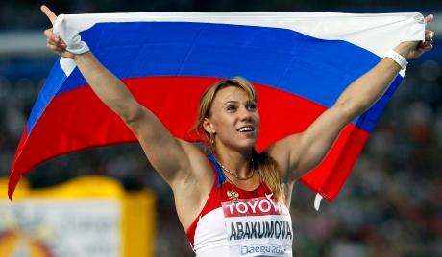
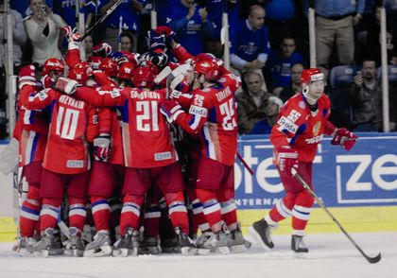
Culture
Family Life and Leisure
Most families live in apartment blocks (housing shortage)
Very small (1 BR, 1 bath for a family of 4)
Extended family often live together
Ex. Grandmas or Babushkas often live with their children and grandchildren.
Concerts, ballet, and theater provide entertainment
Sports are also popular
Tennis, track and field, figure skating, and ice hockey are most popular

