Slide 1
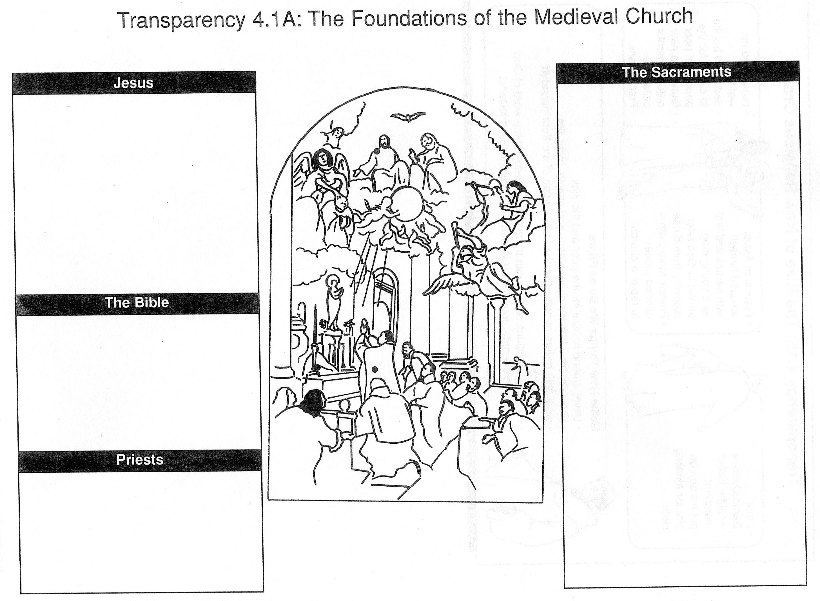
Baptism: admittance into the Church
Confirmation: Holy Spirit conferred upon those becoming adult members
Eucharist: central part of mass
Reconciliation: forgiveness by God for an act a person regrets
Marriage: formal union of man and woman
Ordination: becoming a priest
Last rites: final blessing for sick and dying
used parables to explain message of love & morality
Christians believed in his miracles
Crucified
Apostles spread religion
Peter brought it to Rome
Gospels (stories of Jesus) written 100 yrs after his death
Old Testament + New = Christian Bible
Early leader St. Paul and Apostles were 1st priests
Over time, only specially trained men could administer sacraments

Slide 2
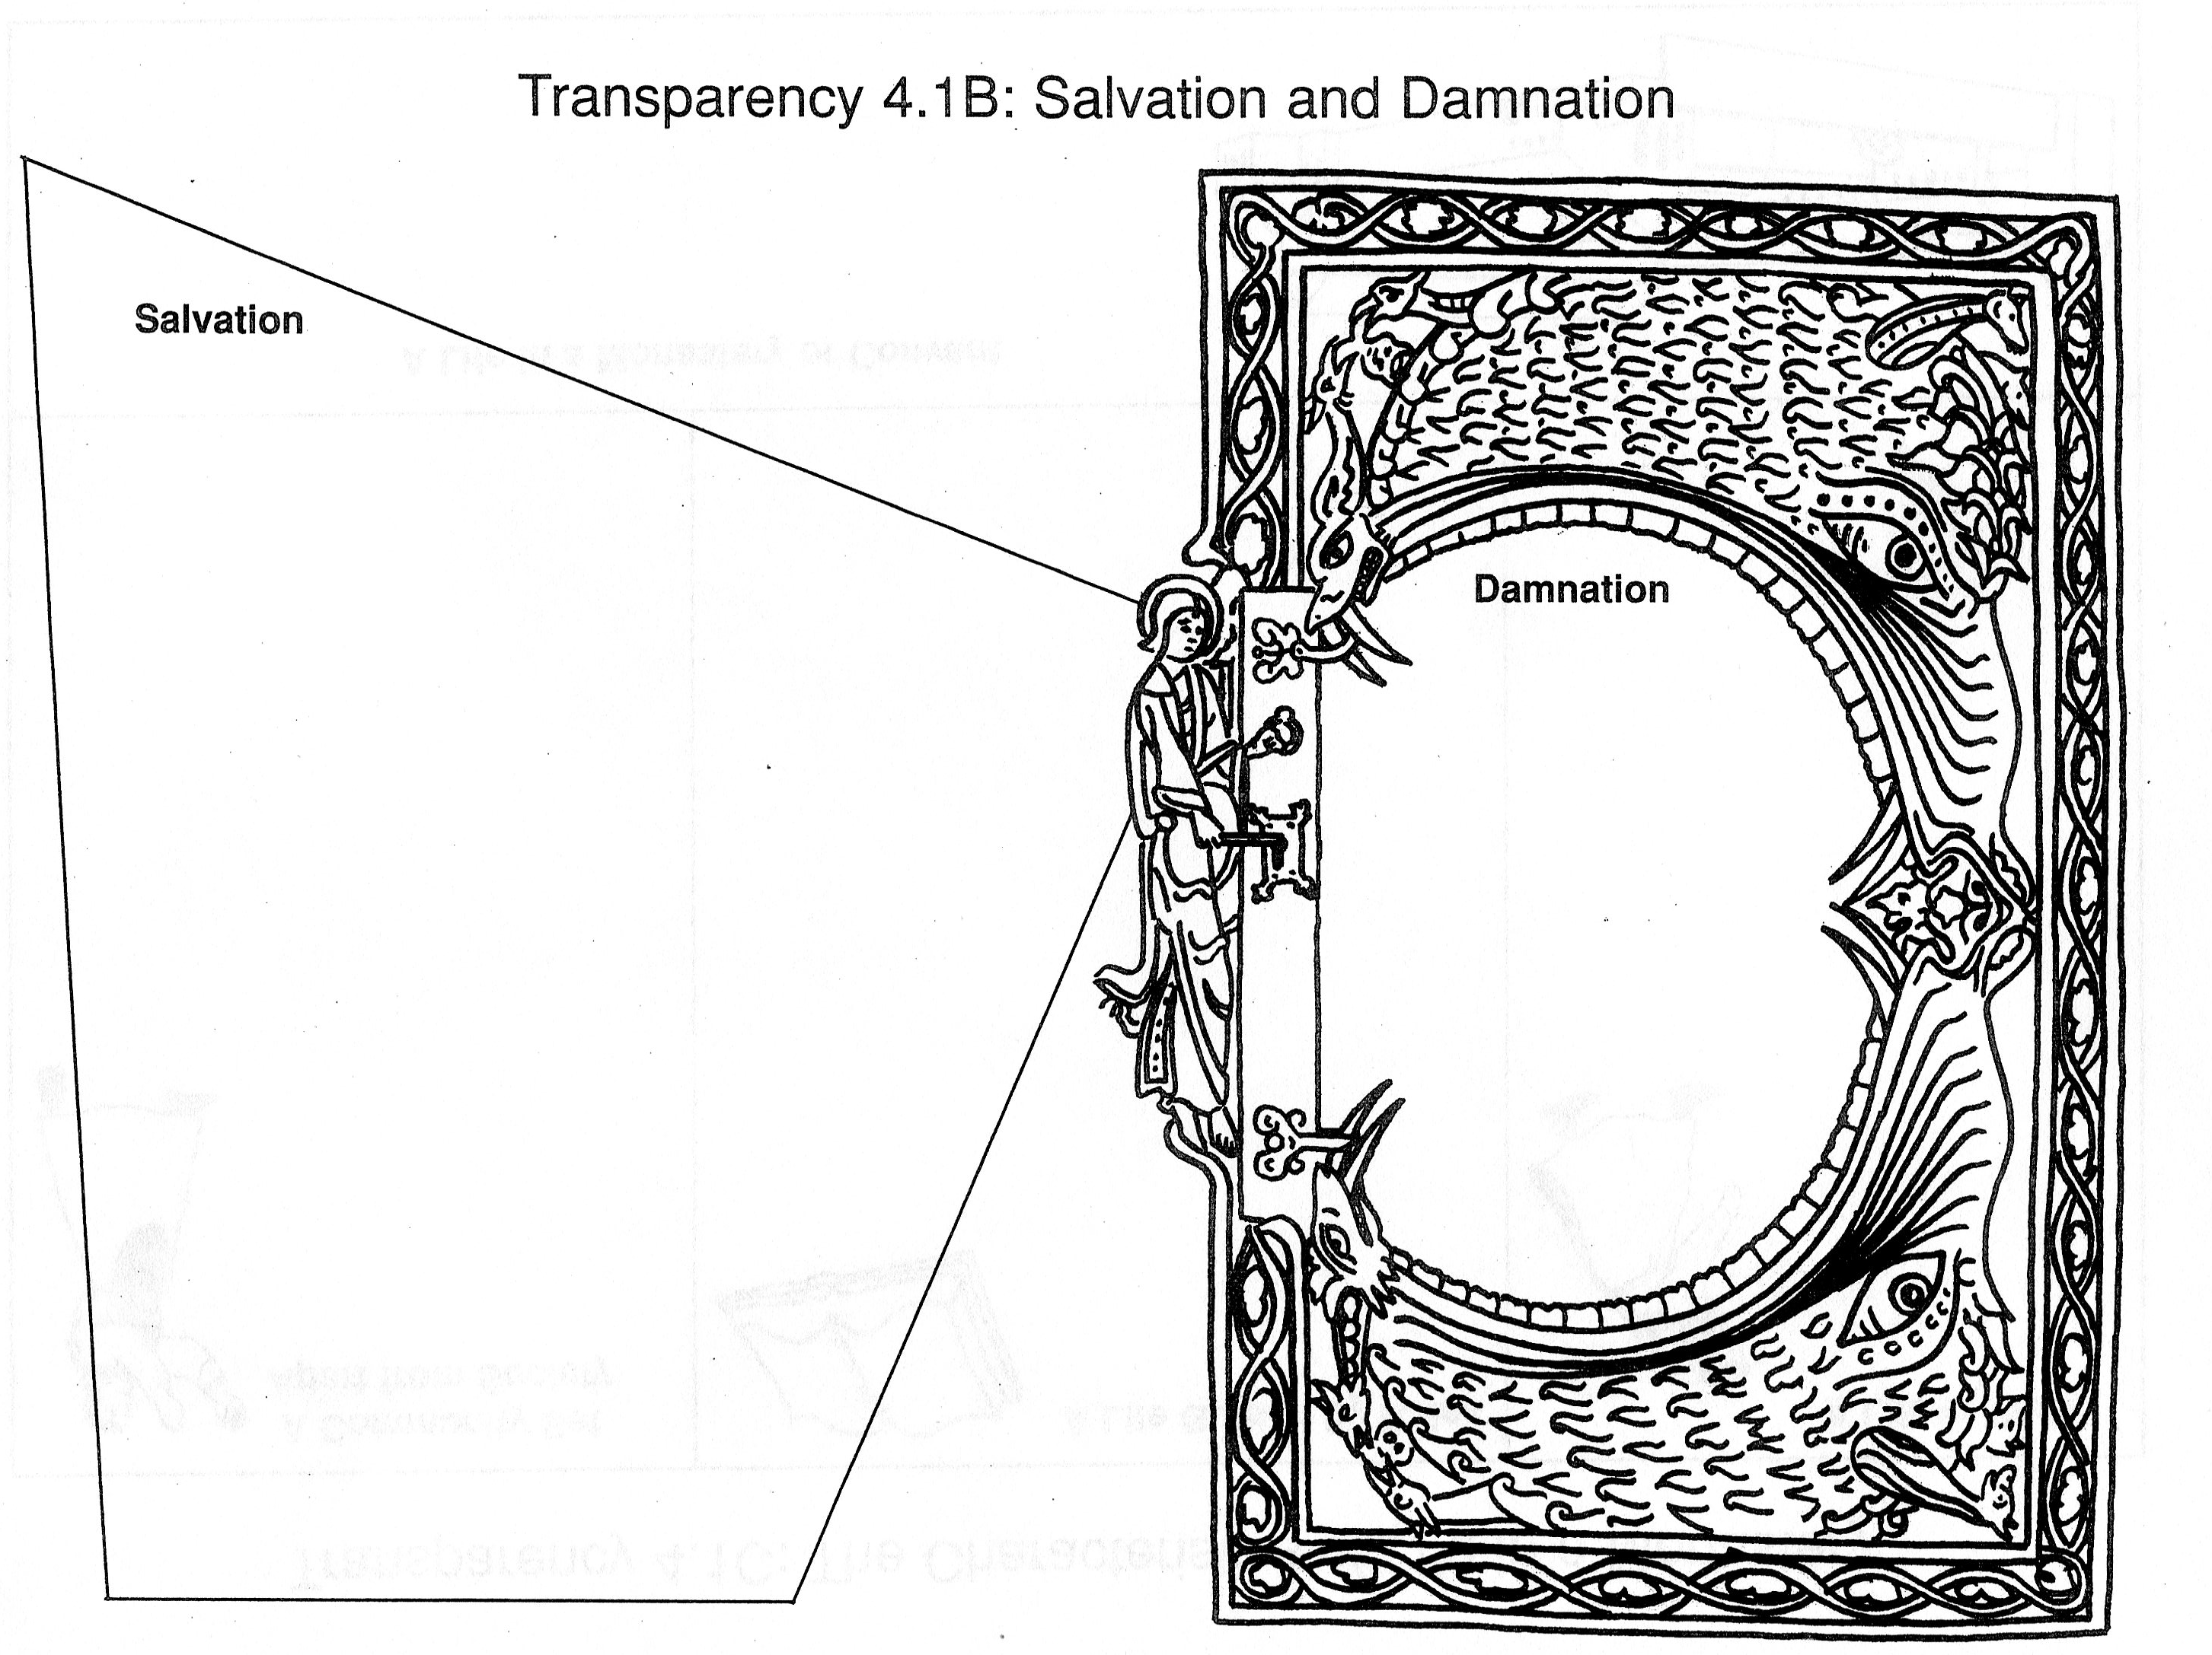
Salvation=saving
Salvation was gained through:
Following the beliefs of the church
Performing good deeds
Living a moral life
Christian believed that salvation would help their souls enter Heaven
Damnation is result of living a life of sin
Souls banished to Hell
Hell ruled by Lucifer, who was cast out of Heaven
Souls tortured by fire & demons

Slide 3
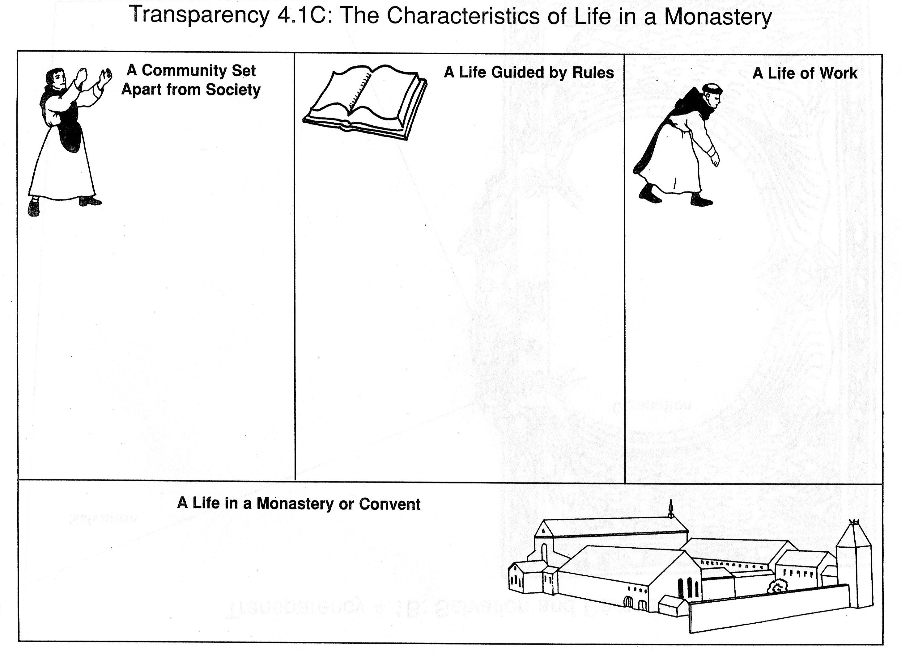
St. Benedict renounced wealth, founded Italian monastery in 529
Wrote “The Rule,” a set of rules for monks to live by
Duties: work, study, pray
Vows: chastity, poverty, and obedience
Monasticism= life led by monks and nuns
Nuns and monks wanted to avoid war, sickness, sin, corruption, and wanted to serve God and fellow Christians
Self-sufficient tasks: farming, cooking, sewing, building, etc.
Charitable tasks: hospitals, refuge for homeless, food for poor, lodging for travelers, and sacraments
____________
Led by an abbot (elected by monks); convents led by abbess
Bound by the abbey church
Dormitory, where monks slept
Refectory, where monks ate
Library and scriptorium, where monks wrote
____________
______________________
____________

Slide 4
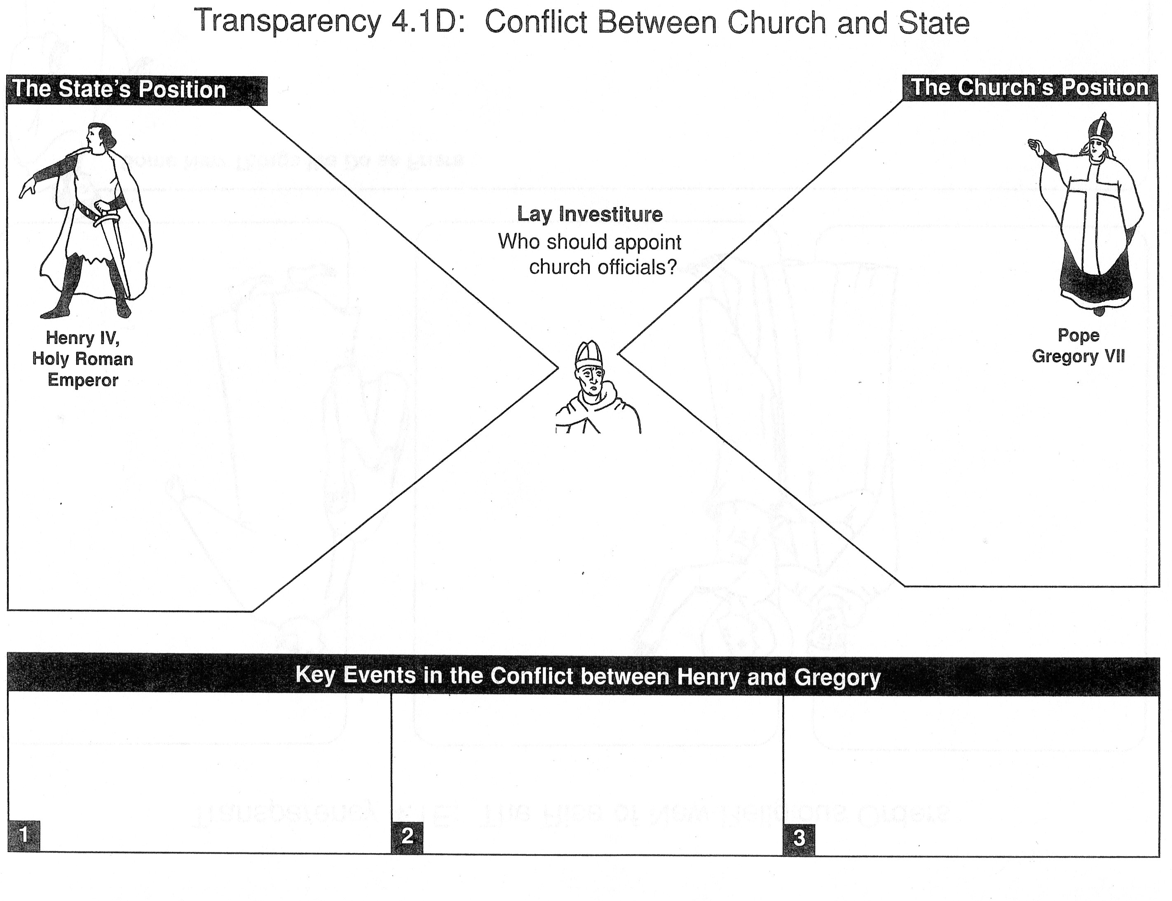
Angered by Pope Gregory’s actions because he needed church leaders to support him against powerful German lords
Wanted to reform corrupt church leaders who plotted with kings to increase wealth and power
In 1075 outlawed lay investiture
Threatened to excommunicate any who disobeyed
Henry IV demanded that Gregory VII resign
Henry IV was excommunicated
Henry realized he couldn’t defeat the pope
Begged for forgiveness
With help of Countess Matilda, Henry was forgiven
Resolved by Concordat of Worms
Church officials could appoint church leaders
Kings could give titles and land to church officials

Slide 5
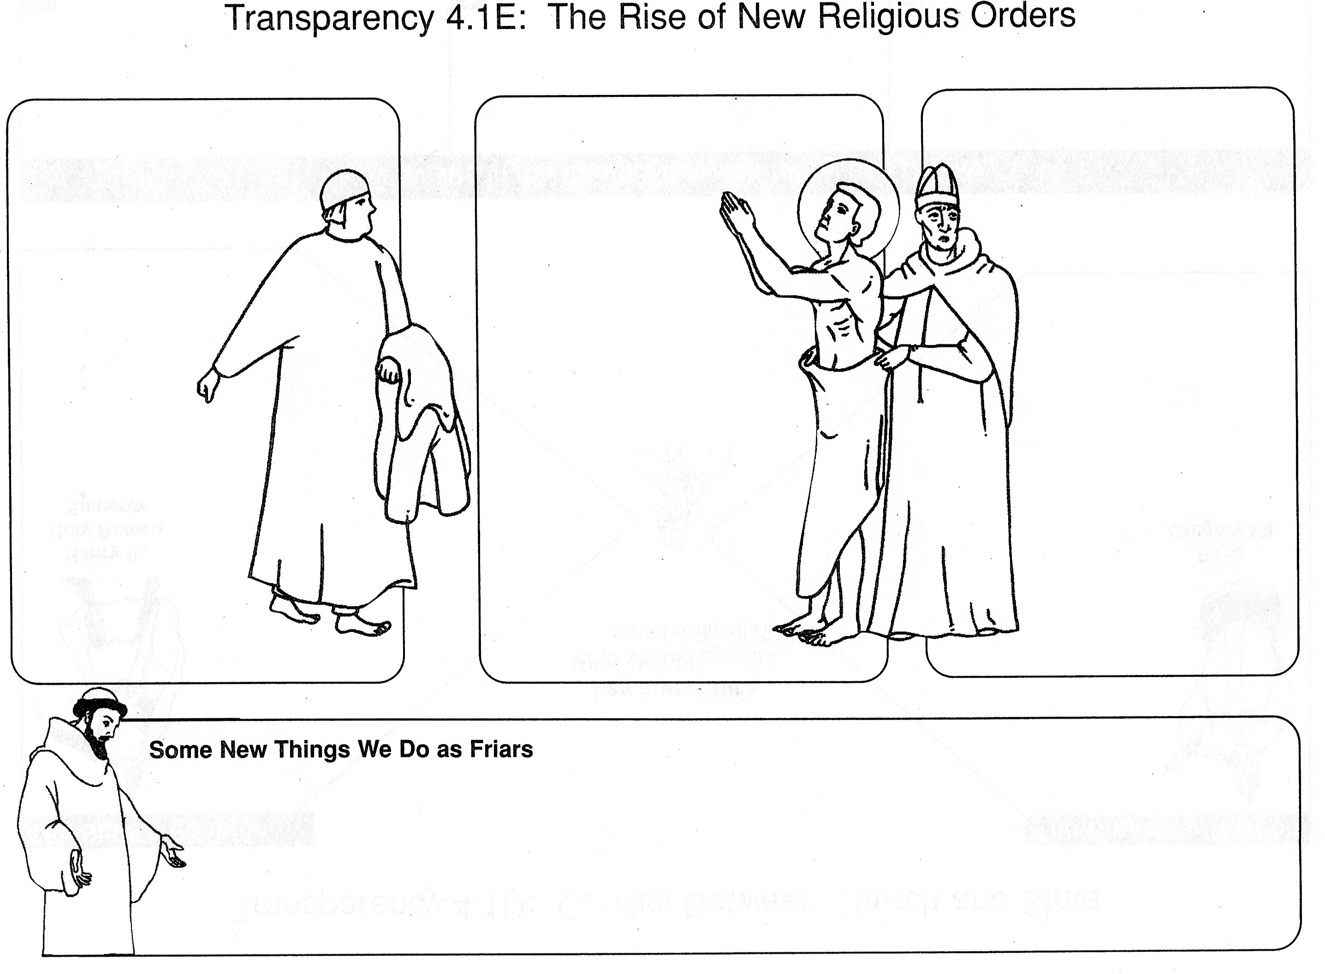
Peter Bernardone, a wealthy Italian merchant
Put his son on trial for stealing cloth
Francis of Assisi amused himself with parties
and war as a
young man
Turned to God
after recovery from
battle
Francis stole cloth- needed money to
repair a church
Renounced his wealth
Dedicated his life to caring for the poor
Founded a new order of the monks called the Franciscans
Travel around to care for the poor and sick
Show others a humble cheerfulness and simple, pious life
Work with orders of nuns, like Little Sisters of the Poor (founded by Francis)
Educate Christians so they can more fully understand the word of God

Slide 6
Processor:
Foundations
Roman Catholic Church in the Middle Ages
Relationship with State

