Slide 1
Renaissance and Reformation
Exam Corrections

Slide 2
1. Draw an illustrated dictionary entry for the term “Renaissance.”

Slide 3
2. The birthplace of the Renaissance was ________ because _______________________________________.

Slide 4
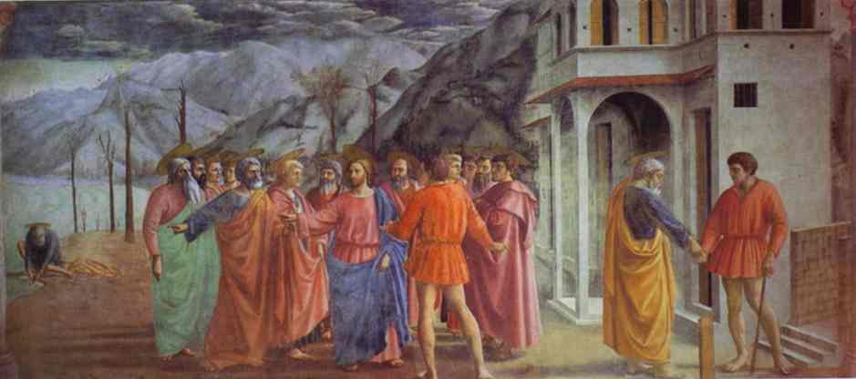
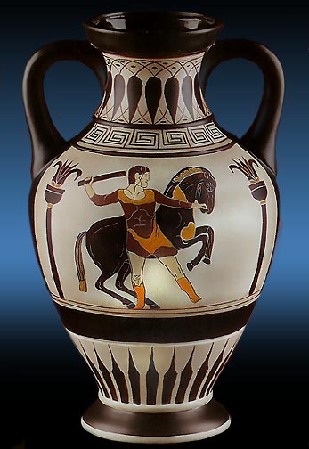
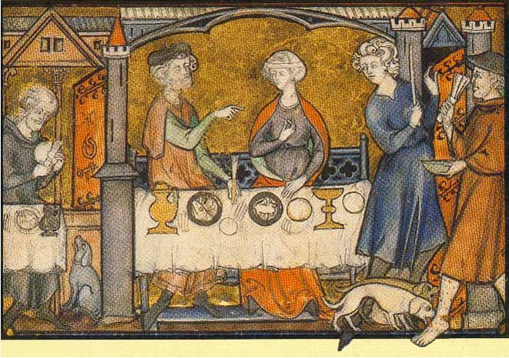
#3
Piece 1
Piece 2
Piece 3

Slide 5
4. Who was the most influential person of the Renaissance/ Reformation Era? Justify your choice.

Slide 6
5. Pictoword “REFORM”
3 effects of the Reformation

Slide 7
6. Venn Diagram:
Compare/Contrast the beliefs and practices of Catholics and Protestants

Slide 8
7. What was an indulgence?
Was it fair to use one?

Slide 9
8. a. Who believed the use of indulgences was wrong?

Slide 10
8. b. What did he do about his belief? What revolution started?

Slide 11
9. Explain how the Reformation spread throughout Europe.
Hint: Include the four Protestant faiths and the invention that helped it.

Slide 12
10. The first Protestant faith was _________.

