Slide 1
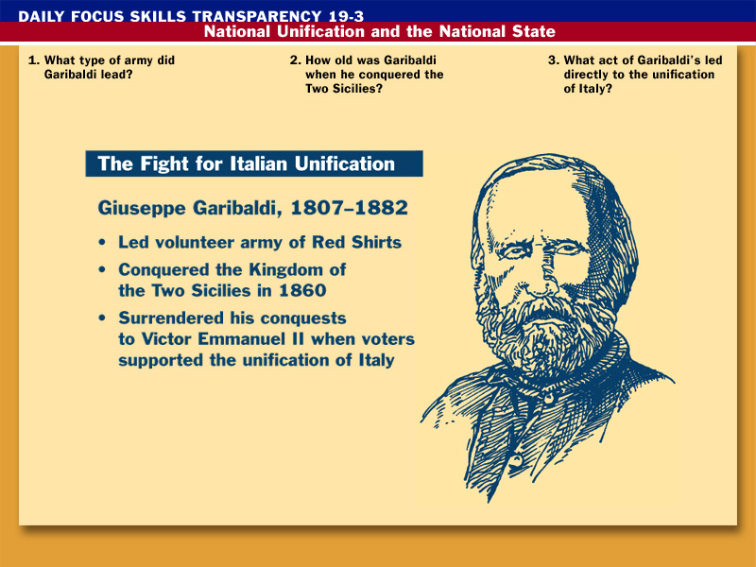



Garibaldi led a volunteer army.
Garibaldi was 53 years old.
He surrendered his conquest to Victor Emmanuel II.

Slide 2
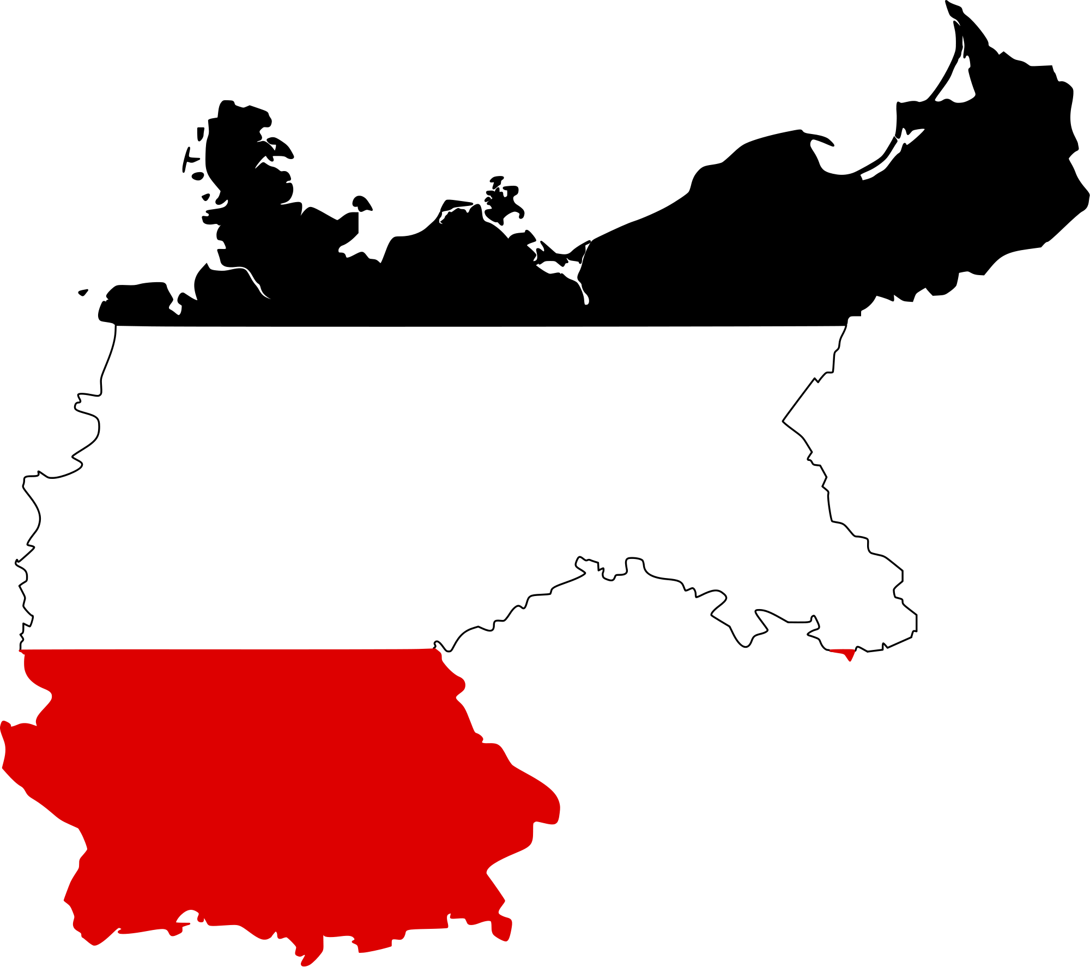
Reaction and Revolution
GERMANY

Slide 3
Big Ideas
Explain how nationalism influenced European nations.
Compare and contrast liberalism and conservatism.
Explain how Italy and Germany became a unified countries.

Slide 4
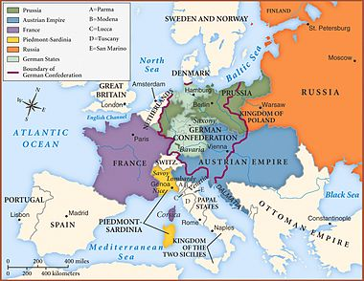
The Congress of Vienna
After Napoleonic Wars and dissolution of the Holy Roman Empire, European lines had to be redrawn.
Goal: Restore Europe to the old order (aka: monarchies)
  Great Britain, Russia, Austria, and Prussia met
  Re-aligned European borders
    Keep one country from dominating Europe
    For example, Austria gained land because of Russia’s gains

Slide 5
Conservatism, Liberalism, Nationalism
Conservatism= based on tradition and social stability
  Most favored obedience to political authority
  Religion is crucial to society
  Hated revolutions!!
Liberalism= people should be as free as possible from government restraint.
  Believed in Enlightenment principles
  Religious toleration, written constitutions, Bill of Rights, etc.
  Connected to middle-class men
    should hold property to vote

Slide 6
Conservatism, Liberalism, Nationalism
Nationalism= cultural identity of a people based on race, language, nationality.
  People should be loyal to the nation
    Not necessarily a particular dynasty or other political unit
  Became a threat to the existing political order
    If Germany united, the balance of power set up at the Congress of Vienna would be upset
    Conservatives tried to suppress nationalism

Slide 7
Another French Revolution?
Economic problems and middle class men wanting to vote caused another French Revolution
  Louis-Philippe refused to change
Monarchy overthrown in 1848
  Provisional gov’t set up universal male suffrage
    All men can vote!!
    Provided work for the unemployed
      Ran out of $, so they stopped it
      Workers ran to the streets and rioted- thousands killed
Ratified a new constitution- A republic
  Elected a single legislature and a president (Louis-Napoleon)

Slide 8
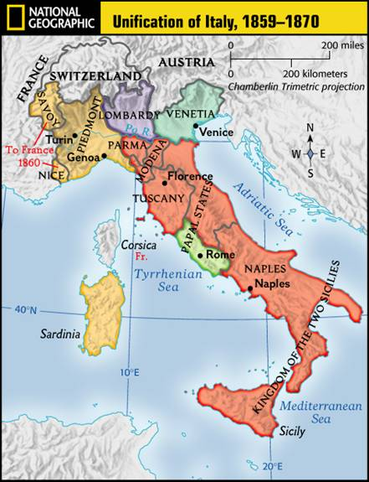
Unification of Italy
1850- Austria dominant power in Italy
  People looked to Piedmont (in N. Italy) to lead the charge- had $
Prime Minister- Camillo di Cavour- allied with France
  Provoked Austria into declaring war
Conflict result: Piedmont an independent state
  This encouraged others to join their states to Piedmont
S. Italy- Giuseppe Garibaldi raised an army
  Red Shirts- Color of uniform

Slide 9
Unification of Italy
Revolt broke out in Kingdom of Two Sicilies against the Bourbon Dynasty
  Sicily and Naples
Garibaldi jumped in and took control of Sicily and Naples
  Turned conquests over to Piedmont
King of Piedmont became the ruler.
Full unification meant that they needed Venetia (Austria) and Rome (France)
  They allied with Prussia in the Prussian-Austrian War
    Prussia gave them Venetia
  France left Rome in 1870

Slide 10
Unification of Germany
Before 1871- Germany made up of many separate states
  Had a good rail system, industries, and foundation for a prosperous state
1862- Otto von Bismarck named Prime minister of Prussia
  Focused on foreign affairs
  Fought a war with Austria over Schleswig and Holstein
    Prussia administered Schleswig, Austria- Holstein
      He’ll use this as an excuse to fight again

Slide 11
Unification of Germany
Seven Weeks War (1866)
  Bismarck picked a fight with Austria & won
    Holstein given to Prussia
    Venetia to Italy
    North German Confederation- States north of Main River unified
Franco Prussian War (1870-71)
  Bismarck knew if they could defeat France, German princes would agree to unity
  July 1870-Bismarck doctored a telegram that Wilhelm I (King of Prussia) insulted the French Ambassador
    France lost by September

Slide 12
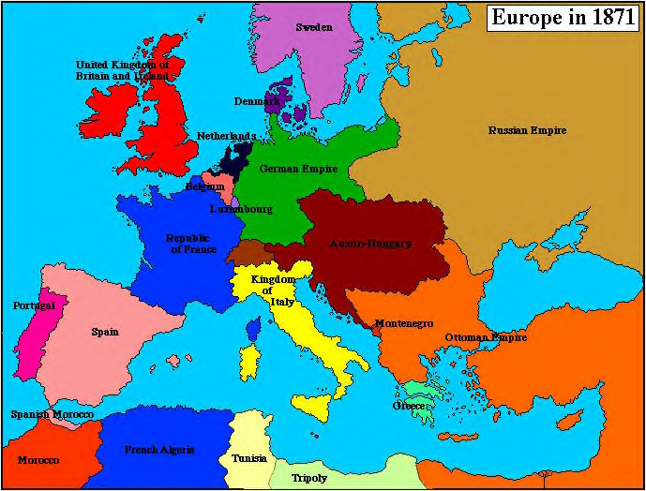
Results of the War:
Wilhelm declared Kaiser (emperor) of Germany
France lost Alsace & Lorraine
Europe redrawn with new states of Italy and Germany
  Germany- conservative with lots of resources and people
France and Austria
weakened

