Slide 1
The Protestant Reformation

Slide 2
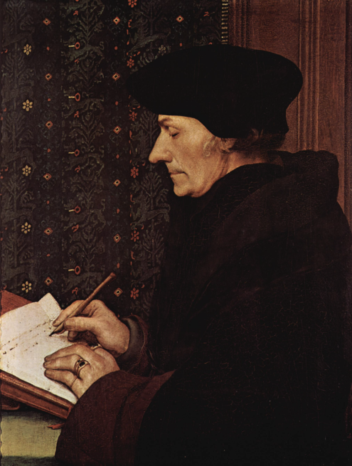
Erasmus & Christian Humanism
Italian humanism spread to Northern Europe
Created Christian Humanism
Believed in the ability of human beings to reason and improve themselves
Goal: reform the Catholic Church through inner piety (religious feeling)
The best known Christian Humanist=Desiderius Erasmus
Developed what he called “the philosophy of Christ”
Showed people how to live good lives daily rather than how to achieve salvation
Stressed inward piety, not external observance of rules and rituals
Wrote The Praise of Folly- criticized the monks
“Erasmus laid the egg that Luther hatched.”

Slide 3
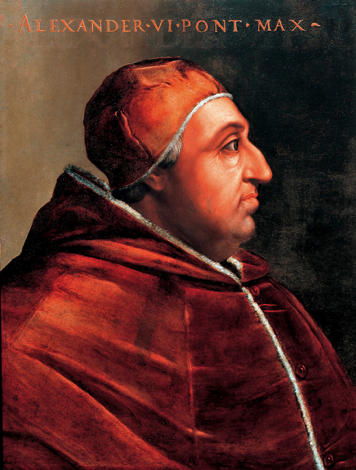
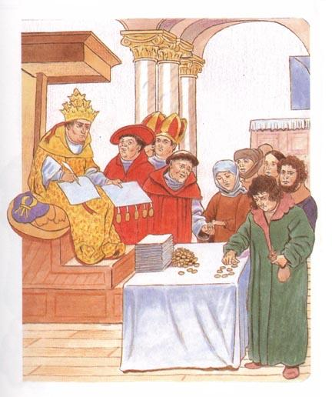
Corruption in the Church
Many people were calling for reform of the Church
Uneducated priests didn’t understand the mass or how to achieve salvation (acceptance into Heaven)
Absenteeism- Many priests neglected their parish because they didn’t live there.
Wealthy bishops were more interested in making money
Simony- Accepting bribes for Church offices
Immoral Popes
Alexander VI had a mistress and 7 children
Cesare Borgia (son) inspiration for The Prince
Sixtus planned to assassinate Lorenzo de Medici
Nepotism- give important jobs in the Church to relatives
Selling indulgences
A release from all or part of punishment for sins
Using money to build St. Peter’s Basilica, fund wars, etc.
1
2
3
4
5

Slide 4
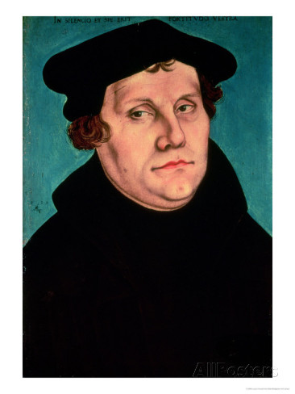
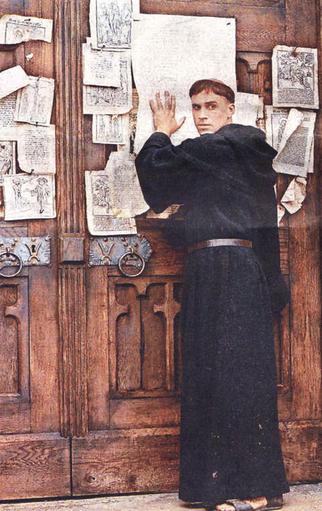
Martin Luther
Martin Luther was a monk and professor at the University of Wittenberg
Through his study of the Bible, he came to believe that faith alone was needed for salvation (Catholics believe in faith and good works)
God is merciful, so he forgives sins
Believed selling indulgences harmed people’s chance at salvation
Wrote the 95 Theses
Nailed it to the door of the Wittenberg Chapel on October 31, 1517
Thousands of copies were printed
Exposed the corruption of the Church

Slide 5
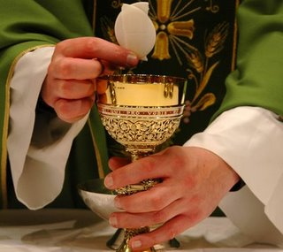
Martin Luther
Ideas of Luther
Purgatory was a false doctrine
Salvation was through faith alone
The Bible alone should be the final authority for truth
Baptism and Eucharist are only valid sacraments
Only ones with scriptural support
Eucharist is not a transformation of bread and wine into body and blood of Christ
Christ is just present through it
1520- Luther wanted the German princes to overthrow the papacy, to make a reformed German church, using his ideas

Slide 6
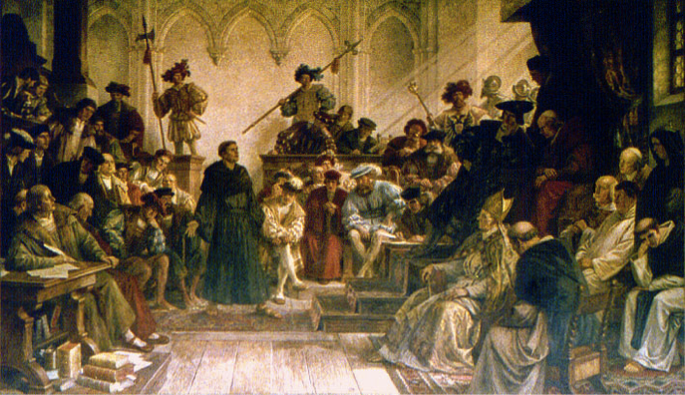
Martin Luther
1521- Luther was excommunicated
Summoned to appear before the imperial diet
Charles V tried to get him to change his ideas
Luther refused (it went against his better conscience)
Edict of Worms
Luther was an outlaw in the empire
All books to be burned and he was to be delivered to Emperor
Luther went into hiding (protected by Frederick the Wise)
Caused many more princes to support him
Took control of Catholic churches and made them into state churches
Luther set up new services to replace mass
Features Bible readings, preaching the Word of God, and song
His doctrine came to be known as Lutheranism (1st Protestant Faith)

Slide 7
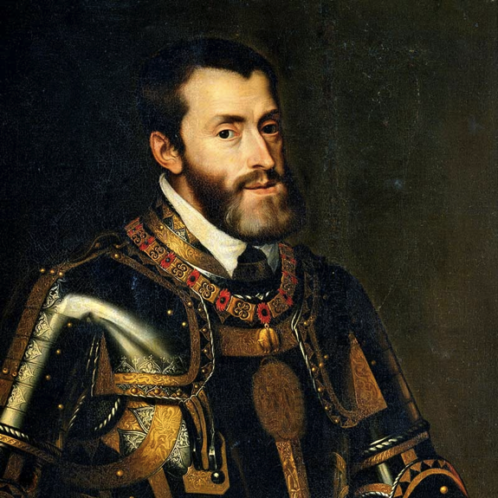
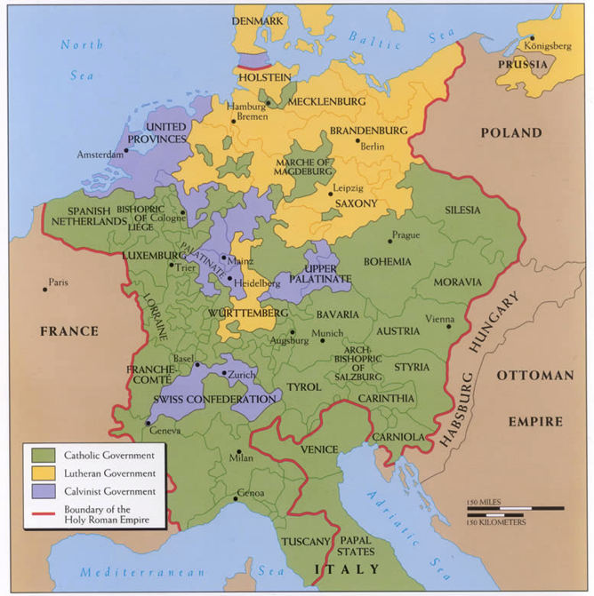
Politics in the German Reformation
From the beginning Luther’s revolution was tied to politics
Charles V (Holy Roman Emperor) ruled Spain, most of Central Europe and the New World
He wanted to keep it all Catholic and under Hapsburg dynasty
Charles was fighting a war with France and the Pope
Many German rulers were supporting Luther, so he had to make peace
Peace of Augsburg
Accepted the division of Christianity in Germany
Princes could choose Catholic or Lutheran
All states would have same legal rights
Does NOT recognize religious tolerance of individuals

