Slide 1
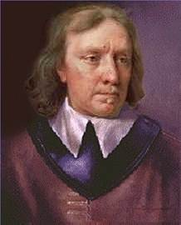
Oliver Cromwell Debate Carousel

Slide 2
Based on what you read, was Oliver Cromwell a hero or villain?

Slide 3
Was Parliament justified to fight against the king?

