Slide 1
Northern Europe

Slide 2
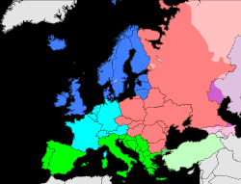
Population Patterns
Northern Europe includes these countries:
UK, Ireland, Iceland, Norway, Sweden, Finland, and Denmark
The People
The most populated part is British Isles
UK (England, Scotland, Wales, and N. Ireland) and Ireland
Early Celtic peoples settled there about 3000 years ago
Followed by Romans, Normans, and other invaders
Recently, they have welcomed many immigrants
Refugees (people who flee to another country for safety) settled there after WWII

Slide 3
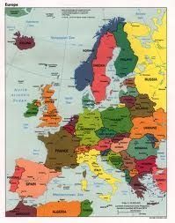
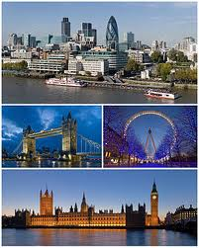
Population Patterns
Swedes, Norwegians, and Danes live in separate countries and have their own languages
Mostly Germanic influences
Shared history
Similar ways of life
Internal and external migration have shaped the region
Urbanization is driven by poverty in rural areas
London is the largest and oldest urban area
7 million people

Slide 4
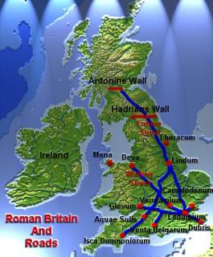
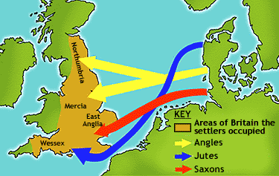
History and Government
The Rise of Northern Europe
AD 43- Romans invaded Britain
Built towns, roads, cities and brought Christianity
Left in the 400s (vulnerable to invasions)
Germanic Angles, Saxons, and Jutes invaded (early Middle Ages)
Scandinavians raided the coasts of Europe during this time
Viking kingdoms led to creation of Denmark, Sweden, and Norway

Slide 5
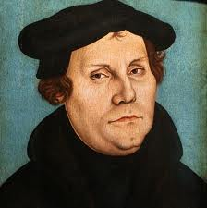
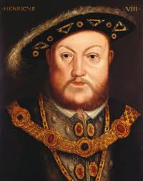
History and Government
1066- Britain fell to the Normans
Established feudalism- monarchs or lords gave land to nobles in return for pledges of loyalty
Britain laid the foundation for its strong gov’t and built its foreign trade
Protestant Reformation- introduced Protestantism to the area
It was popular with the Northern monarchies, where the power of the Catholic Church was unwelcome

Slide 6
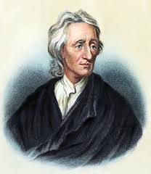
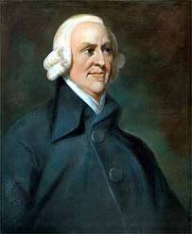
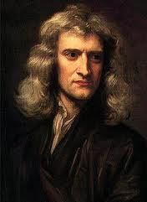
History and Government
Winds of Change
Early 1700s- intellectuals embraced the Enlightenment- movement to value reason and question tradition.
People wanted a voice in gov’t
English Bill of Rights- limited the power of the monarchy
English gov’t became a model for many gov’ts around the world

Slide 7
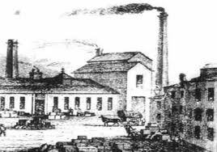
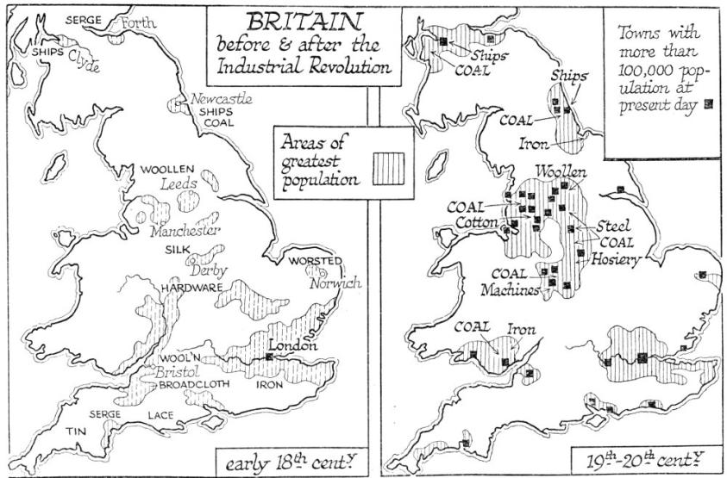
History and Government
Industrial Revolution began in Britain
Industrial capitalism- economic system where owners used profits to expand their companies
Workers were poorly paid and lived in pitiful conditions
This led to communism- a philosophy that called for economic equality and ownership of resources by workers

Slide 8
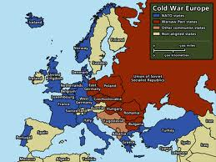
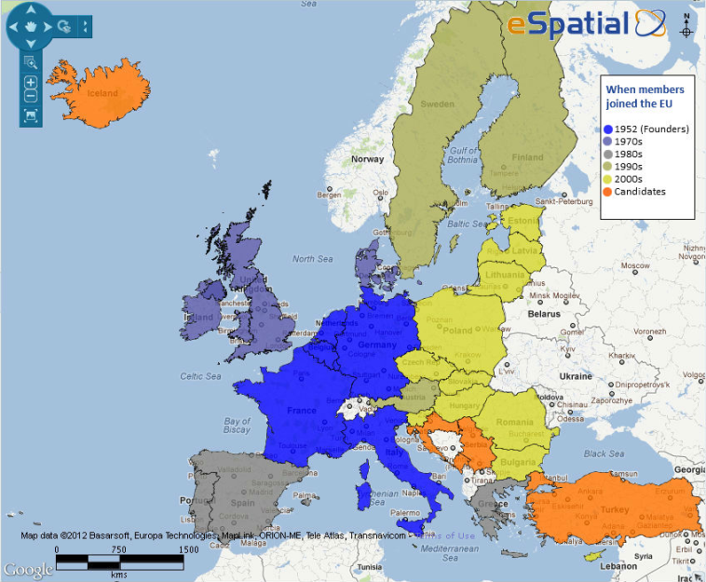
History and Government
In the 1900s, two world wars killed millions and left countries in ruins
After WWII- The Cold War- a power struggle between the Soviet-controlled Communist world and the non-Communist world
A New Era
In the last few decades, N European countries have built strong democracies and successful economies
N Europe belongs to the European Union
Goal= unite Europe so goods, services, and workers can move freely among the member nations

Slide 9
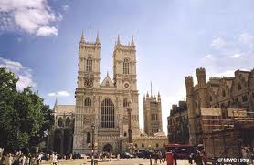
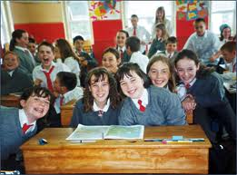
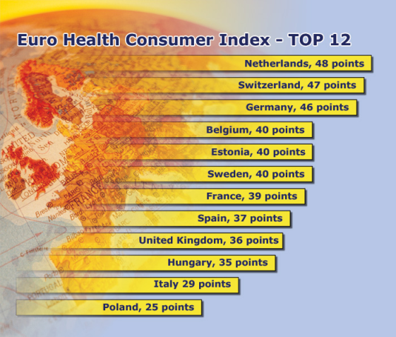
Culture
Language and Religion
Mostly Indo-European (English and Swedish)
No single religion is dominant
Value religious freedom
Most people are Protestant
Education and Health Care
School is mandatory up to 10
Literacy is almost 100%
Excellent health care
Sweden offers complete social welfare to its citizens (welfare state)

Slide 10
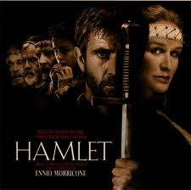
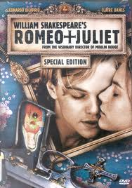
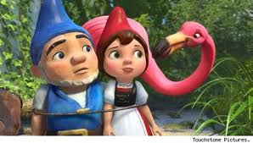
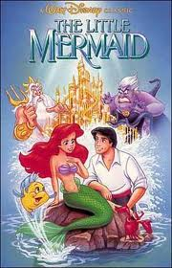
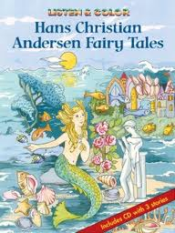
Culture
The Arts
British writings have influenced the world
William Shakespeare- most read works of all time
Romanticism- focused on emotions, stirring historical events, and the struggles of individuals
Fairy tales of Hans Christian Anderson (Danish) are known throughout the world

