Slide 1
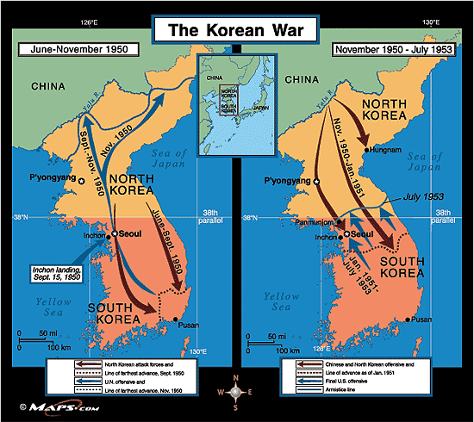
Daily Focus Skill: Korea Map
Where was the maximum South Korean advance in 1950? How does its location compare to that of the Chinese and North Korean advance in 1950?
2. How close to the
prewar boundary is the
cease fire line?

Slide 2
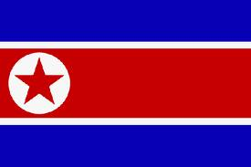
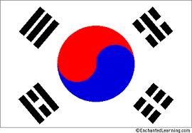
North and South Korea

Slide 3
Population Patterns
The People
Korea is ethnically homogenous
It is divided into Communist North Korea and Democratic South Korea
Density and Distribution
Most live on the coastal plains
About 2/3 of pop. live in Seoul, SK or Pyongyang, NK
S Korea has a higher pop. density than N Korea
N Korea’s gov’t has focused on industrialization since WWII
Led to a shortage of farm labor (more people moved to cities for jobs)
About 60% urban today
S Korea is about 80% urban

Slide 4
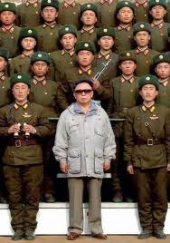
Population Patterns
To escape Communism, many people have fled from N Korea to S Korea or to other countries
US, Canada especially
S Korea’s pop. more than doubled since the 1950’s
48.8 million, twice that of N Korea
Standard of living is much better in S Korea
North and South Korea are divided by the Demilitarized Zone (DMZ)
Established at the end of the Korean War (38th Parallel)
Soldiers watch each other from their side
Despite tension, two sides have begun to cooperate on trade and tourism

Slide 5
History and Government
Early History
1200s-Chinese brought culture to Korea
Buddhism became major religion
Dynasties- Silla and Koryo united Korean Peninsula
Throughout its history, countries have fought over its land
1300- China controlled it and introduced Confucianism
It became the model for Korea’s gov’t, education, and family life
1500s- Japan invaded

Slide 6
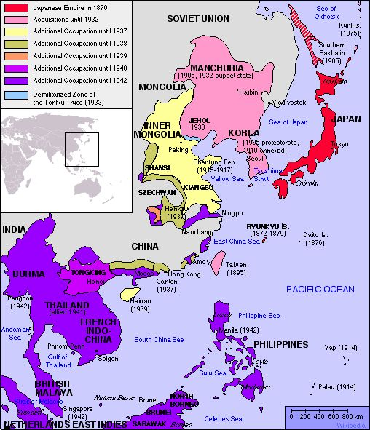
History and government
1800s- Japanese and Europeans fought over it
Korea became isolationist (Hermit Kingdom)
Sino-Japanese War- China and Japan fought over Korea
Russo-Japanese War- Japan and Russia fought over Korea
Japan controlled it until 1945
They tried to force Japanese language and culture on the Koreans

Slide 7
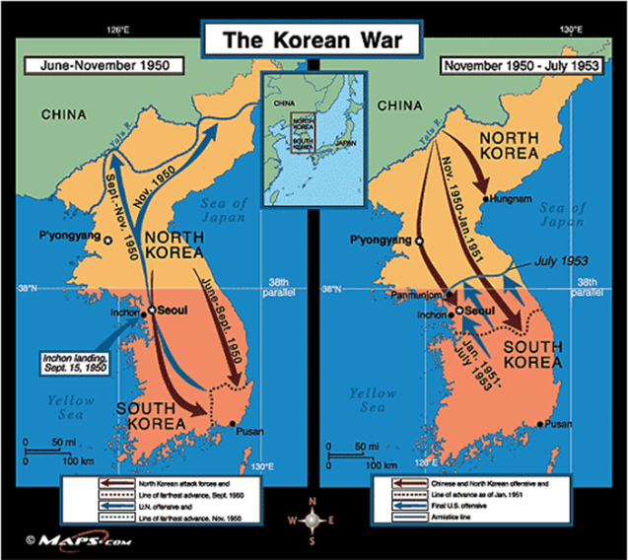
History and Government
A Divided Korea
After WWII Korea was divided in two
S Korea- backed by US
N Korea- Communist ruled
1950- N Korea invaded S Korea
UN forces went to help S Korea out
June 1951- each side had dug in at the 38th Parallel
This war was a stalemate
Ended with a truce in 1953
Millions of Koreans died and both countries were devastated

Slide 8
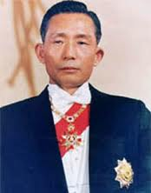
History and Government
Today, they’re still separated
Experienced cultural divergence- growing apart from their cultures
Because of their different political and economic systems
S Korea- After the war, a military coup put Major General Chung-Hee in power
Assassinated in 1979
People protested against his harsh rule
They wanted a democracy
Today they have a republic (modeled after ours)

Slide 9
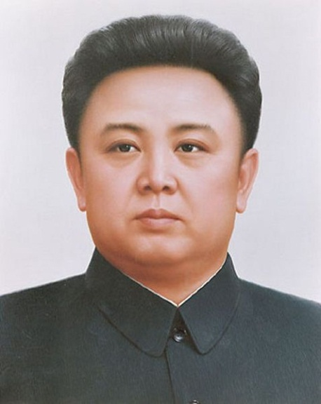
History and Government
N Korea has a centralized government controlled by Korean Workers Party (KWP)
All gov’t officials belong to it
Kim Jong Un now rules with absolute authority
2000- talks between N and S Korea have improved relations
2002- N Korea reactivated its nuclear reactor
2006- N Korea tested a nuclear weapon
Strict gov’t rule of N Korea has led to food shortages, economic stagnation, and mismanagement of resources
200,000 political prisoners in N Korea
Slave labor camps have also been reported

Slide 10
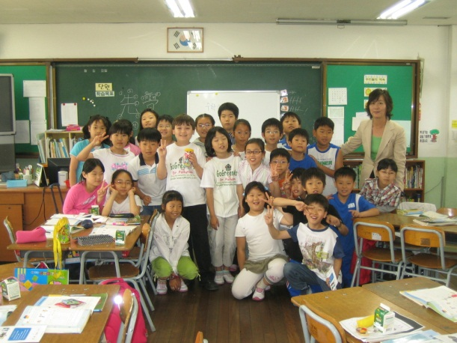
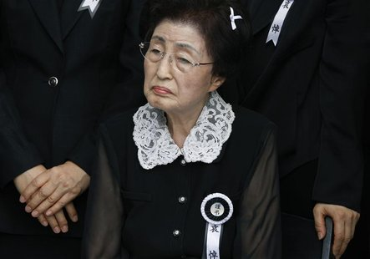
Culture
Education
S Korea- most attend middle and high school and university attendance is up
N Korea- only purpose is to teach communist ideology
Health Care
S Korea- successful, modern system (life expectancy=77 yrs)
N Korea- provides health care, but people still suffer from inadequate food, water, etc.
Language- both speak Korean

Slide 11
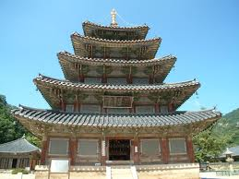
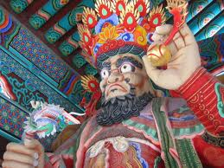
Culture
Religion
S Korea- practice Confucianism, Buddhism, Christianity, and Cheondogyo (combination of these religions)
N Korea- no religion is allowed
Arts
S Korea- has adopted many elements from Western culture
Traditional arts still practiced
Art in temples (sculptures done in bronze, stone, or jade)
N Korea- Kim Jong Un dictates what type of art is made

