Slide 1
North Africa

Slide 2
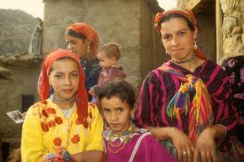
Population Patterns
The People
Coasts- influenced by European cultures
Primary influence is a mix of indigenous and Arab cultures
Indigenous people= Berbers
Most are farmers, but many were nomadic
People who move from place to place depending on the season and availability of grass for grazing and water.
Most populous in the Atlas Mountains and Sahara Desert

Slide 3
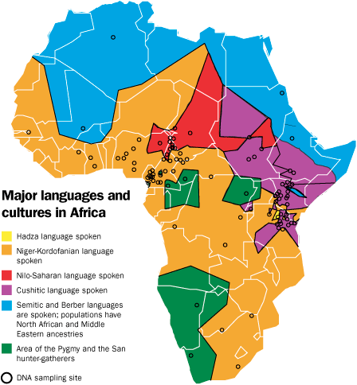
Population Patterns
Arabs= people who speak Arabic
Nomadic Bedouins migrated to N Africa from the Mid East
Egypt was the primary gateway for Arabs migrating to N Africa
Can be found herding animals in the desert where there is enough vegetation to support herds or water for growing food

Slide 4
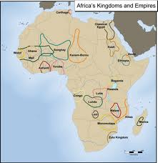
History and Government
N Africa’s proximity to Europe and the Mid East has made it vulnerable to invasions
Early Peoples and Civilizations
About 10,000 yrs ago, hunters and gatherers settled in N Africa
6000 BC- farming communities rose along the Nile and Mediterranean
These farmers were among the first to domesticate plants and animals
Adapt them from wild for uses as food, clothing, and transportation

Slide 5
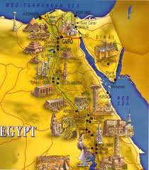
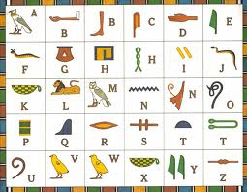
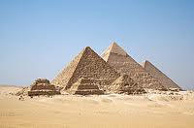
History and Government
Egyptian civilization developed about 6,000 yrs ago in Nile River Valley
Used sophisticated irrigation systems to enable farmers to grow two crops each year
Developed a calendar with a 365-day year
Built impressive pyramids as tombs for pharaohs
Invented a form of picture writing- hieroglyphics

Slide 6
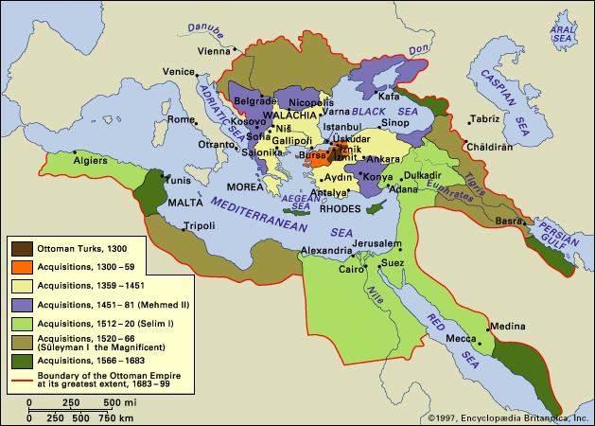
History and Government
Invasions
7th century invasions of Arabs heavily influenced the cultures of N Africa
Berbers assimilated with Arab cultures in Algeria, Tunisia, and Morocco- survived through the Ottoman rule (1922)
Muslim and Jewish exiles fleeing Christian persecution in Spain infused Morocco with Spanish culture in the 1400s

Slide 7
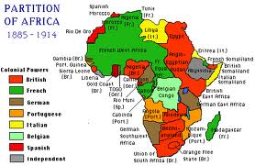
History and Government
European colonial rule also affected people and cultures in N Africa
French influenced Algeria
Geometric boundaries- lines that follow straight lines and do not account for natural and cultural features- separate Libya, Egypt, and Algeria
These were drawn by Europeans
Caused conflict between the new countries
Local practices of gov’t were not the same as European ideas of governing

Slide 8
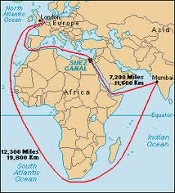
History and Government
1800s- well-educated urban middle class developed in N Africa
Adopted ideas of nationalism- belief in the right of an ethnic group to have its own independence
Stirred developments for self-rule
Independence
Egypt gained independence from UK in 1922
Suez Canal has made Egypt a key regional power
Also important center for Arab nationalism

Slide 9
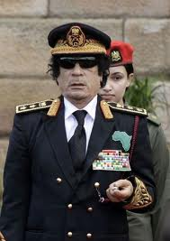
History and Government
Algeria gained independence from France when a strong nationalist movement led to a civil war in the mid 1900s
Since independence in 1962- Algeria has developed its resources and increased its standard of living
However, a civil war in the 1990s killed over 100,000 people
1951- Libya won independence from Italy
1969- Colonel Muammar al-Qaddafi overthrew the monarchy
1956- Tunisia gained independence from France
1956- Morocco won independence from France
Constitutional monarchy today

Slide 10
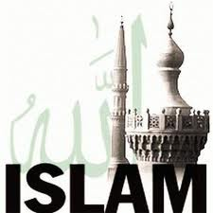
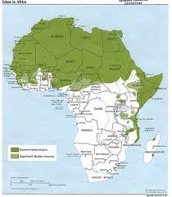
Culture
Religion and Language
When Arabs invaded, they brought the religion of Islam
Most belong to the Sunni branch- believe that leadership should be in the hands of the Islamic community at large
Most Berbers have adopted Islam, but some maintain indigenous religions

Slide 11
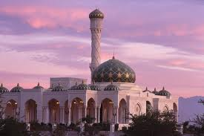
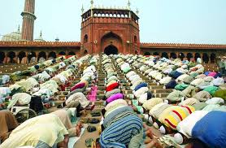
Culture
Islam
Calls to worship occur 5 times a day
A muezzin (crier) calls the faithful to prayer from the minaret
Follow the movements of the imam (prayer leader)
They bow and kneel, touching their foreheads to the ground in the direction of the holy city of Mecca in Saudi Arabia
Arabic is the main language in N Africa
Muslims learned it to read the Quran (holy book)

Slide 12
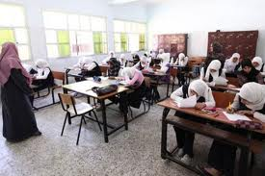
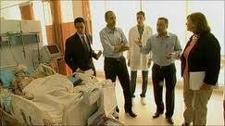
Culture
Education and Health Care
Most young people attend school
Primary education is free and enrollment is increasing
Literacy rates vary widely from 52% in Morocco to 82% in Libya
Health Care has improved in recent decades
People go to gov’t owned hospitals for medical treatment
Doctor shortages mean limited care for rural people

