Slide 1
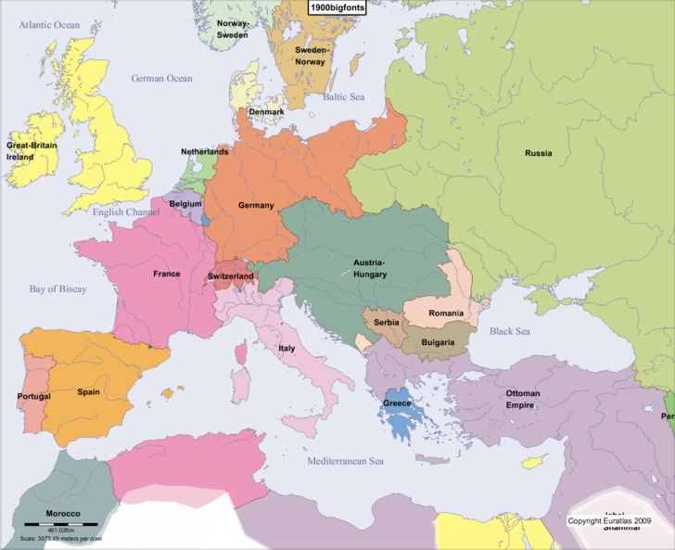
Europe 1900
Warm-up:
Using the map, explain why there might be conflicts in the Balkan Peninsula.

Slide 2
National State and Democracy

Slide 3
Big Ideas
List the ways workers gained more rights.
Explain how alliances in Europe led to WWI.

Slide 4
Western Europe and Political Democracy
Late 19th century- progress in establishing constitutions, parliaments, and individual liberties in the main European states
As more people won the vote, political parties needed to create larger organizations and find ways to appeal to the masses
GB- two parties (liberals and conservatives)
Competed with each other to pass laws to expand the right to vote
1918- males over 21 and women over 30 could vote

Slide 5
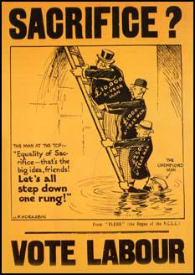
Western Europe and Political Democracy
Social reforms for the working class soon followed (Liberal ideas)
Growth of trade unions and Labour Party made Liberals fear they would lose support of workers
Liberals enacted social reforms:
Benefits for workers in case of sickness, unemployment, or injury on the job

Slide 6
Western Europe and Political Democracy
France
The collapse of Louis-Napoleon’s Second Empire left the country in confusion
1875- the Third Republic gained a republican constitution
a president
two-house legislature
Senate- elected indirectly
Chamber of Deputies- elected by universal male suffrage
A premier (prime minister) actually ran the new French state
The premier was responsible to the Chamber of Deputies
ministerial responsibility–the idea that the prime minister is responsible to the popularly elected legislative body and not to the chief executive

Slide 7
Central and Eastern Europe: The Old Order
Germany
Constitution of the gov’t begun by Otto von Bismarck in 1871 made a two-house legislature
Lower house= Reichstag
Gov’t ministers reported to the emperor, not the legislature
Emperor controlled the armed forces, the government bureaucracy, and foreign policy
Chancellor (Prime Minister) Bismarck- worked to suppress democracy
As Germany industrialized, the people wanted it, though
Conservatives (nobles) didn’t want it
Thought that if they expand territory and made profits that would distract the people

Slide 8
Central and Eastern Europe: The Old Order
Austria-Hungary
1867-Created a constitution after the creation of Austria-Hungary
Emperor, Francis Joseph, ignored the parliamentary system
Appointed and dismissed his own ministers
Enacted laws when parliament was not in session
Troubled by disputes among the nationalities
Germans, Czechs, Poles, and other Slavic groups
Wanted their own freedom
Hungary had a Parliament that worked
Controlled by Magyar landowners-dominated the peasants and ethnic groups

Slide 9
Central and Eastern Europe: The Old Order
Russia
Nicholas II began his rule in Russia in 1894
Believed in absolute power of the czars
Conditions were changing
Industrialization brought the creation of an industrial working class and pitiful living conditions for most of its members
Socialist parties developed-gov’t repression forced them underground
Revolution broke out in 1905
Workers went to the Winter Palace to give grievances to the czar
Troops opened fire and killed hundreds of demonstrators (“Bloody Sunday”)
Workers organized a strike
Nicholas granted civil liberties and created a legislative assembly, the Duma

Slide 10
United States
US
A series of amendments granted African Americans rights
State laws took many of those away (Jim Crow Laws)
1900- 40% of the pop. lived in cities and the US was the world’s richest nation
Europeans migrated to America in massive numbers
Huge gap between rich and poor
Workers organized unions
Wanted better working conditions, better hours, and more pay
US began to expand by late 19th century
Gained Hawaii- lucrative sugar cane
Queen Liliuokalani tried to retain control of her kingdom
US sent troops and took control
Spanish American War
US gained Puerto Rico, Cuba, Guam, and the Philippines

Slide 11
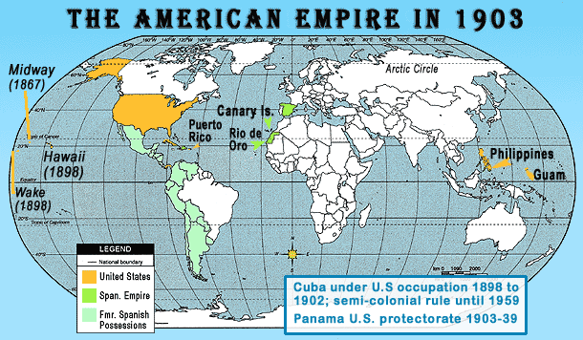

Slide 12
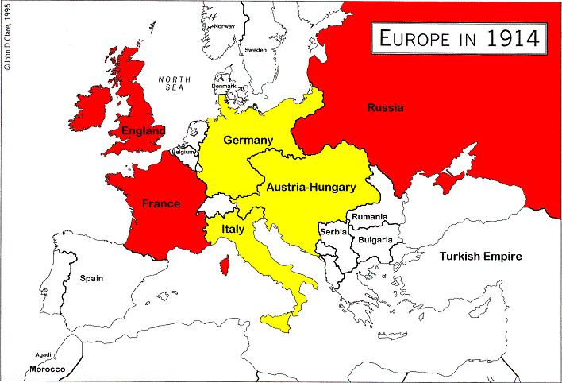
International Rivalries
Germany formed the Triple Alliance with Austria-Hungary and Italy
Defensive alliance against France
1894- France, Russia, and Great Britain formed the Triple Entente
Europe was now divided into two uncompromising camps

Slide 13
International Rivalries
Problems in the Balkans
Greece, Romania, Serbia, and Montenegro were independent from the Ottoman Empire by 1878
Austria-Hungary annexed Bosnia-Herzegovina
Serbia resented this (wanted to create a Slavic nation)
Russia supported Serbia
Germany demanded Russia acknowledge Austria-Hungary’s claim
The result would be war if they did not
Allies of Austria-Hungary and of Russia were determined to support the countries on their sides
In 1914, each side viewed the other with suspicion and hostility

