Slide 1
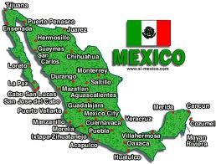
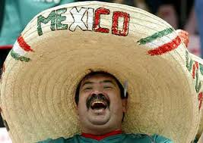
Mexico

Slide 2
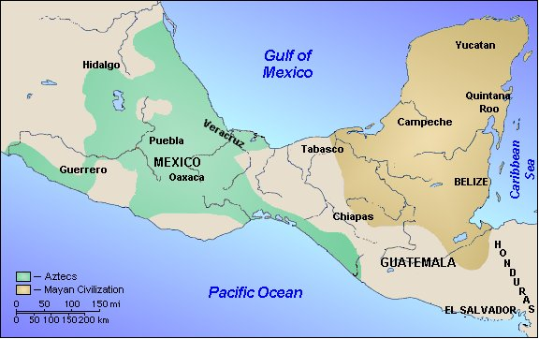
Population Patterns
The People
The ancestors of Native Americans were the first to populate Mexico
AKA- Indigenous population= people from an area’s first inhabitants
Migrated from Asia about 40-60,000 years ago
Most remained isolated, but two civilizations emerged
Mayans (Yucatan) and Aztecs (Southern Mexico)
The arrival of Europeans created a new ethnic group- Mestizos
Make up the largest part of the population today.

Slide 3
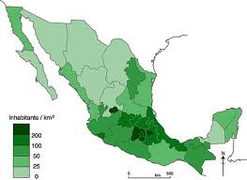
Population Patterns
Density and Distribution
World’s most populous Spanish speaking country (142/sq. mi.)
Mexico City- 19 Million
Rural-to-Urban migration= 75% of pop. live in cities
Limited land, lack of social services, and lack of jobs
This has led to urbanization- the migration of people from the countryside to cities
Mexico City is a primate city- an urban area that dominates its country’s economy, culture and political affairs

Slide 4
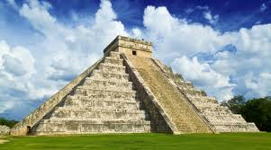
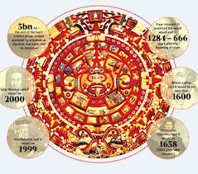
History and Government
Native American Empires
Mayans- S. Mexico (250 AD)
Priests and nobles ruled cities
Economy- agriculture and trade
Developed accurate calendars through astronomical observations
Eventually abandoned cities (about 40 have been recovered)
Most glyphs remain untranslated
Ancestors live in S. Mexico and C. America

Slide 5
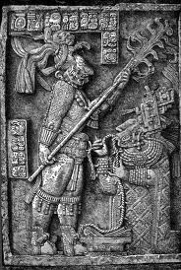
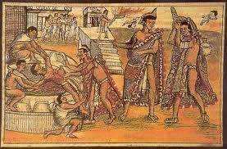
History and Government
Aztecs- C. Mexico (1300s AD)
Capital= Tenochtitlan (Mexico City)
Grew crops on chinampas
Floating islands made from large rafts covered with mud from the lake bottom
Highly structured class system
Emperor and military officials
Priests- performed rituals to win favor of the gods
Human sacrifices
Farmers, laborers, soldiers

Slide 6
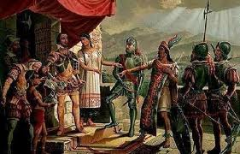
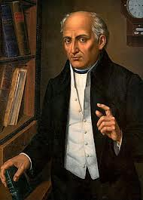
History and Government
An Independent Nation
Aztecs were still expanding when the Spanish arrived in 1519
Spanish conquistador, Hernan Cortes defeated them in 1521
For the next 300 years, Mexico was a viceroyalty of New Spain
Ruled by viceroys- royally appointed officials
Late 1700’s- resentment against the Spanish spread throughout Mexico
Mexico became the 1st Latin American country to win independence from Spain
Miguel Hidalgo led the Mexican independence movement in 1810
Became officially independent in 1821

Slide 7
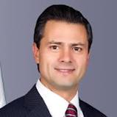
History and Government
After independence a small group of wealthy landowners, army officers, and clergy ruled.
Power struggles and revolts led to chaos
The caudillo (dictator) emerged
The military and landowners backed them
1917- new constitution established a federal republic
3 branches
President elected in 6-year terms
1929- Institutional Revolutionary Party (PRI) dominated politics
Control ended in 2000- Vicente Fox (PAN) won the election
2006- Felipe Calderon (PAN) became president-elect
2012 election- Enrique Pena Nieto (PRI)
Struggles for reforms for N. Americans, farmers, and workers continue to this day

Slide 8
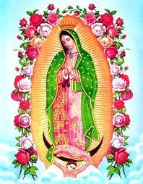
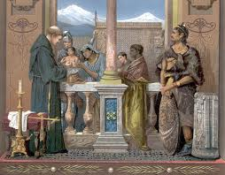
Culture
Language and Religion
Official language is Spanish (95% of pop.)
More than 50 indigenous languages spoken
90% of Mexicans are Roman Catholic
Many indigenous religions practiced
Maya and Catholic beliefs have been blended by some
Known as syncretism

Slide 9
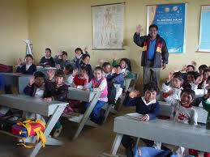
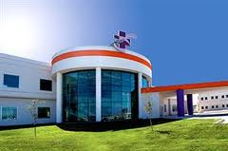
Culture
Education and Healthcare
Most public schools are in rural areas
Not as much money or qualified teachers as schools in cities
More private schools in urban areas
Government has been trying to make gains in education recently
Health problems linked to poverty, lack of sanitation and malnutrition are a big issue
Gov’t subsidizes health care- available to all
Poor quality of public medicine causes many to go to cities or other countries for health care

Slide 10
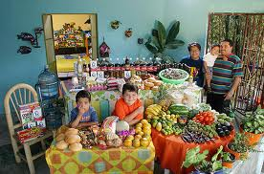
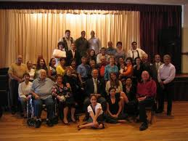
Culture
Family life
Highly value the family
Extended family- great grandparents, grandparents, aunts, uncles, cousins, parents, children
Often share home with extended family
Compadres (godparents) chosen to sponsor and watch over babies
Machismo- Spanish and Portuguese tradition of male supremacy
Women have made advances in recent years

Slide 11
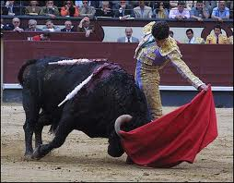
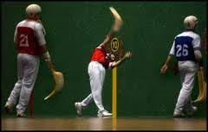
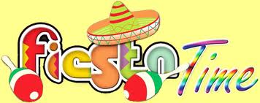
Culture
Sports and Leisure
Mexico’s national sport= bullfighting
Very passionate about soccer (futbol)
Baseball and Jai alai (a game like handball) are also popular
Favorite leisure activity is celebrating
Friendly gatherings, family dinners, religious holidays, and patriotic events
Any reason to have a fiesta is celebrated

