Slide 1
Middle Ages Debate Carousel

Slide 2
Question 1
Should the Church and State always remain separate?

Slide 3
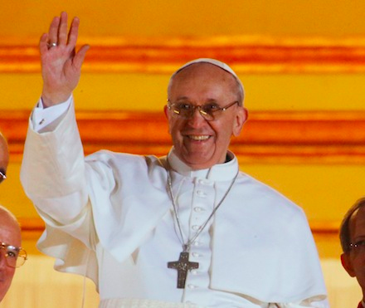
Question 2
Should the Pope be allowed to politically control land?

