Slide 1
Japan

Slide 2
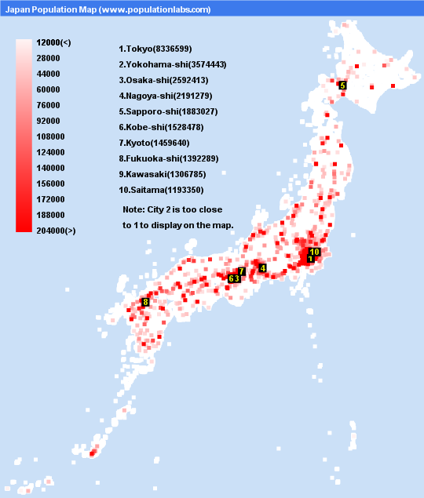
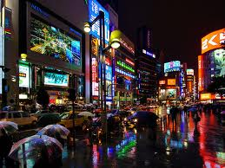
Population Patterns
The People
Japan’s population is ethnically homogeneous
They belong to the same ethnic group- no ethnic conflict
99% are descendants of migrants who came from Korea centuries ago
Forced Ainu (aboriginals) to move north
Density and Distribution
Japan has limited land for its large pop.
Central Japan has forested mountains, so the people live in the valleys and coastal plains
Tokyo= world’s most populous urban area- 35 million
Hundreds of skyscrapers tower over their cities.
Lots of neon signs
Most people live in tiny 1-2 bedroom apts
Suburban homes are small compared to US

Slide 3
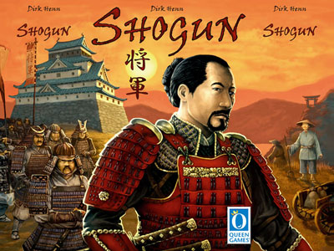
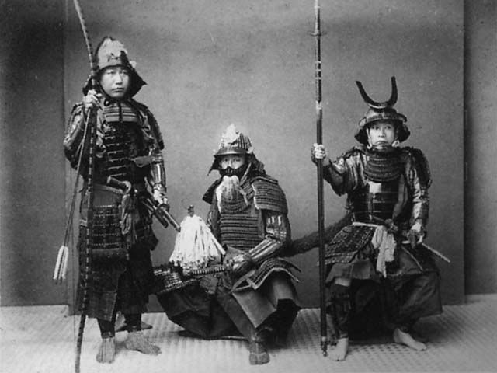
History and Government
Early History
China and Korea had a significant impact on Japan’s civilization
400s- Japan was ruled by clans (large family groups)
United under the Yamato dynasty
Adopted China’s philosophy, writing system, art, sciences, and government
By 1100s- armies of nobles started fighting for control of Japan
Yorimoto Minamoto- first shogun (military ruler)
Samurai protected the shogun
Helped govern the country until the late 1800s
Technically they were ruled by an emperor, but held no power

Slide 4
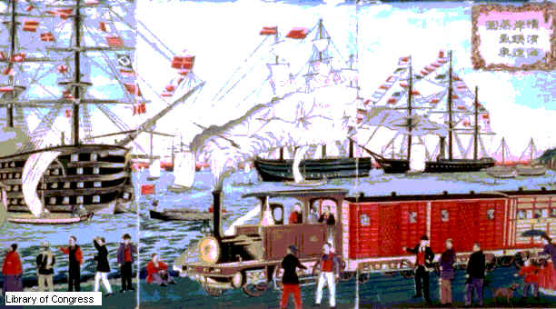
History and Government
1542- 1st contact w/West
Portuguese ship headed to China was blown off course
Next came traders and missionaries
Shoguns feared European conquest was next
Restricted foreigners in Japan (stayed isolated for 200 years)
1800s- US worked to open Japan for trade
1854- US Navy pressured Japan to trade with them
Rebel samurai forced shoguns to return full power to emperor
New gov’t modernized the economy, government, military, education, and legal system
This was called the Meiji Restoration

Slide 5
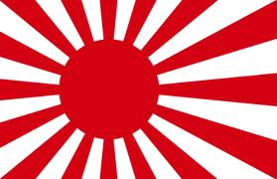
History and Government
Modern Japan
1890s-1940s- Japan went from feudal to modern
Cultural convergence- mixing of cultures, as interaction increased
Used diplomacy and military force to build and empire
Went to war with China (1894-5)
Gained Taiwan
Fought Russia (1904-5)
Gained Manchuria and Sakhalin
Japan annexed Korea in 1910

Slide 6
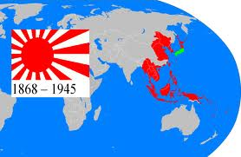
History and Government
This expansion led Japan to fight the Allies in WWII
After WWI (fought w/us), they experienced prosperity
Military leaders gained influence over the gov’t
1931- Invaded Manchuria
1936- Signed a pact with Nazi Germany
1937- Invaded China
Japan was involved in WWII for 4 years
Lost 3 million Japanese lives
Suffered dropping of atomic bombs on Hiroshima and Nagasaki

Slide 7
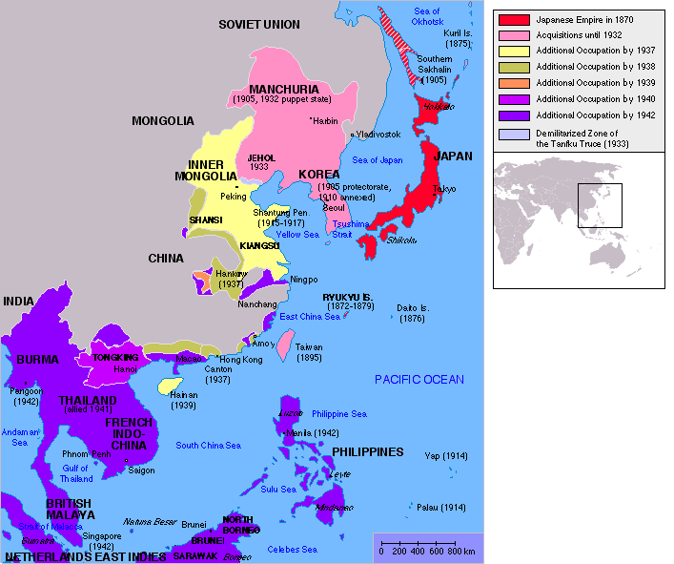

Slide 8
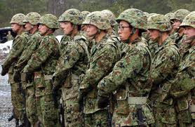
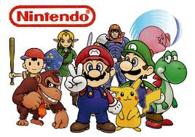
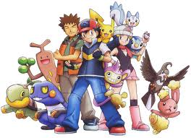
History and Government
After its surrender in 1945, Japan became a democracy
Lost its territories and military
Have Japanese Self Defense Forces
Not allowed to leave Japan w/o permission from UN
Rebuilt shattered economy and society
Late 1900s- became a global economic power
Today- 2nd largest economy

Slide 9
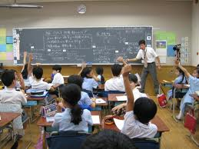
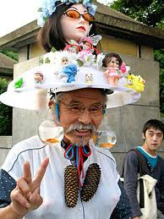
Culture
Education and Health Care
Education is highly valued
Early on, students focus on getting into good schools
Compulsory up to age 15
High School is designed to prepare for university
Health care has improved life expectancy to 82 years
Gov’t provides preventative care
No insurance from employer= gov’t provides it

Slide 10
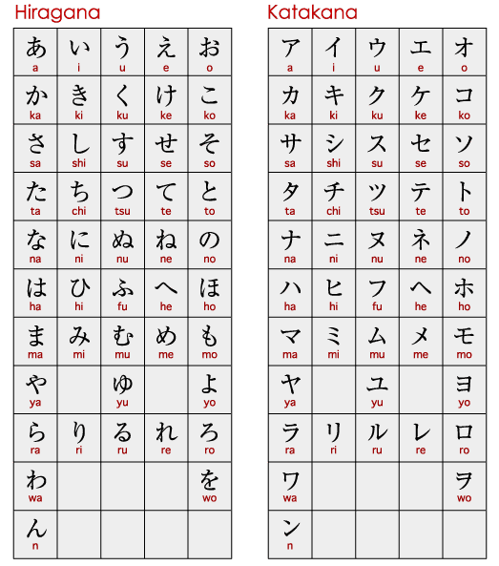
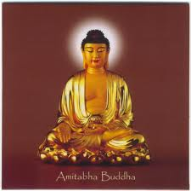
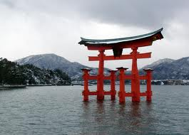
Culture
Language and religion
Japanese language may be related to Korean and Mongolian
Borrowed words and writing from Chinese
Western language, especially English, have influenced Japanese
Many practice Buddhism or Shintoism (ancient religion that stresses reverence for nature)
Religious practices tend to blend religions
A family may celebrate Shinto rituals, have a Christian wedding, and hold a funeral at a Buddhist temple

Slide 11
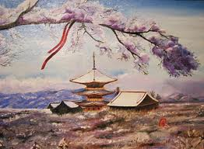
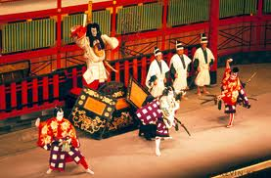
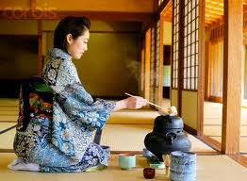
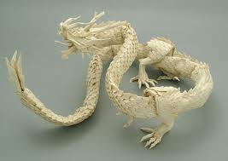
Culture
The Arts
Throughout history, artists have painted the landscape of Japan
Other art forms: Origami, tea ceremony, landscaping, Kabuki theater
Lady Muasaki Shikibu wrote one of the world’s first novels The Tale of Genji
About the life and loves of a prince at the imperial court
Poetry- Haiku
Originally had 3 lines and 17 syllables
Now it varies in combination

Slide 12
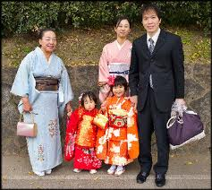
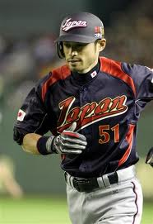
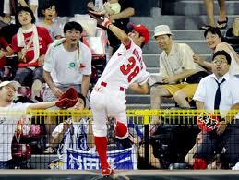
Culture
Family Life and Leisure
Family is the source of stability and strength
Ancient traditions and beliefs shape how children are raised
Being a part of a group is more important than the individual
Japanese people experience acculturation- absorption of popular culture from another country
Ex. Baseball

