Slide 1
Hidalgo
1821
Símon Bolívar
Chile and Peru
Click the mouse button or press the Space Bar to display the answers.

Slide 2
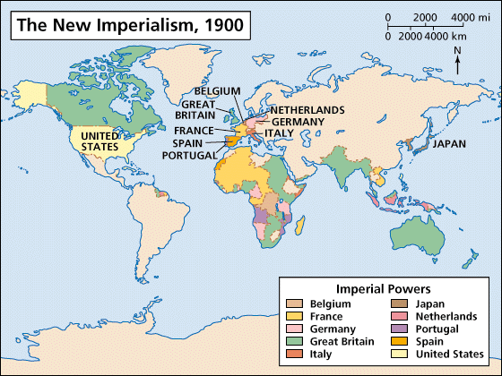
Imperialism Around the World

Slide 3
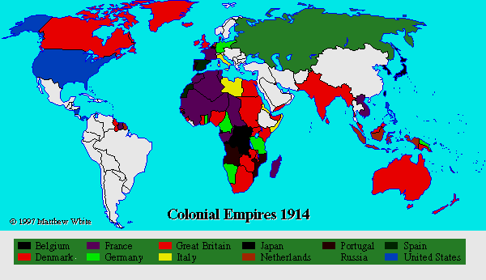
Big Ideas
What are the motives and effects of imperialism?
In what ways did colonial powers rule their colonies?
How were the Europeans hypocritical in their rule of their colonies?

Slide 4
Motives for Imperialism
Imperialism= extension of a nation’s power over other lands
Motives:
Economic- make money, expand foreign trade, create new markets, get resources
Political- gain power, compete with other countries, expand territory, gain prestige
Religious- spread Christianity, moral values, educate people
Exploratory- explore the unknown, conduct scientific research, go on an adventure
Ideological- “White Man’s Burden”- civilize the heathens, Social Darwinism (only the strong survive)

Slide 5
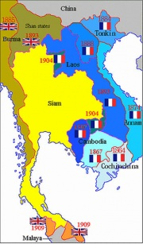
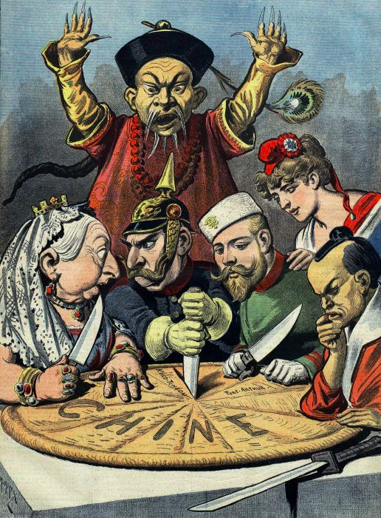
Asia
1900- Virtually all of SE Asia was under European control
US- Philippines (Spanish-American War)
China limited trade to one port: Guangzhou
Britain was importing more than exporting to
China= trade imbalance
They began trading opium to China
Chinese gov’t wanted it stopped
Britain refused, so China blockaded Britain
Britain went right through it
Treaty of Nanjing- China open 5 ports, gave Britain the island of Hong Kong, and allowed Europeans extraterritoriality (live by their own laws)

Slide 6
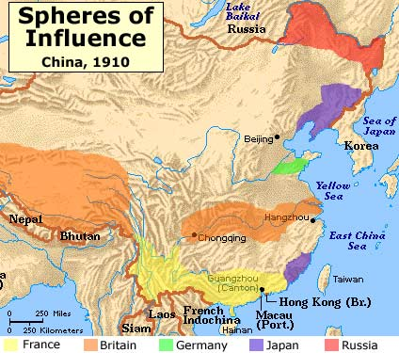
Asia
1886-1985- France, Russia, and Great Britain seized land throughout East Asia.
Spheres of Influence= areas where imperial powers had exclusive trading rights
1899- U.S. secretary of state, John Hay, wrote notes to Britain, Russia, Germany, France, Italy, and Japan asking each country to respect equal trading rights in China
Led to the Open Door Policy

Slide 7
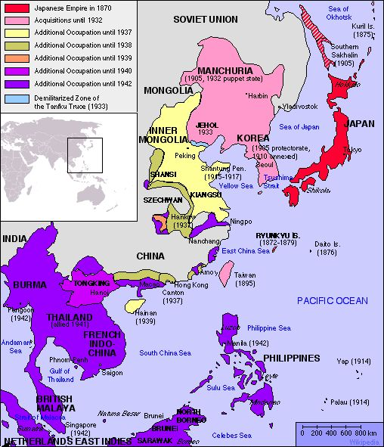
Asia
Japan was isolationist
US wanted them to open ports
Signed a treaty that opened some
Other Western nations did the same
Gov’t changes
Studied Western gov’ts to reform their own
Became a republic, but it was authoritarian, like Imperial Germany
New imperial army created
New education system (based on American system)
More rights for the people

Slide 8
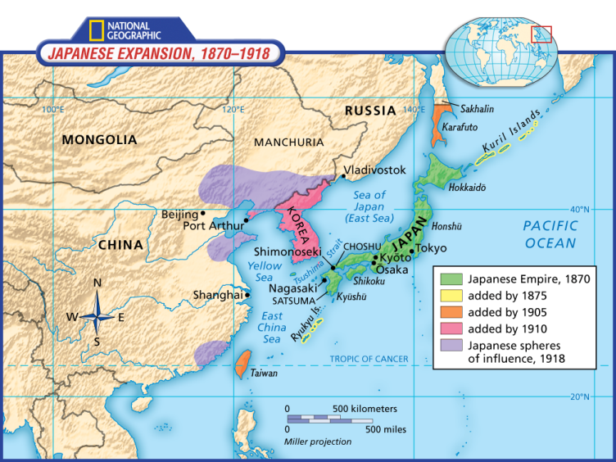
Asia
Japan needed raw materials and wanted to expand
Gained control of the Ryukyu Islands- belonged to the Chinese Empire
Forced the Koreans to open their ports to Japanese trade
Japan led a successful surprise attack on
the Russian naval base at Port Arthur
Japanese navy defeated the Russian fleet
Some Americans began to fear the rise of Japanese power
1907- President Theodore Roosevelt stopped Japanese immigration into the US

Slide 9
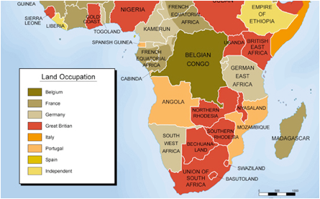
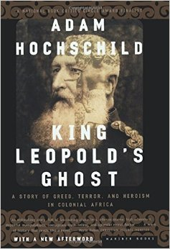
Africa
Europeans used deception to gain land and nat. resources from Africans
GB, France, Germany, Belgium, Italy, Spain, and Portugal competed to gain the most land
West Africa- slave trade declined in late 19th C
Abolished in most civilized nations
Many natural resources (gold, ivory, etc.) & easy ports, so it was most desired area
Central Africa-European explorers made the jungles of C. Africa interesting
King Leopold II of Belgium colonized the area
This worried some countries
France rushed to gain land in C. Africa

Slide 10
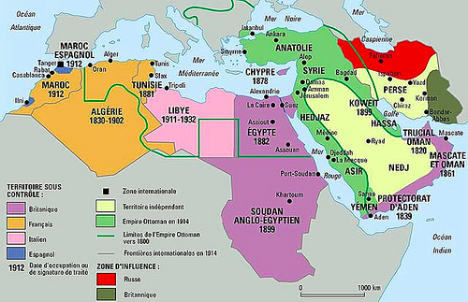
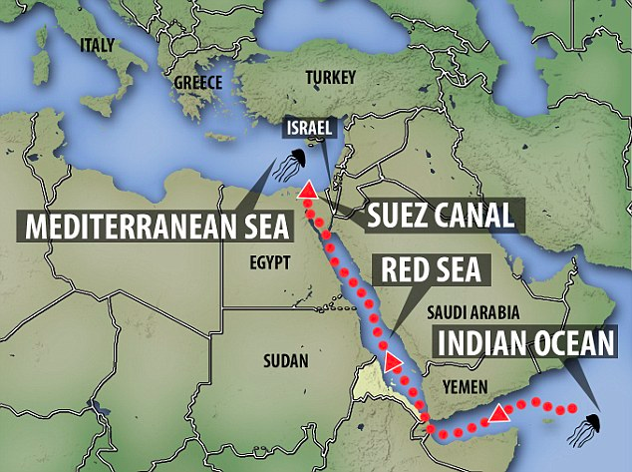
Africa
Egypt was a part of the Ottoman Empire
Muhammad Ali, an Ottoman military officer, took control and made an Egyptian state
Europeans wanted to build a canal that connected the Mediterranean and Red Seas
French completed the Suez Canal in 1869
GB bought their share of the canal
GB put down a revolt- Egypt became a protectorate in 1914
GB seized Sudan in 1898

Slide 11
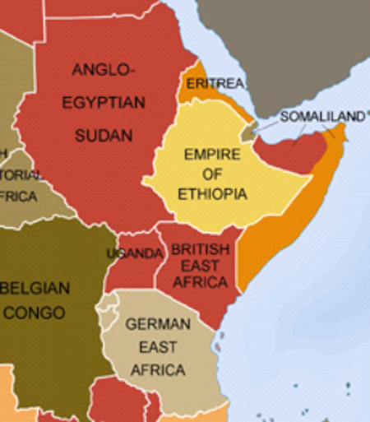
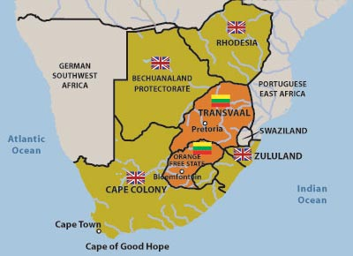
Africa
At the 1884–1885 Berlin Conference, the major European powers divided up East Africa, giving recognition to German, British, and Portuguese claims
No African representatives were there
Most European colonization took place in S Africa
1865- close to 200,000 people moved there
Cecil Rhodes set up diamond and gold companies
Took control of Transvaal (named it Rhodesia)

Slide 12
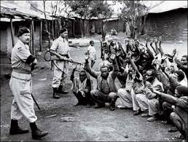
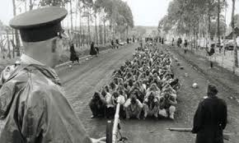
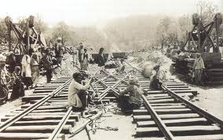
Africa
By 1914, only Liberia and Ethiopia remained independent
Indirect Rule- GB relied on existing political institutions to govern
Interfered much less with indigenous traditions and customs
Most decisions came from the parent country
Direct Rule- Most other nations used this
Set up their own governments within the colony
This often destroyed African traditions

Slide 13
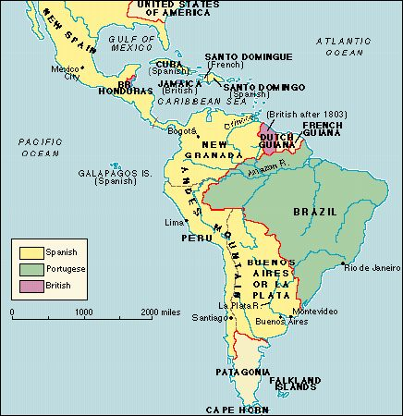
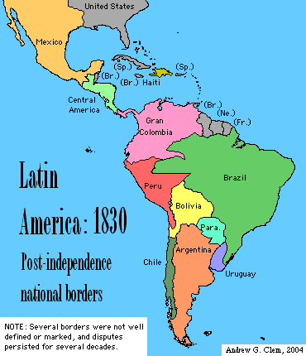
Latin America
Creoles- descendent of Europeans
Controlled land and business
Attracted to principles of equality of all people
19th Century- Napoleon’s wars gave creoles an opportunity
Napoleon overthrew monarchies of Spain and Portugal, weakening control of colonies
1807-1825= series of revolts enabled most of Latin America to become independent
Hispaniola- slave revolt led to independent Haiti- first revolt

Slide 14
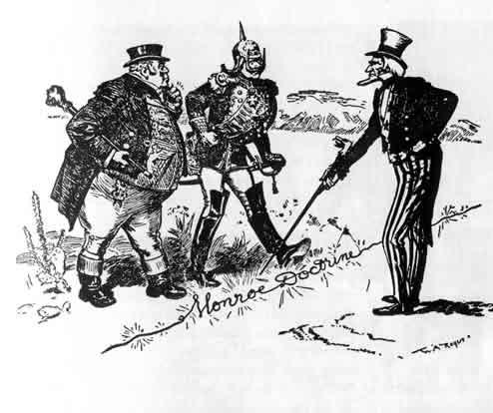
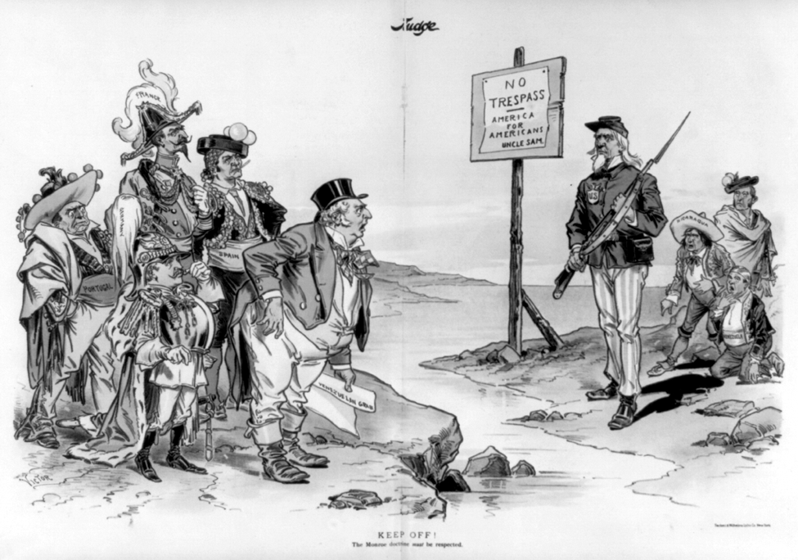
Latin America
The US and GB protected the new independent states
Monroe Doctrine- warned against European intervention in LA
The US and GB now dominated LA
GB dominated trade
US was their source for investment money and loans
US involvement in Latin America
Began intervening in LA by making Cuba a protectorate and annexing Puerto Rico
1903- built the Panama Canal
Americans wanted to protect their investments in LA, so the US began using the military
Many Latin Americans lost trust in the US

Slide 15
Effects of Imperialism
Positive effects
Reduced local warfare
School systems created
Infrastructure created (roads, railroads, telephones, etc.)
Improved medicine, nutrition, etc.
Negative effects
Loss of control of government and economy
Economic pursuits brought poverty
Access to resources and industries destroyed
Increased taxes
European rule- degrading and insensitive to native culture
Most harmful: division of continent (esp. Africa) created problems

