Slide 1
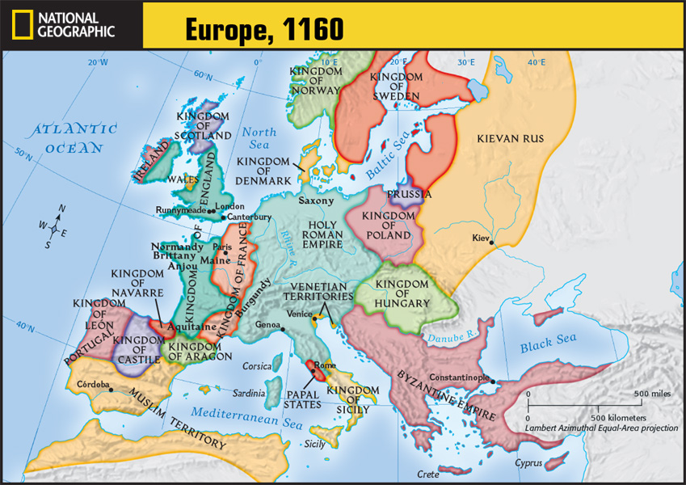
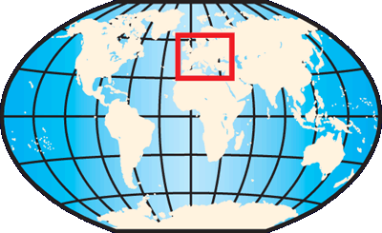
Locate Runnymede. What kingdom is it located in?
What modern-day countries are within the Holy Roman Empire?
The Kingdom of England
Germany, Italy, Switzerland, France, Netherlands, Austria Luxembourg, Liechtenstein, Poland, Czech Rep.

Slide 2
The Growth of European Kingdoms

Slide 3
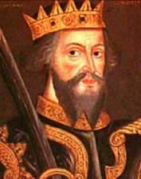
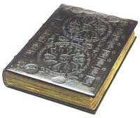
England in the High Middle Ages
Increasing power of the monarchy
1066-William of Normandy defeated King Harold of England at the Battle of Hastings
William was crowned king
Gave fiefs to Norman knights
The Normans and the English merged to create a new English culture
Created the 1st census (Domesday Book) and new system of taxation

Slide 4
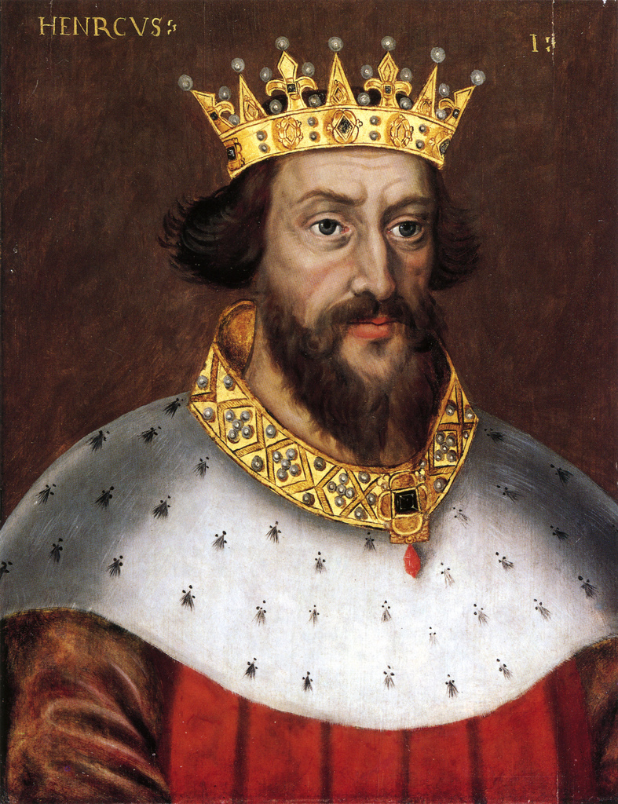
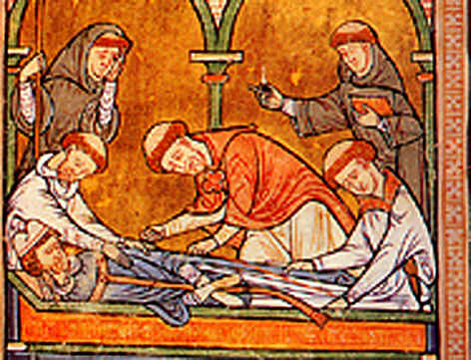
England in the High Middle Ages
Henry II (1154 to 1189)-enlarged the power of the English monarchy
Expanded the royal courts’ powers
This created common law- law common to the whole kingdom
Wanted the right to punish clergy in royal courts
Thomas á Becket (Archbishop of Canterbury) disagreed
Henry had 4 knights kill him
There was public outrage and Henry backed off the Church

Slide 5
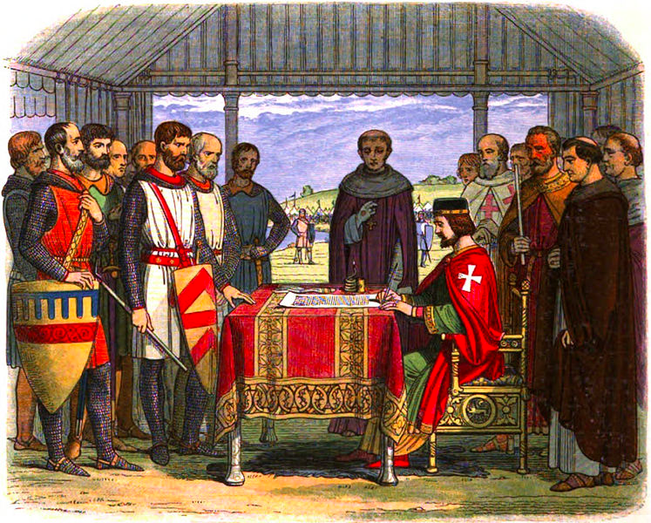
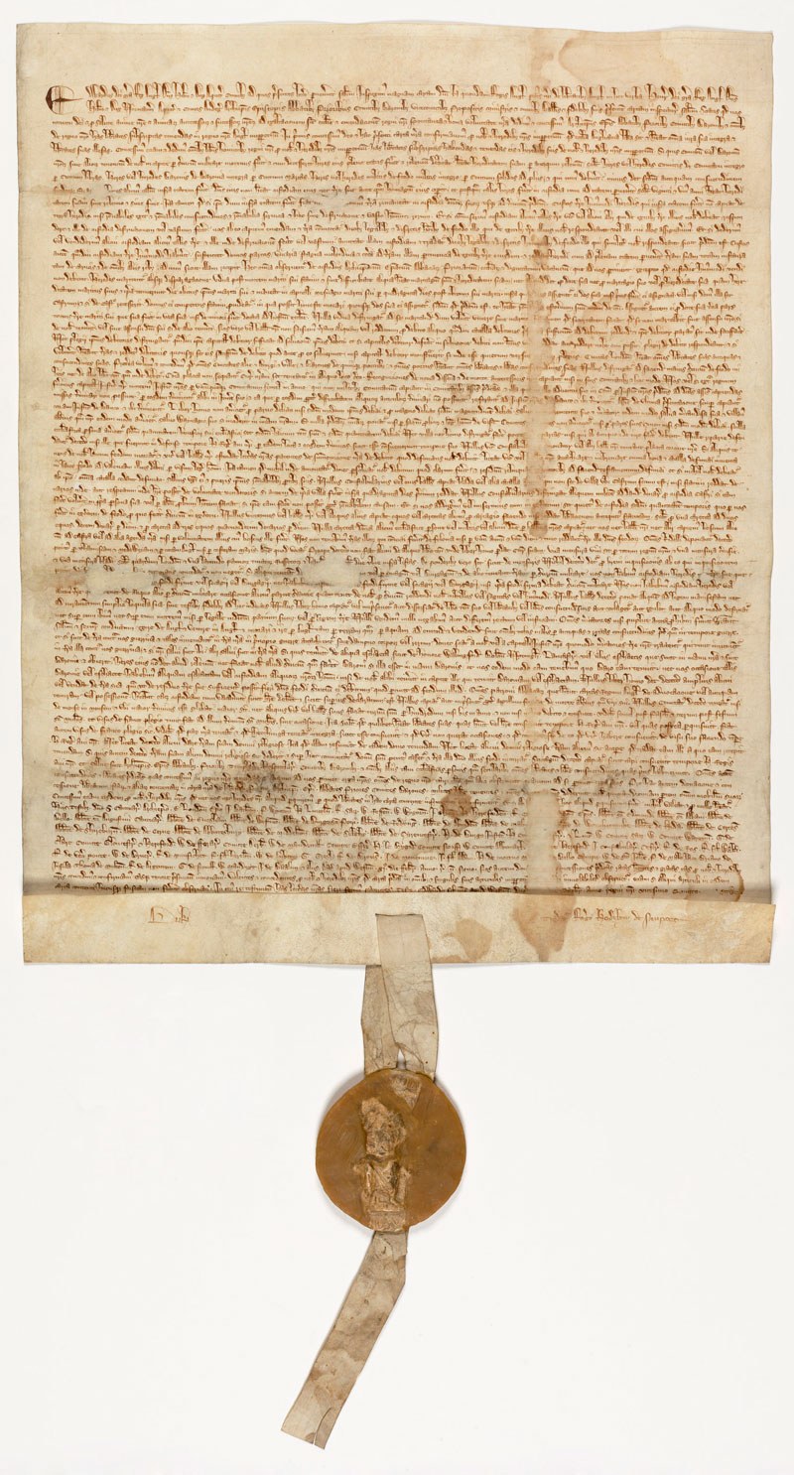
England in the High Middle Ages
Many began to resent the monarch’s power
1215 at Runnymede- King John was forced to agree to the Magna Carta (Great Charter)
Recognized the feudal idea of mutual rights and obligations between lord and vassal
It paved the way for our current system of government
It was the original model of modern British democratic constitution
It did not create Parliament, but gave people the right to

Slide 6
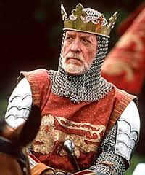
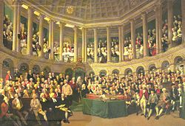
England in the High Middle Ages
Parliament emerged during the reign of Edward I
It granted taxes and passed laws
Composed of two knights from each county, two people from each town, and all of England’s nobles and bishops
Later-nobles and church lords formed the House of Lords
Knights and townspeople formed the House of Commons

Slide 7
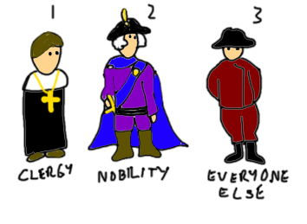
French Kingdom
The last Carolingian king died in 987
Frankish nobles chose Hugh Capet as king
Established Capetian dynasty of French kings
Had very little power- only controlled area around Paris
Nobles were stronger
Power grew under Philip II Augustus
Took back the French territories of Normandy, Maine, Anjou, and Aquitaine from the English
Greatly increased the income and power of the French monarchy
Philip IV- greatly expanded the royal bureaucracy
Began the first French parliament-Estates-General
Made up of three estates (classes)
1st (clergy), 2nd (nobility), 3rd (commoners)

Slide 8
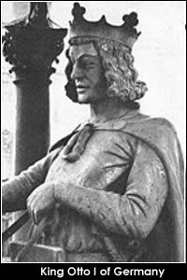
Holy Roman Empire
10th Century- Saxon dukes became kings of the eastern Frankish kingdom
Best known- Otto I- became Roman Emperor after protecting the Pope
Tried to rule both German and Italian lands
Frederick I considered Italy the center of a “holy empire,” hence the name Holy Roman Empire
1176-N. Italian states and the pope allied to defeat Frederick’s army

Slide 9
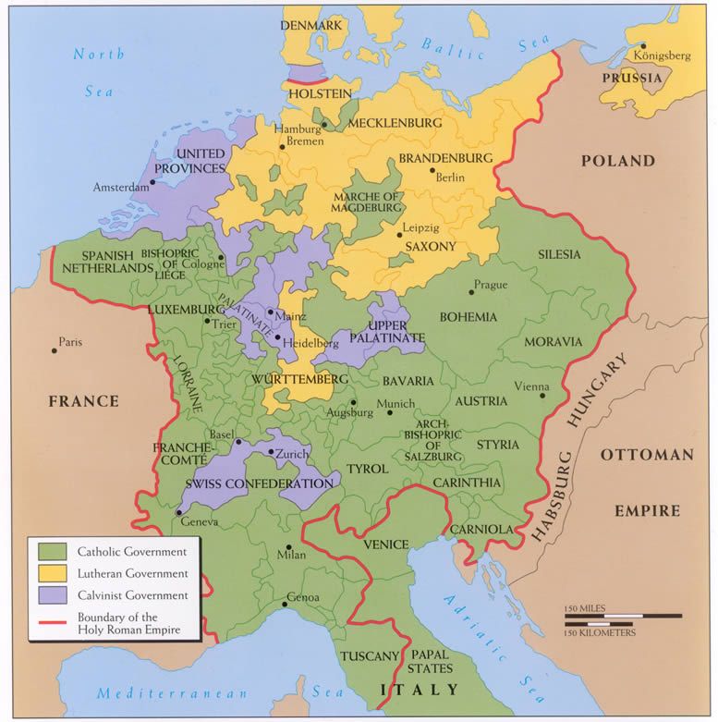
Holy Roman Empire
When the emperor was gone to war, the German nobles created their own independent states
Unlike England and France, neither Italy nor Germany created a national monarchy
Consisted of small states and did not unify until the 19th century

