Slide 1
Galileo Trial

Slide 2
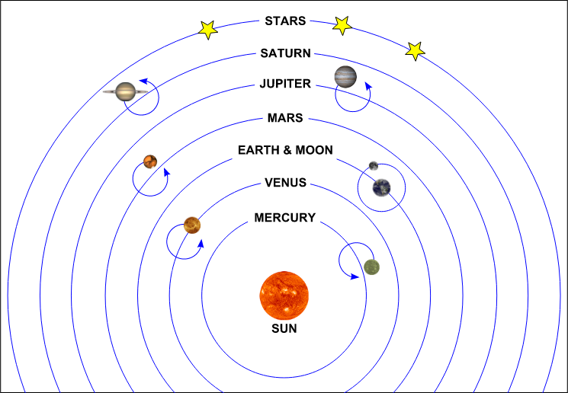

Slide 3
