Slide 1
Click the mouse button or press the Space Bar to display the answers.

Slide 2
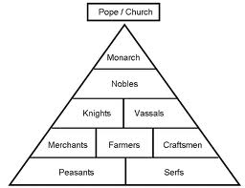
Feudalism

Slide 3
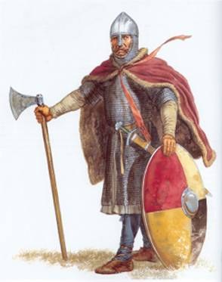
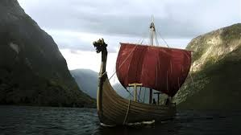
The Invaders
The Treaty of Verdun divided the Carolingian Empire into three parts
One for each of Charlemagne’s grandsons
With no strong central government, this allowed invaders to seize lands.
Vikings- attacked present-day Britain, France, Germany, Iceland
Superb shipbuilders, warriors, and sailors
The Franks tried to assimilate the Vikings by making them Christian
One ruler gave them land that became known as Normandy

Slide 4
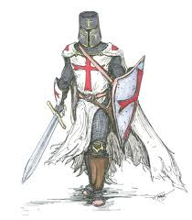
Feudalism
Because of the invaders, people began to look to local landed aristocrats, or nobles, for protection
This led to feudalism
Similar systems were found in Japan and among the Aztec
At the heart of feudalism is the idea of vassalage
A man who served a lord militarily was known as a vassal
Many vassals were knights- heavily armored cavalry
They became the backbone of the medieval aristocracy
Feudal contract- rules that determined the relationship between lord and vassal

Slide 5
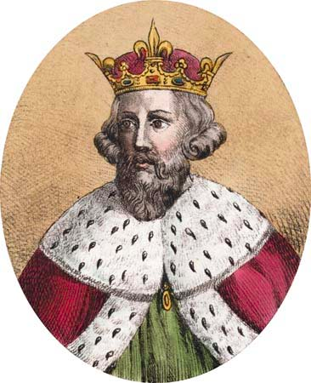
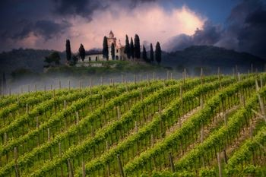
Feudalism
At the top of feudal society was the king
He controlled all of the land in the kingdom
Nobles were granted large fiefs by the king
They would swear an oath of loyalty
Provide troops for the king
Knights were considered lower nobles
They would swear an oath of loyalty to their lord
Provide military service
To stay ready they would compete in tournaments
The joust became the main attraction
Were to uphold an ideal of civilized behavior, known as chivalry
Had to be noble to become a knight
Many started as squires around 14-15 years of age

Slide 6
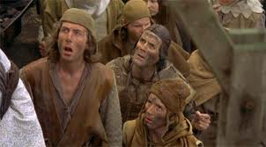
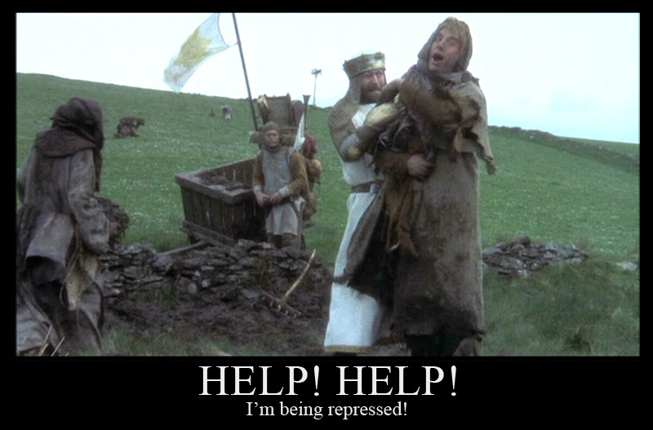
Feudalism
Peasants were dependent on the lord and lived on the manor or fief
There were two kinds:
Serfs- they could not leave the fief
Worked without getting paid
Owed the lord part of their harvest
Freemen- they could leave
They worked on the lord’s land and paid rent
They kept some of their harvest
Paid a percentage to the Church- tithe
Life as a peasant was very difficult
Work was hard, they used rudimentary tools, illnesses were often fatal, and disasters (droughts or floods) destroyed lives and harvests

Slide 7
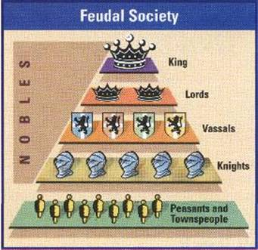

Slide 8
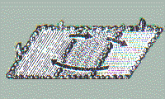
Economics
The number of people almost doubled from 38 m to 75 m in Europe
Increased stability and a larger food supply
There was a climate change
Moved from a two-field to a three-field system
Able to produce more food
One field for fall harvest, one for spring harvest, and one left untouched
New technologies, like the carruca (iron plowshare), allowed farmers to more easily harvest crops

Slide 9
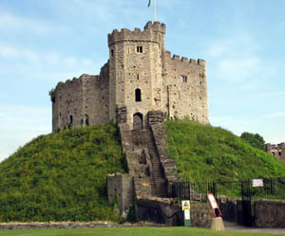
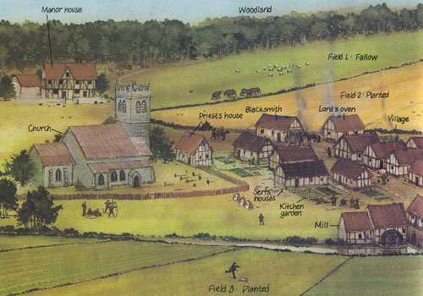
The Manor
Manors were self-sufficient
Trade and transportation was almost non-existent
Own court of law (headed by the lord)
All food, clothing, etc. was produced on the manor
Manors were comprised of a manor house (where the lord lived), cultivated lands, woodlands (to hunt), pastures (for cattle), fields, a village, a church, a priests house, a mill (used to grind grains into flour, and an oven.
Ideally were located along a stream or river to provide power for the mill.

Slide 10
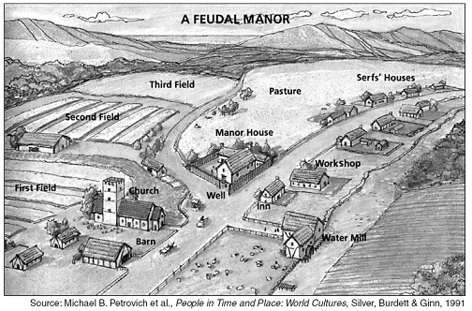
The Manor

