Slide 1
Europe’s Transition from the Middle Ages to the Renaissance

Slide 2
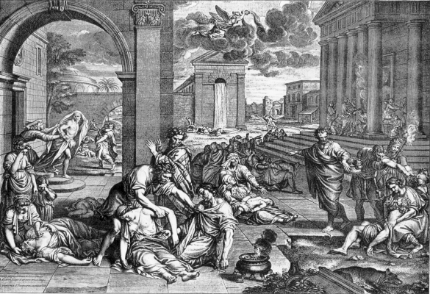
The Black Death
What was the Black Death?
A deadly plague that spread across Europe Caused by bacteria Appeared in 3 forms: Pneumonic: attacked lungs Septicemic: bloodstream Bubonic: Caused buboes on body
How did it spread?
Originated in Mongolia and spread to Black Sea along Silk Road Bacteria carried by fleas on black rats Italian merchant ships brought rats to Europe First appeared in Sicily
Why couldn’t people stop it?
They were ignorant about its cause: blamed the stars, God’s anger, and Jews Tried ineffective cures, like pomanders, flagellation, and repentance of sins
How did it change life?
Killed 1/3 of the population Forced farmers to diversify their crops Peasants revolted and demanded more freedom Working class moved to cities for better wages Reduced the power of feudal lords

Slide 3
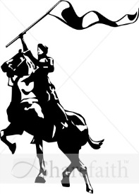
Hundred Years’ War
How did the war begin?
French king, Charles IV died in 1328 with no male heir
Two men attempted to claim the vacant throne
Edward III of England (son-in-law)
Philip of Valois (nephew)
English armies attacked France
Who was Joan of Arc? How did she affect the war?
Young French peasant woman who was inspired by God to save France
Convinced Charles VII to let her lead an army in 1429
Helped push the English Armies out of central France
Was captured, accused of heresy, and burned at the stake in 1431
Sainted in 1922
War begins 1337
1429
1453
How did the nature of warfare change?
Longbows eliminated advantages of armor
Cannons could be used to blast holes in castles
Monarchs used armies recruited from common people
How did the war contribute to the end of feudalism in France?
People became more patriotic, more devoted to the monarch than their feudal lord
Monarchs built huge armies with the taxes they collected which reduced the power of the nobles

Slide 4
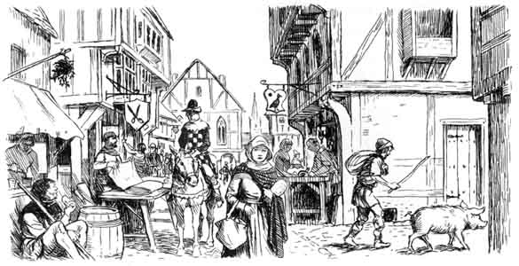
Trade and Commerce
Trade and Commerce: Foundations of Town Life
Towns were centers for trade and shipping
Luxury goods, like silk, spices, ivory, etc. could be bought in towns
Guilds dominated social and civic life of towns
Guilds reflected importance of Christianity
Contributed to building cathedrals
Adopted patron saints and sponsored parades in their honor
500
1400
1650
Town life in the Middle Ages |  | Town life during the Renaissance
Towns were small because society was based on agriculture and most people lived in the countryside | Society | Towns grew because society began to be based on commerce and more people lived in cities
Nobles had most of the power Lords owned the land Towns needed protection from knights | Power | Middle class had most of the power Limited the power of feudal lords by forcing them to grant charters Gained control of great sums of money by organizing banks
Status was determined by birthright | Status | Status determined by wealth and ability

Slide 5
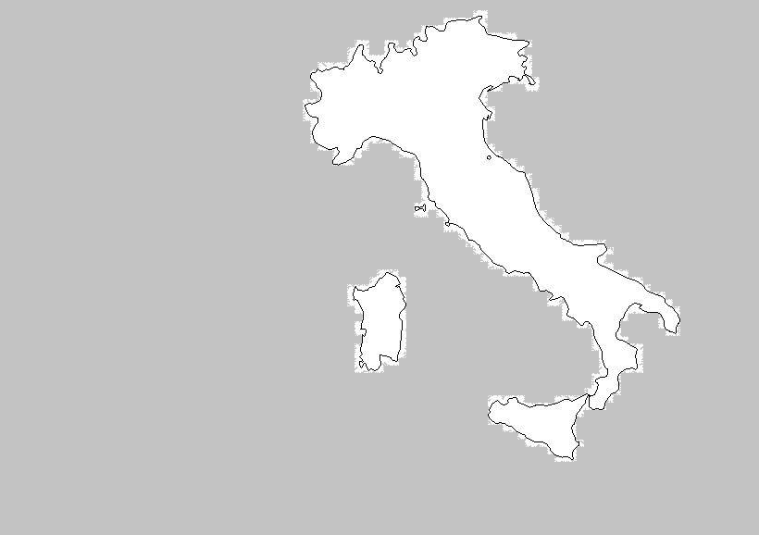
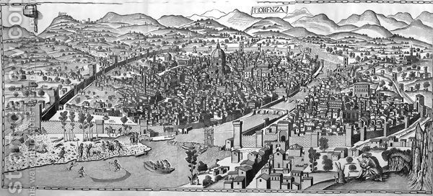
Growth of Italian City-States
How did Florence become the most influential city-state?
Maintained thriving industry in wool and silk
Purchased luxury items from the East and sold them for a large profit
Sold insurance to sea traders to protect their overseas investments
Created numerous banks that made loans or exchanged currency
Medici family promoted trade, banking, the arts, scholarship, and civic pride
Why were Italian city-states so rich and powerful?
Had strong ties with Byzantine and Muslim merchants
Each city-state specialized in one commercial activity
Milan- metal goods and armor
Florence- banking and textiles
Venice- Asian goods
European monarchs and nobles sought loans from merchants
Venice
Milan
Florence
Florence 1480
What was the Renaissance and why did it begin in Italy?
Renaissance is a French word, meaning rebirth
Period when scholars became interested in ancient Greek and Roman culture
Italian city-states displayed their wealth by giving financial support to artists who created works with classical themes

Slide 6
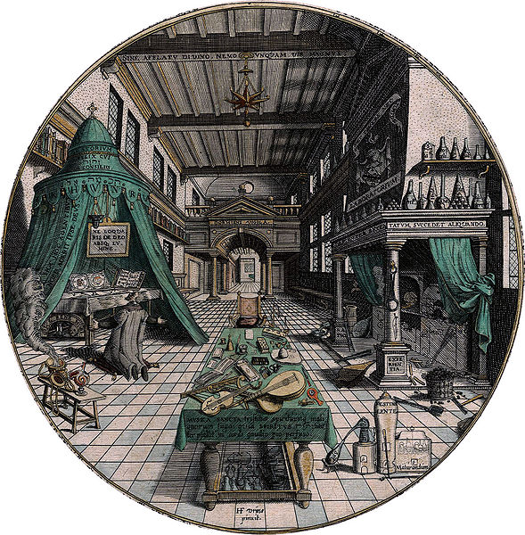
The Spirit of the Renaissance
Why people like me became interested in Ancient Culture…
Knowledge of ancient Greece and Rome was discovered by scholars
The Crusades made Europeans eager to learn about the world around them
Scholars thought ancient Greek and Roman writings would help solve problems
The Spirit of the Renaissance included….
A New Type of Scholar Called a Humanist
Humanists devoted themselves to studying ancient writings
They tried to learn about many subjects, like Latin, Greek, history, and mathematics
Petrarch, a Florentine, was the first great Humanist
A Fascination with Classical Cultures
Artists used ancient art as models
Donatello created statues that copied the Roman ideal of the human body
Brunelleschi designed buildings after studying ruins in Rome
Revolutionary innovations were made
A Belief in Human Potential
Believed each person could achieve great things
Claimed that people educated in the classics could create a better world
Emphasized human achievement on earth, rather than the afterlife

