Slide 1
Africans lost their farms to Europeans.
taxation of Africans probably high since Africans had no say
Africans forced to give up many customs around which family life revolved
Click the mouse button or press the Space Bar to display the answers.

Slide 2
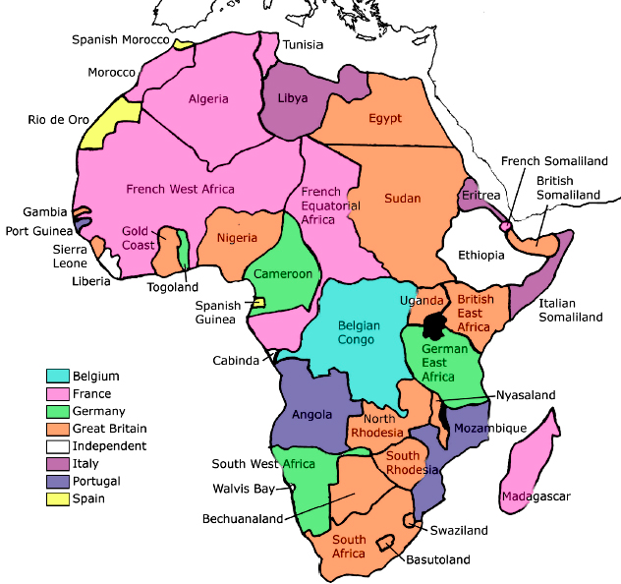
Empire Building in Africa

Slide 3
Big Ideas
Explain the motives for imperialism.
Why is the Suez Canal important?
How did European nations rule their colonies?

Slide 4
Motives for Imperialism
Imperialism= extension of a nation’s power over other lands
Motives:
Economic- make money, expand foreign trade, create new markets, get resources
Political- gain power, compete with other countries, expand territory, gain prestige
Religious- spread Christianity, moral values, educate people
Exploratory- explore the unknown, conduct scientific research, go on an adventure
Ideological- “White Man’s Burden”- civilize the heathens, Social Darwinism (only the strong survive)

Slide 5
West Africa
Europeans used deception to gain land and nat. resources from Africans
GB, France, Germany, Belgium, Italy, Spain, and Portugal competed to gain the most land
West Africa- slave trade declined in late 19th C
Abolished in most civilized nations
Started trading peanuts, timber, hides, and palm oil
1874, Great Britain annexed (incorporated a country within a state) the west coastal states as the first British colony of Gold Coast
France controlled the largest part of W Africa
Germany controlled Togo, Cameroon, German Southwest Africa, and German East Africa

Slide 6
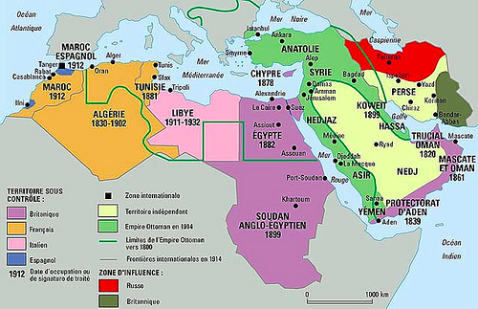
North Africa
Egypt was a part of the Ottoman Empire
Muhammad Ali, an Ottoman military officer, took control and made an Egyptian state
Europeans wanted to build a canal that connected the Mediterranean and Red Seas
French completed the Suez Canal in 1869
GB bought their share of the canal
GB put down a revolt- Egypt became a protectorate in 1914
GB seized Sudan in 1898
French settled in Algeria, made Tunisia and Morocco protectorates
Italy tried to take over Ethiopia, but was
defeated
Seized Turkish Tripoli (Libya)

Slide 7
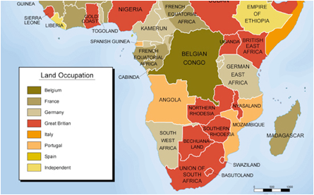
Central Africa
European explorers made the jungles of C. Africa interesting
David Livingstone- explored for 30 years, but disappeared
NY Herald sent Henry Stanley to find him
“Dr. Livingstone, I presume.”
Stanley tried to get GB to settle the Congo, but they refused
King Leopold II of Belgium did instead
Hired Stanley to set up colonies
This worried some countries
France rushed to gain land in C. Africa

Slide 8
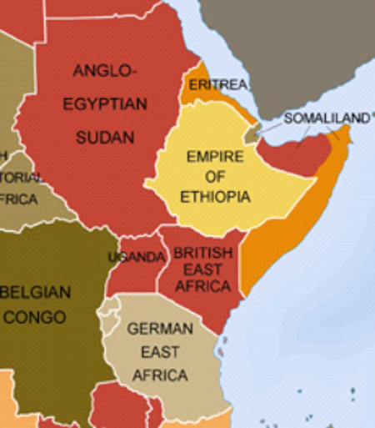
East Africa
By 1885, GB and Germany had become the chief rivals in East Africa
Bismarck downplayed the importance of colonies
He converted to colonialism
Many Germans wanted a German empire
At the 1884–1885 Berlin Conference, the major European powers divided up East Africa, giving recognition to German, British, and Portuguese claims
No African representatives were there

Slide 9
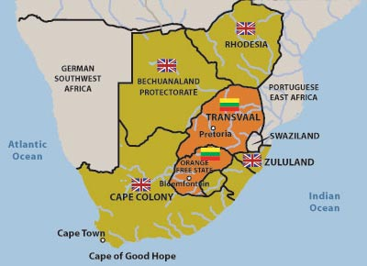
South Africa
Most European colonization took place in S Africa
1865- close to 200,000 people moved there
Boers (descendants of Dutch settlers) fled north from British rule in 1830’s
Established Transvaal and Orange Free State
Believed in white supremacy
Indigenous peoples sent to reservations
Frequently battled the Zulu
British later defeated the Zulu

Slide 10
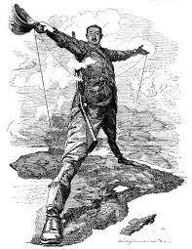
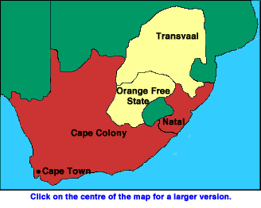
South Africa
Cecil Rhodes set up diamond and gold companies
Became very wealthy
Took control of Transvaal (named it Rhodesia)
Boer War- GB fought the Boers from 1899-1902
Boers used guerilla warfare
GB burned crops, kidnapped women and children
1910-GB set up Union of South Africa, combining the Cape Colony and the Boer republics
Self-governing nation within the British Empire
To appease the Boers, the policy was that only whites and a few propertied Africans could vote

Slide 11
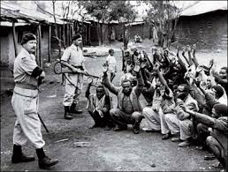
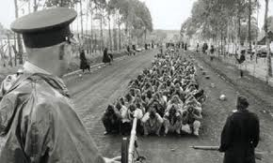
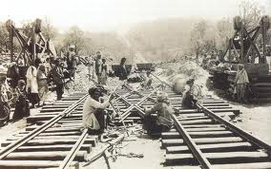
Effects of Imperialism
By 1914, only Liberia and Ethiopia remained independent
Indirect Rule- GB relied on existing political institutions to govern
Interfered much less with indigenous traditions and customs
Most decisions came from the parent country
Direct Rule- Most other nations used this
Set up their own governments within the colony
This often destroyed African traditions
Not until the 20th C will Africans revolt for independence

