Slide 1
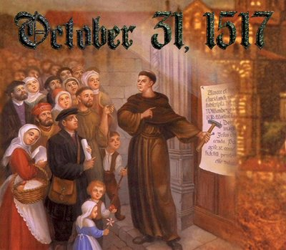
Debate Team Carousel
The Protestant Reformation

Slide 2
The Protestant Reformation
Flow Chart
Corruption in the Catholic Church
Desiderius Erasmus
Martin Luther
Church’s Response
Emperor’s Response
Peace Treaty
The Protestant Reformation

Slide 3
The Protestant Reformation
Flow Chart
Corruption in the Catholic Church
Popes concerned with political power
Clergy using position to gain wealth and further career goals
Priests ignorant of how to achieve salvation
Selling of indulgences
Desiderius Erasmus
Wrote Praise of Folly- exposed Church corruption. Spread “Philosophy of Christ.”
Martin Luther
Church’s Response
Emperor’s Response
Wrote 95 Theses- attacked selling of indulgences
Excommunicated Luther in 1521
Edict of Worms- Bring Luther in and burn his books
Peace Treaty
Peace of Augsburg- Princes could choose Catholic or Lutheran
The Protestant Reformation

Slide 4
Prompt #1
Was Martin Luther right to break away from the Catholic Church?

Slide 5
Prompt #2
Was the Peace of Augsburg a reasonable compromise for the religious disputes in the Holy Roman Empire?

