Slide 1
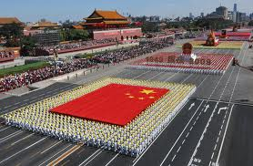
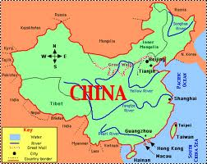
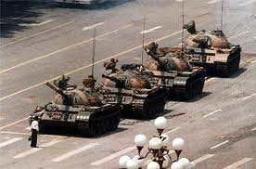
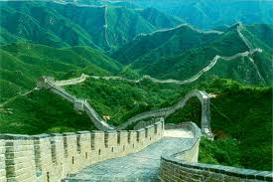
China

Slide 2
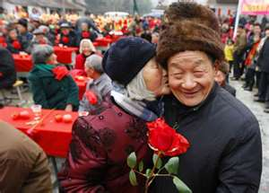
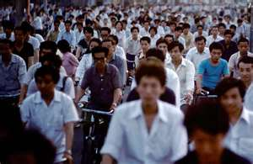
Population Patterns
The People
92% (1.3 billion people) of Chinese people belong to the Han
Ethnic group named for a powerful ancient ruling family
Han rulers developed a culture whose influence has lasted to this day
8% belongs to about 55 different ethnic groups
Non-Chinese ethnic groups have their own separate histories and cultures
Tibet- Buddhist kingdom
China took over in the 1950s

Slide 3
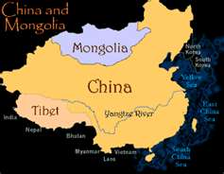
Population Patterns
Taiwan- island country off of China’s southern coast
Most people descended from Chinese who migrated to the island several hundred years ago
Aborigines- related to peoples of SE Asia and Pacific region
Mongolia- Most are ethnic Mongolians
Mongol ancestors ruled the largest land empire (China to E Europe)
Today they’re divided by separate linguistic groups

Slide 4
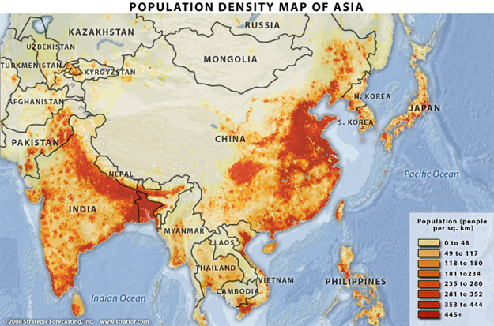
Population Patterns
Density and Distribution
More than 90% of the people live on 1/6 of the land in China
Most live in the fertile valleys and plains of the three big rivers:
Huang He, Chang Jiang, and Xi River
Big cities: Shanghai, Beijing, Tianjin, and Guangzhou- lie in river valleys or coastal plains
Mongolia’s steppe regions have pop. density of 4 people/sq. mile

Slide 5
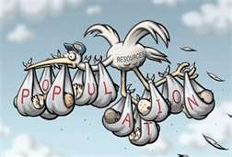
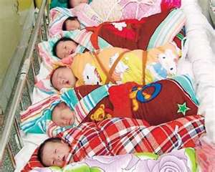
Population Patterns
Urban Growth
Most live on farms, but millions continue to migrate to the cities
Led to overcrowding in some cites
Led to farm-labor shortages, so China built new agricultural towns in remote areas
Provides more social services and better quality of life
Gov’t has tried to limit pop. growth
1979- China began a policy that allowed each family to have no more than 1 child
Not strictly enforced anymore- pop. is growing again

Slide 6
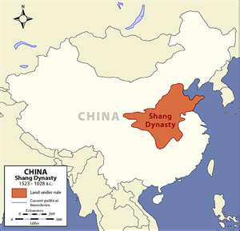
History and Government
Early History
China is a culture hearth- center from which ideas and practices spread to surrounding areas
China’s culture began around 5,000 yrs ago
Historical records were first kept under the Shang dynasty (ruling family)
Took power around 1600 BC in N. China plain
Faced rebellions by local lords, attacks by nomads, and natural disasters
When gov’t was stable it fended these threats off
Whenever a dynasty ended, the Chinese said they lost “the mandate of heaven.”

Slide 7
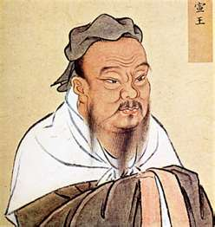
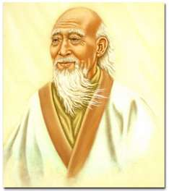
History and Government
After the Shang, the Zhou dynasty ruled for about 800 yrs
Culture spread, trade grew, and they began making iron tools
Confucius lived during this time
Confucianism- a system of thought based on discipline and moral conduct
Lao-Tzu- helped form Taoism
Philosophy of living in simplicity and harmony with nature

Slide 8
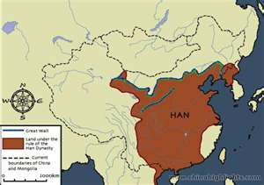
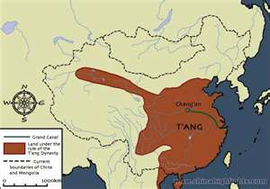
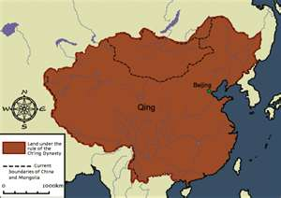
History and Government
Around 200 BC, Qin Shi Huang Di united all of China and built the first section of the Great Wall (to ward off attacks from C. Asia)
Han and Tang- traders and missionaries took Chinese culture to all of E Asia
Ming- Zheng He (explorer) reached to coast of E Africa
Qing- ruled from mid-1600s to early 1900s
By then, Western countries had set up shipping routes, hoping to share in the region’s rich trade in silk and tea
1800s- Europeans used powerful warships to force China to open their ports
These were called Spheres of Influence

Slide 9
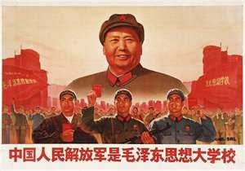
History and Government
Modern China
1911- a revolution led by Sun Yat-sen ended the rule of emperors in China
1927- Chaing Kai-shek formed the Nationalist gov’t of the Republic of China
At the same time, Mao Zedong (communist) gained support from farmers
After years of civil war, the Communists won power in 1949
Nationalists fled to Taiwan
1950s- large gov’t owned farms replaces smaller ones
New farms failed to produce, though
Millions died and economy crumbled
1970s- Deng Xiaoping allowed private ownership of businesses and farms
Even welcomed foreign businesses and technology
1990s- Communist party still rules, but they had
pressure to modernize
This opened up their economy to free market influences
Today, it is more socialist than communist

Slide 10
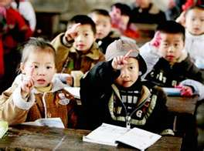
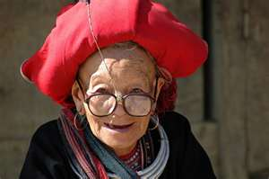
Culture
Education and Health Care
In the past, only the wealthy learned to read and write
Communist gov’t has pushed to increase literacy
1960s- Cultural Revolution, literacy suffered a setback
Schools and factories closed
People believed to be enemies of Mao Zedong’s communism were persecuted
After his death, they refocused on education and literacy has steadily risen
Better health care has increased life expectancy to 70 yrs
Pay for treatment, but economic reforms mean fewer promised services

Slide 11
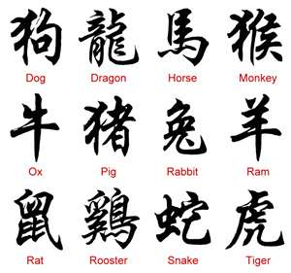
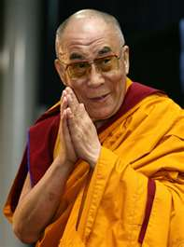
Culture
Language and Religion
Most speak Mandarin
Use ideograms (pictures or symbols that stand for ideas)
Communist gov’t discourages religious practices, and many define themselves as atheist
Others still hold traditional faiths, like Buddhism, Confucianism, and Taoism
Tibet- restrict Buddhist population
Face arrest for owning photos of the Dalai Lama

Slide 12
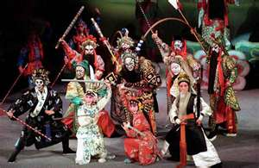
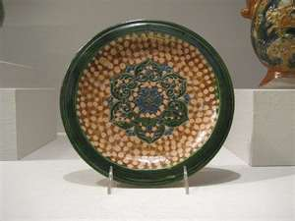
Culture
The Arts
Ancient poetry described human relationships and beauty in nature
Opera uses elaborate costumes, music, acrobatics, and martial arts
Tang dynasty- made fine porcelain (china)
Cultural Revolution tried to wipe out traditional arts, but they are slowly returning

