Slide 1
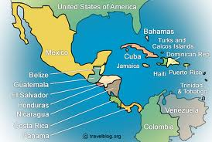
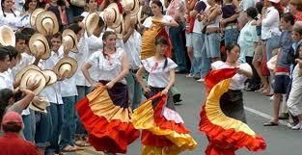
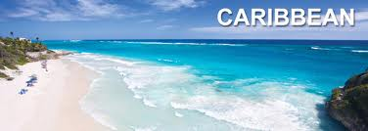
Central America and the Caribbean

Slide 2
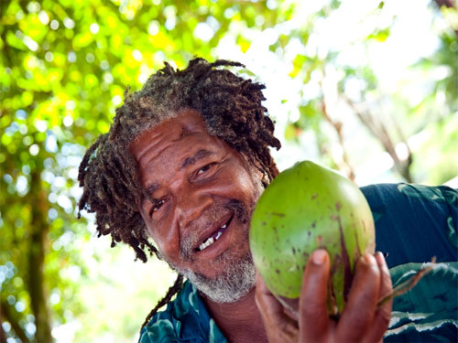
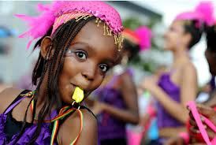
Population Patterns
The People
First inhabitants were indigenous peoples
People of Maya descent make up about ½ of indigenous pop. In Guatemala
Costa Rica- most from European descent
Africans first arrived as enslaved people
Slavery ended by late 1800s
Bahamas- majority is of African descent

Slide 3
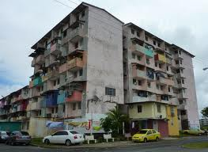
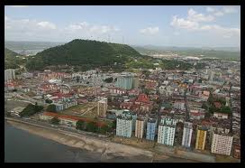
Population Patterns
Urban Challenges
People migrate to cities in search of work
Often don’t find it
Cities’ resources are being drained by large pop.
Can cause a collapse of a city’s infrastructure
Could deprive people of electricity, water, etc.
Most stay in the cities
Can’t afford to move back to villages

Slide 4
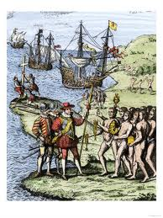
History and Government
European Conquests
Columbus’s voyages led to Spanish exploration and colonization
1st settlement on Hispaniola
Easily conquered the Native Americans
Forced to work in gold mines and plantations
Hard labor, starvation, and European diseases nearly wiped them out
Europeans imported Africans to meet labor shortage

Slide 5
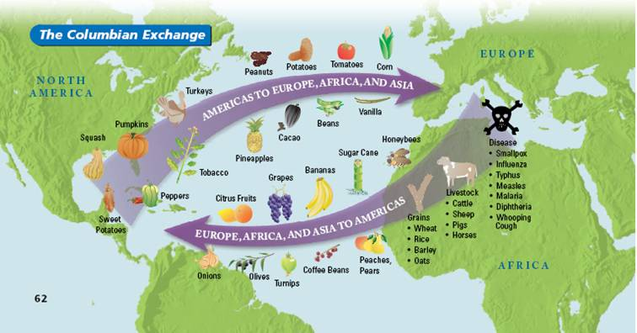
History and Government
Columbian Exchange
Movement of plants, animals, and diseases between Europe and the Americas
Spain, Portugal, France, and Britain moved these goods

Slide 6
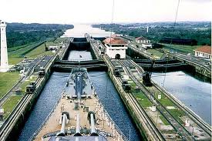
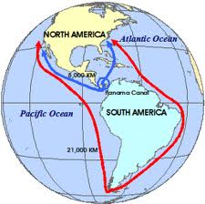
History and Government
Panama Canal
Explorer Vasco Nunez was the first to grasp the geographic features of the isthmus of Panama
Led to the idea of creating a shortcut to the Pacific
1904- Panama Canal final construction began
1914- it officially opened

Slide 7
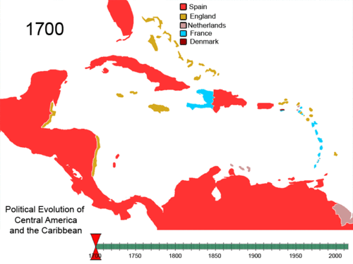
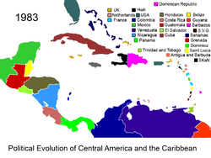
History and Government
Gaining Independence
Haiti was the first to get independence in 1804
Won a revolt led by Francois Toussant Louverture
Cuba won independence in 1898 from Spain
Under US “protection” until 1902
Puerto Rico and Virgin Islands remain under US control
1823- independent C. American provinces formed a federation (United Provinces of Central America)
Led by powerful elites
Separated into 5 countries:
Guatemala, El Salvador, Honduras, Nicaragua, and Costa Rica

Slide 8
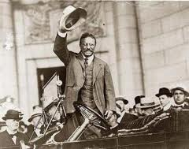
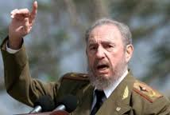
History and Government
Movements for Change
20th Century brought political changes
US backed Panama to gain independence from Colombia in 1903
With more industries, railroads, and trade upper classes gained more wealth
Ignored lower class’s demands for reforms
1959- Fidel Castro took control of Cuba (communist)
Today, many countries are battling political corruption and violence
More people have been voting

Slide 9
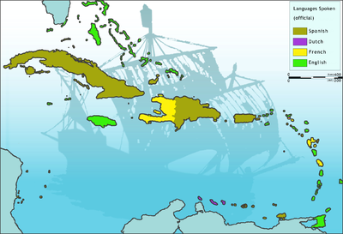
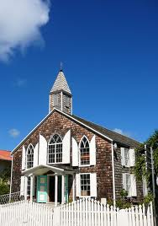
Culture
Language and Religion
Spanish is the primary language
In Caribbean- English, Spanish, French, and Dutch
Each country has its own dialect (form of a language unique to a particular region)
Many speak Native American languages
Patois- dialects that blend indigenous, European, African, and Asian languages
Most are Roman Catholic in C. America
French and Spanish speaking Caribbean nations are Catholic
English, Dutch- Protestant
Other faiths: Hinduism, Islam, Indigenous, African
Some mixed religions: Santeria and Voodoo

Slide 10
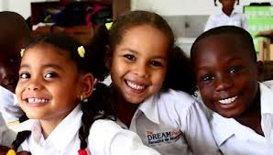
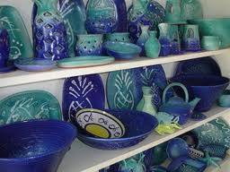
Culture
Education
Children are generally required to complete elementary school
Many do not because of long distances to school and lack of money
The Arts
N. Americans made early art (woodcarving, pottery, metalwork, and weaving)
Music combines N. American, European, and African influences
Styles evolved from music traditions of indigenous wind and percussion instruments, European string instruments, and African drums, rhythms, and dances.

Slide 11
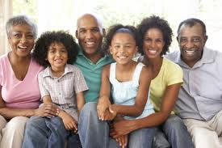
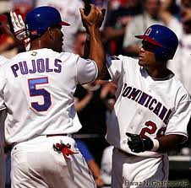
Culture
Family Life
C. America- importance on extended family
Caribbean- matriarchal (family ruled by a woman- mother, grandmother, etc.)
Characteristic of West Africa
Sports and Leisure
Baseball, basketball, and volleyball are most popular sports
Baseball came from Americans who taught it to Cubans, who spread it throughout the Caribbean

