Slide 1
Canadian Culture

Slide 2
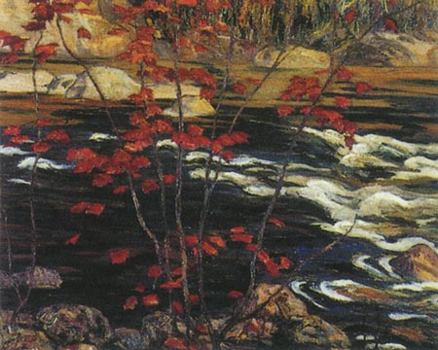
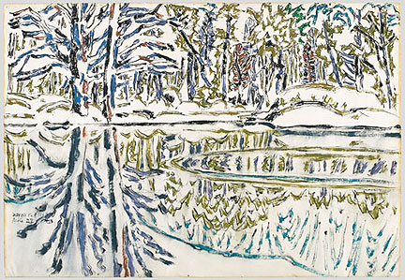
Arts
The arts have flourished since WWII.
The gov’t has done much to support them.
Advertised art and art events in publications
Opened many art schools and colleges
Early Canadian Art
Followed European trends of the 19th century
Painted landscapes and scenes of Native American peoples
Since the 1930s, Canadian paintings have been more individualized
Emily Carr- painted pictures of totem poles
David Milne- landscapes
Abstract painters- Jean-Paul Riopelle, Harold Town,
Michael Snow
Canadian sculpture has been enriched by the walrus ivory and soapstone carvings by the Inuit artists.
Show objects and activities from the daily life of the Inuit.

Slide 3
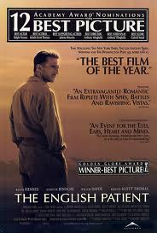
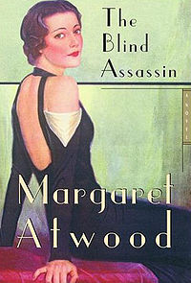
Literature
It is often divided into French and English-language literature
Reflects the Canadian perspective on nature, frontier life, and Canada’s position in the world
Famous Authors:
Michael Ondaatje- wrote The English Patient
Margaret Atwood- wrote The Blind Assassin
Yann Martel- wrote The Life of Pi

Slide 4
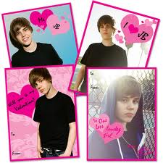
Music
Aboriginals, the French, and the British have all made contributions to the musical heritage of Canada
Since the 17th century, Canada has developed a music infrastructure
Canadian Content (CANCON) regulations require all radio stations in Canada play at least 36% Canadian music
This has allowed Canadian artists to get their music out
It had been dominated by American and European artists
Juno Awards- recognizes Canadian achievement in popular music
Famous Canadian Musicians
Shania Twain
Justin Bieber
Sara McLachlan
Michael Buble
Alanis Morissette
Celine Dion
Avril Lavine

Slide 5
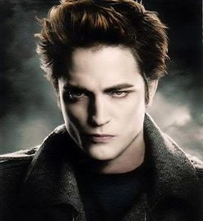
Film & Television
The Canadian film industry has been dominated by Hollywood
Many Hollywood movies are made in Canada,
especially in Vancouver
Some Twilight movies were made there
Canadian producers have been successful in Sci-fi
X-Files, Stargate SG-1, Battlestar Galactica, Smallville
Television
This is also dominated by the US
Discovery Channel (Canada), MTV Canada, and BBC Canada
But, Canadians have the CBC, which produces Canadian made shows

Slide 6
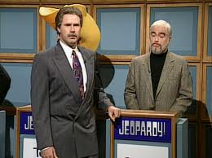
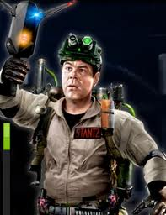
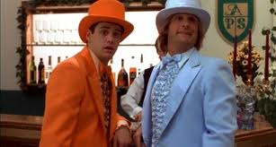
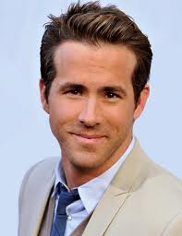
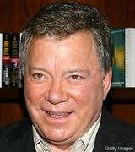
Film & Television
Famous Canadian Actors:
Alex Trebek
Brendan Fraser
Dan Ackroyd
Donald Sutherland
Jim Carrey
Mike Meyers
Ryan Reynolds
William Shatner

Slide 7
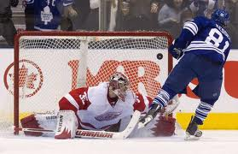
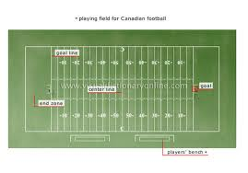
Sports
Canadians sport culture is unique
Ice hockey is the official winter sport and the most popular sport in Canada
Lacrosse is a sport many Canadians play
Originated from the aboriginals
Canadian Football- different from American football
110 yard field, not 100
12 players, not 11
3 downs, not 4
1 point for kicking the ball into the end zone with no return

Slide 8
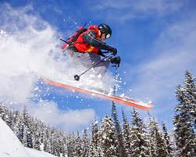
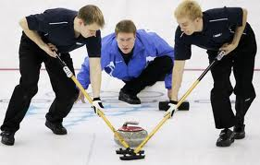
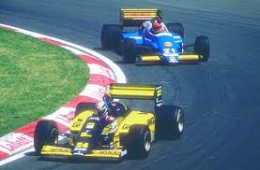
Sports
Other popular sports:
Auto racing
Curling
Skiing/snowboarding
Golf
MMA

