Slide 1
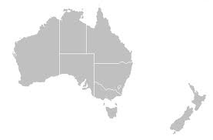
Australia & New Zealand
Homework:
Acrostic: Australia

Slide 2
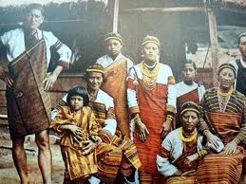
Population Patterns
The People
Aborigines- Australia
World’s oldest surviving culture
Arrived in Australia 40-60,00 yrs. ago
About 2% of the population
Different groups:
Arrente- believe they have a direct relationship to the landscape
believe in Dreamtime (a system of beliefs that connects them back to the beginning of time)
Palawa- lived on island of Tasmania for about 32,000 yrs.
Maori- New Zealand
Came from Polynesia
Live by hunting, fishing, and raising crops.
Many traditions still exist
Europeans/Asians
Europeans began colonizing Australia in the late 1500s
Asians have been recruited by Australia to live there recently

Slide 3
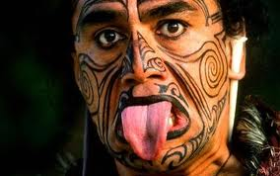
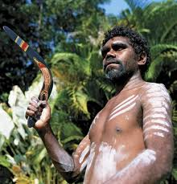
History and Government
Early Peoples
Earliest settlers migrated over land bridges during the Ice Age
Early aborigines led a nomadic life
Clans (family groups) traveled together within ancestral territories
Carried baskets, bowls, spears and sticks for digging (that’s it)
To hunt animals, men would use a heavy throwing stick called a boomerang
Women and children gathered plants and seeds
Between 10th and 14th centuries Maori migrated to NZ
Lived in villages and grew traditional root crops
Taro and yams

Slide 4
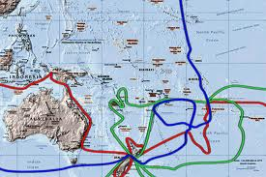
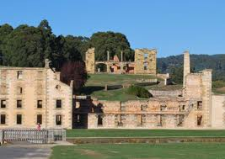
History and Government
European Exploration
James Cook claimed eastern Australia for Britain
Used it as a penal colony (their old one was Georgia) in 1788
By 1850s- imprisonment had ended and settlers were establishing coastal farms and settlements
Livestock (sheep) were introduced
Made a lot of money selling wool to Britain
Discovered gold in 1850s= more wealth and settlers

Slide 5
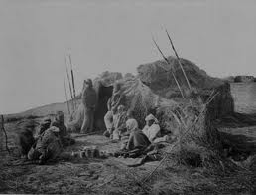
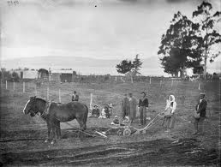
History and Government
Arrival of the Europeans had a dangerous impact on indigenous pop.
Forcibly removed many Aborigines and denied them basic rights
They resisted, but diseases and violence greatly reduced their populations
Placed them in reserves
Maori- British introduced new ways of farming and their culture
Fought for 15 yrs= many Maori died and lost more land to the British

Slide 6
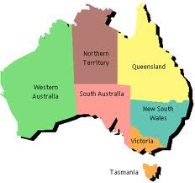
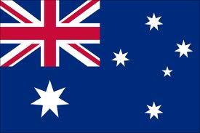
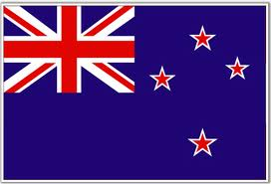
History and Government
Independence
Australia and NZ peacefully won independence in early 1900’s
1901- Australia formed the Commonwealth of Australia
Became a dominion (self-governing country of the British Empire)
Gov’t blended US federal system w/ Britain’s parliamentary democracy
1907- NZ became a dominion
1893- NZ became the first country to give women suffrage
Since WWII- economies and gov’ts linked to the US

Slide 7
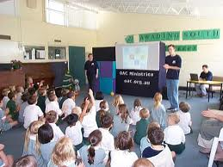
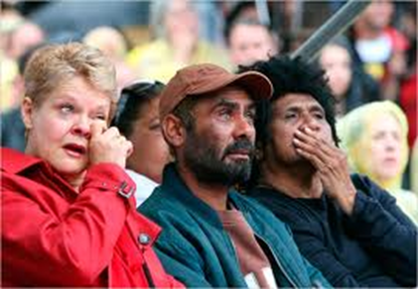
Culture
Education and Health Care
Both countries provide free, compulsory education
99% literacy rate
In the Outback students go to school through mail or two-way radios
Both have quality health care
Some parts- rugged terrain and long distances make health care difficult
Doctors access patients through two-way radios or mobile clinics
Indigenous people don’t receive these benefits
Suffer from poverty, malnutrition, and unemployment
Gov’t and private organizations have tried to help
Courts recognize claims of Aborigines to gov’t assistance, land, and resources

Slide 8
Culture
Language
English is the major language
Australian English (Strine) has a unique vocabulary
Use Aboriginal words and slang
Maori is also spoken in certain areas of NZ
Religion
Indigenous peoples focus on relationship of humans and nature
Aborigines believe in Dreamtime
The early time when they say wandering spirits created land, plants, animals, and humans
All natural things (rocks, trees, humans, etc.) have spirits and are interrelated
Europeans later brought Christianity- most widely practiced
Slang | English Meaning
Barbie | Barbeque
Sheila | Woman
Ridgy-Didge | Original; genuine
Mad as a cut snake | Angry
Chuck a sickie | Call in sick when you are healthy

Slide 9
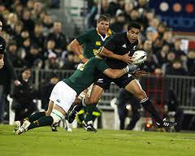
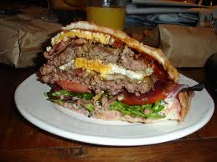
Did you know…
Rugby is the most popular sport in NZ
New Zealanders like to play soccer and netball, which is like basketball but without dribbling
New Zealanders eat hamburgers with fried eggs and a beet slice
Students can choose whether to attend a coed high school or all girl/boy schools

